Slide 1
Grant Writing – Tips & Tricks
Notes:
Welcome to this webinar, which we are running for the first time.
My colleague Maryam and I will be delivering this session and
give an introduction to grant writing with tips and tricks.
At the end there will be time for questions and
we will also ask for your feedback in a survey for further improvement of this presentation

Slide 2
Agenda
How to understand what the funder aims to achieve with the call
Who are you writing for?
How to engage the evaluator?
What is the difference between Excellence, Impact and Implementation?
How to demonstrate that your project is feasible
Notes:
We will cover the following topics:
How to understand what the funder aims to achieve with the call
Who are you writing for?
How to engage the evaluator?
The importance of the first page
Addressing key aspects in the appropriate sections
Effective use of tables, figures, and headings
What is the difference between Excellence, Impact and Implementation?
How to demonstrate that your project is feasible

Slide 3

Research Council of Norway
Aims to:
  increase scientific quality
  increase value creation in the industry
  address major societal challenges
This is promoted by each call to have:
  purpose
  thematic or subject-specific guidelines
  structural guideline
  requirements
All requirements, guidelines and purpose have to be met before you invest time in writing!
Notes:
RCN aims to…
This is promoted by tailorsuiting each call to have
A specific purpose – explaining why the will fund projects
scientific and formal requirements and guidelines
Requirements
Some requirements apply to all applications, and others are call-specific
You should familiarise yourself with all these requirements before writing your application.
RCN aims is based upon:
The Government’s (Ministry of Education and Research) long-term plan for research and higher education
RCN’s strategy
RCN’s 12 portfolio plans
RCN’s investment plan
receives money from the ministries – mainly Ministry of Education and Research

Slide 4
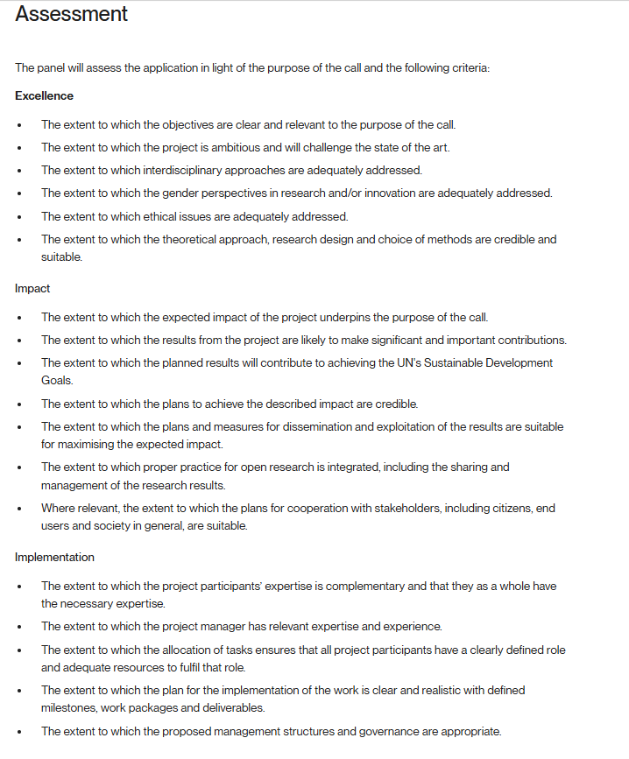
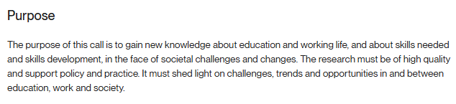
Read and re-read the call!
All information is in the call text
Evaluators base their judgement only on the call text
Purpose = what the funder will achieve with the call:
Use the assessment/evaluation criteria as a check list
Research for Future Skills, Education and Working Life
Notes:
Read the call for proposals carefully – at least three times!
All key information is in the call text
Pay attention to
- whether or not R&D suppliers may be included in the project
The evaluators base their judgement only on the call text
The purpose description tells what the funder will achieve with the call
Example from the Call: Research for Future Skills, Education and Working Life
Use the evaluation criteria as a checklist when writing your proposal

Slide 5

Who are you writing for?
Experts in relevant field and generalists
Come from internationally leading research and innovation environments
Project title, objectives and summary - main source for assigning your proposal to a panel
Evaluators are checked for impartiality
At least three evaluators per application
Assess and score each criterion: Excellence, Impact and Implementation
First: Individual evaluation and scoring
Then: Online meeting to reach consensus
They may assess many proposals – convince them that your proposal should get funded!
Notes:
The proposal should be understandable for both
experts in the relevant field or
generalists with knowledge of main subject of proposal
They work abroad
come from internationally leading research and innovation environments
They should qualify for professorship, The minimum requirement is qualifications as associate professor
They are selected based on project title, goals and summary of the proposal
All evaluators are reviewed for impartiality before they are cleared to assess grant applications.
Can participate in one or more panel
at least three referees per panel (3-6). They assess each application in relation to:
Excellence, Impact and Implementation.
All panel members read and assess the applications assigned to the panel.
Then the panels discuss and provide a consensus-based assessment (NOT AVERAGE OF SCORES) of each grant application
Assign marks per assessment criteria
Form the basis for the Research Council’s decision (Portfolio boards) on whether to grant a project funding
Funding decisions​
The external referees assign marks for each of the three assessment criteria and may be asked to rank the individual applications in relation to one another. ​
Applications that are assessed in relation to the assessment criterion will receive a separate mark for this.​
​
The Research Council’s scientific advisors will draw up a recommended ranking of the submitted grant proposals. Recommendations are based on the referee assessments, and may incorporate an assessment of relevance and an overall assessment of all the applications submitted in response to the call.​
​
The final decision regarding the approval or rejection of grant proposals is normally taken by one of the Research Council’s portfolio boards.​
The portfolio boards review the recommendation and take the final decision regarding funding allocations. The portfolio boards are responsible for ensuring that the funded proposals as a whole will lead to optimal achievement of the board’s objectives.​

Slide 6
Address key aspects in the appropriate sections
Evaluators are busy researchers and will not read every single word
They follow the template and know where to expect the different aspects
Information placed elsewhere may be overlooked and treated as missing

Slide 7

The importance of the first page of the proposal
Notes:
The first page of your proposal can determine whether you get funding,
Why?
Because the evaluator must quickly understand what the project is about
and why it deserves funding
The proposal starts with the excellence part

Slide 8
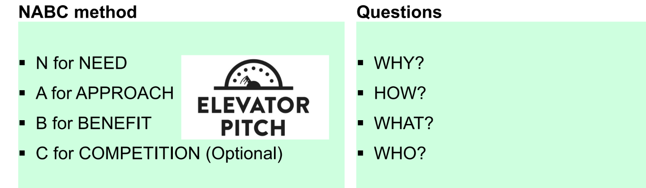
Pitch your project on the first page - engage the evaluator!
- Identify and describe the Need (or problem)
- Come up with a good and original Approach to address the Need and overcome the knowledge gap
- Describe the Benefits from the proposed study
- Identify the Competition – show that you know the field
Notes:
Pitch your project on the first page
You have to engage the evaluator
To quickly understand what your project is about and why it is important and must be funded
Use the NABC method
Identify and describe the Need or Problem – Why is this important?
Come up with a good and original Approach to address the Need and overcome the knowledge gap – HOW TO SOLVE THE
Describe the Benefits, effects, or outcomes for users, society, the research field
Identify the Competition

Slide 9
Tell a story – with a logical structure
After the pitch, present:
  Objectives
  Research questions (RQ) and/or hypothesis
  Overall approach and/or design
  Overview of the work plan/work packages (WPs)
WP description (scientific)
  1
  2
  3
Gender perspectives
Link objectives to the WPs:
One objective per WP
WP title can be an abbreviated form of the objective
Notes:
A recommendation is to link objectives to the WPs
- …..one objective per WP…

Slide 10
Tips to increase readability
Subheadings
  Organize and structure the text
  Easier to navigate
    Descriptive headings
    Evaluators can quickly find specific parts
  Numbering is optional
    1.1.1, 1.1.2,…
Highlight words from the call
Be clear, concise and specific
Figures and tables:
  Easier to grasp your message and get a quick overview of e.g. the concept
  Break up text-heavy pages
  Avoid too much information
Avoid excessively long sentences -> improve readability
Use bullet points, text boxes, bold, italics and paragraphs
Notes:
You can include subheadings to organize and structure the text.
Makes it easier to navigate and find specific parts.
Also, you can understand what the project is about by scanning descriptive subheadings.

Slide 11
Take away messages
Read and re-read the call to:
  ensure your project matches the call before you start writing
  address all aspects of the call in appropriate sections
Write for experts and generalists – ask us to read!
Engage the evaluator and provide strong arguments for funding
Show that the project is feasible with regard to resources, time, competence and methods
First page is your pitch and signature page
Tell a story

Slide 12
Impact
Academic impact
- Theoretical and empirical knowledge
- Contribute to a broad research agenda and scholarly debate
- Ensure reproducibility of project outputs (data, research articles, software, models, algorithms, etc).
Societal impact
- To shape or advance the public debate in the field
- Fasiclitate/enhance dialogue between decision-makers and stakeholders
- Raise awareness and competency, leading to more informed decisions
- Name briefly the relevant SDGs here
UN SDGs
- Expand in more details on the relevant SDGs here.
Notes:
Academic impact: The target group in academia is your colleagues within the same research field and discipline, but still think broadly. For example: if the focus of the project is within linguistics, is it conceivable that other fields will also be able to benefit from the research? Will the results perhaps also be used by those conducting research within computer science or didactics?
Make visible the opportunities for moving the research frontier; build capacity; consolidate international and interdisciplinary collaboration; contribute to competence building (recruitment positions, building research environments/collaboration).
Societal impact: Use the relevant strategy documents to describe and position the societal impacts of your findings in the application:- Read through the portfolio board's portfolio plan and identify the relevant problems that your specific call for proposals are intended to solve. Your reflections and objectives for societal impacts should be concrete and directly linked to your project. The same goes for UN SGDs, read through them, identify the relevant goals, and describe them.

Slide 13
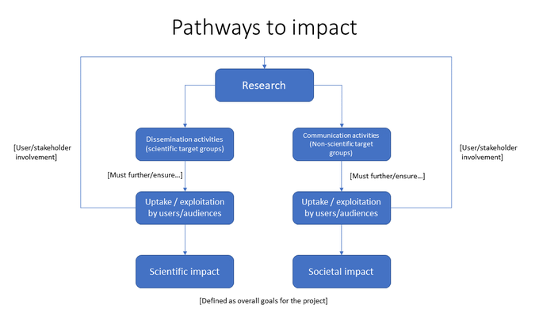
Notes:
Results from your research must be clearly communicated and disseminated in order to achieve impact – both scientific and societal. In order to do that you must introduce measures/activities for knowledge sharing (dissemination) and exploitation (communication).

Slide 14
Measures for communication and exploitation
Identify your target audiences in academia and the society
Then propose your measures for communication and exploitation:
  - In academia it is research articles; monographs; roundtables; conference participations; workshops; etc.
  - In the society, it is policy briefs, media appearances/op-eds, podcasts. Or stakeholder and/or policy-maker involvement through workshops/
  roundtables with project participants; user-oriented seminars, courses, etc.
  → These are your project’s outputs!
Describe how your project will actively seek to promote principles of Open Science.
Notes:
Examples of target audience in academia: scholars in the relevant discipline and other disciplines.
Examples of target audiences in the society: stakeholders (users and beneficiaries); policy/decision makers; the broader Norwegian public.
The strategy for communication and exploitation will make it visible that you have a clear plan for how your project results will reach relevant target groups.

Slide 15
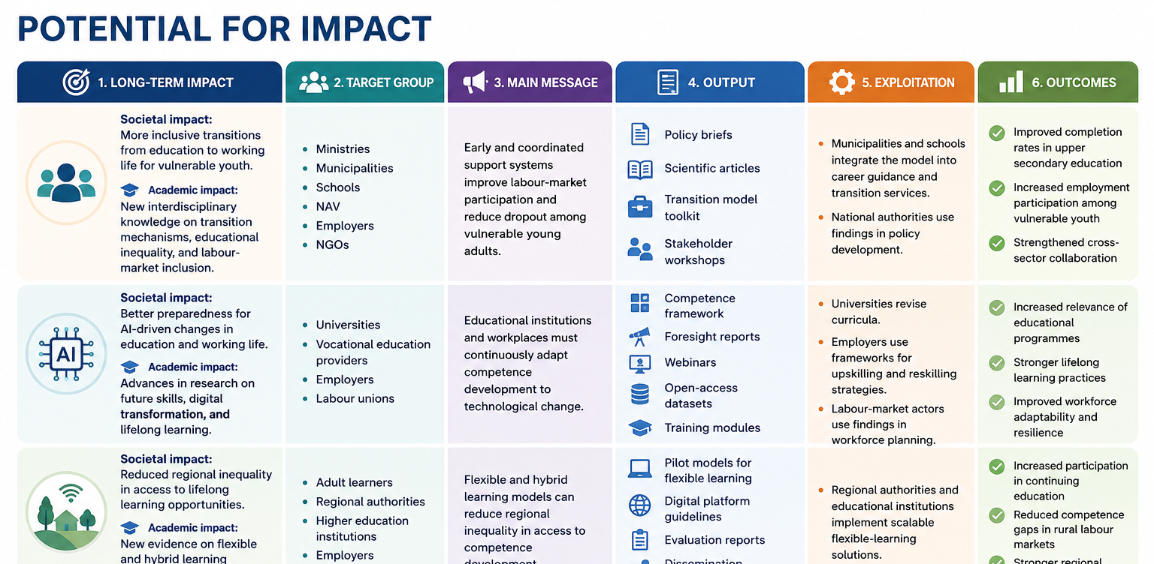
Notes:
Figure generated by Copilot, using the following call for proposals from the Research Council of Norway: https://www.forskningsradet.no/en/call-for-proposals/2026/research-for-future-skills-education-and-working-life/#tab

Slide 16
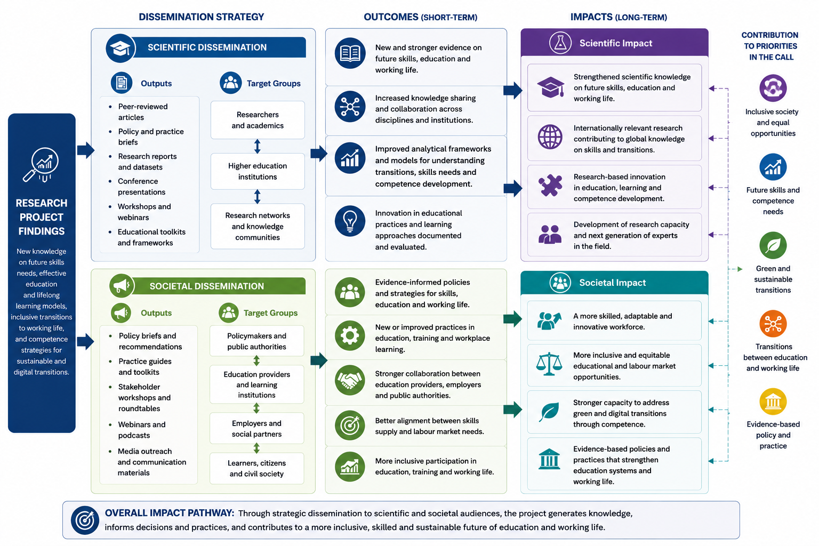
Notes:
Figure generated by Copilot, using the following call for proposals from the Research Council of Norway: https://www.forskningsradet.no/en/call-for-proposals/2026/research-for-future-skills-education-and-working-life/#tab

Slide 17
Implementation
Why you – the PI?
Why you – the team?
  Researchers, as well as PhD and/or postdoc, advisory board.
Synthesize this information under Project team.
Narrative CVs for you and 4 research partners.
Notes:
An application with a clear and concrete plan for Implementation has the most potential to win a grant over applications without such good plan; even if the excellence part in other apps is good. In Implementation you will describe your and your teams relevant competence and experience, and you show realism and understanding of the practical implementation of the project.
Describe the competense:
- You are the best person to lead this project. You have the necessary scientific competence; show that you have good professional contacts, a good network. If possible, describe project management experience or other type of management experience. Show that you have the necessary administrative experience (planned and implemented workshops, conferences, seminars, etc.).
- Your project team is the best one to implement the project activities. Show how the project participants' expertise is mutually complementary. Describe previous collaboration with project participants that will now be built upon. Explain how your and your project team's expertise covers the project’s scientific and methodological needs and a high ability to implement.
PhD or postdocs - describe how the person will contribute to the project. PhD/postdoc will yield increased competency in the field.
Put together an advisory board that will be able to provide feedback on the project along the way and participate in project activities. Advisory boards qualify as project networks, but have a more specific, advisory role.

Slide 18
Organisation
Implementation plan = what will be done, when and how it leads to results:
Activities -> milestones -> outputs (deliverables) -> outcomes (objectives)
Management and roles = who does it, how they are organized, and how collaboration works.
A rule of thumb:
Implementation plan = verbs (build, analyze, test, deliver)
Management & roles = nouns (PI, partner, WP leader, advisory board)
Notes:
Description of the Implementation plan: a logical, operational roadmap showing that your WPs are coherent; that activities lead to milestones -> outputs (deliverables) -> objectives (outcomes). You also show here that resources (time, people, budget) are aligned with what will be done.
Management and roles: here you provide a clear explanation of division of responsibilities in the project; decision-making structure; coordination mechanisms and institutional support.
The Implementation plan shows a credible path to project objectives; the management sections shows a credible team and structure to follow that path. You need both to convince the reviewers.

Slide 19
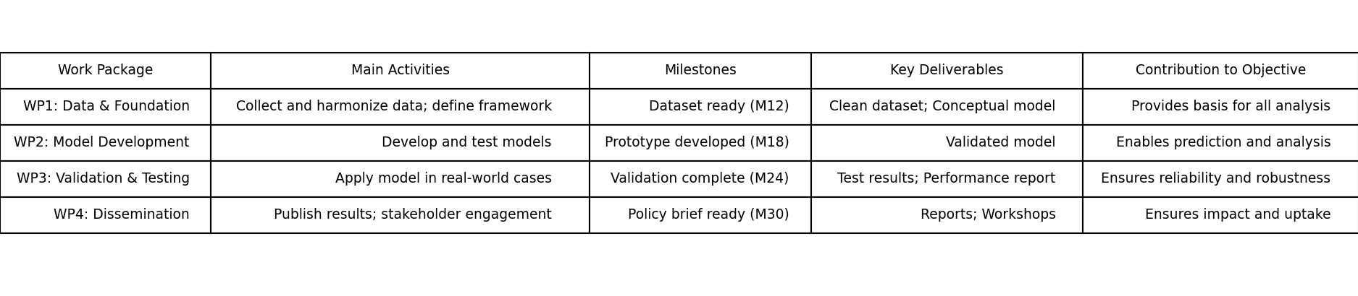
Example: Implementation plan
Notes:
This implementation plan shows how the project is structured into four interlinked work packages. Each work package contains clearly defined activities, milestones, and deliverables that progressively build toward the overall project objective. The milestones you will describe under work package section should not be described here, but they should be indicated as activities. The usual activities which lead to milestones in a research project are: literature review, fieldwork, data/material collection, transcription, analysis, article writing, project meetings, workshops, recruitment of a PhD/postdoc, PhD midway evaluations, conference papers, etc.
Note that WPs can overlap in time, run in parallel, etc. It is recommended to have a separate WP for project management and communication for which the project manager is responsible - specifically for the project's progress, organization of workshops/conferences, recruitment processes, reporting, dissemination activities aimed at target groups within academia and the society.
This type of Implementation plan is also usually visualized with a Gantt Chart as a timeline representation.

Slide 20
Management and roles
How is the project governed and who does what.
What to include:
  Project governance structure (PI, advisory board)
  Roles and responsibilities (WP leads, key expertise)
  Mechanisms of coordination (interactions, communication routines)
  Strategic support from organizations
Reviewers look for clear and credible leadership; unambiguous responsibilities; and a collaboration that will actually work in practice.
Notes:
What to include:
- Roles and responsibilities: who leads which WP and why; key expertise of your partners.
- Mechanism to coordinate project activities: how will partners interact, structure of meetings, communication routines.
- Strategic support from organizations: briefly mention institutional backing (infrastructure, co-financing, networks), and why partners are suited to take on their roles.

Slide 21
Research infrastructure and other resources
Who owns the project? Show that the owner – the research institution - is qualified to host the project.
What infrastructure is there at the institution needed to successfully implement the project?
  Required and necessary office infrastructure
  Research administration
  Communications department
  IT (securing the data) and library services (access to databases, journals, etc).
What relevant infrastructure the project can utilize at the partner organizations?

Slide 22
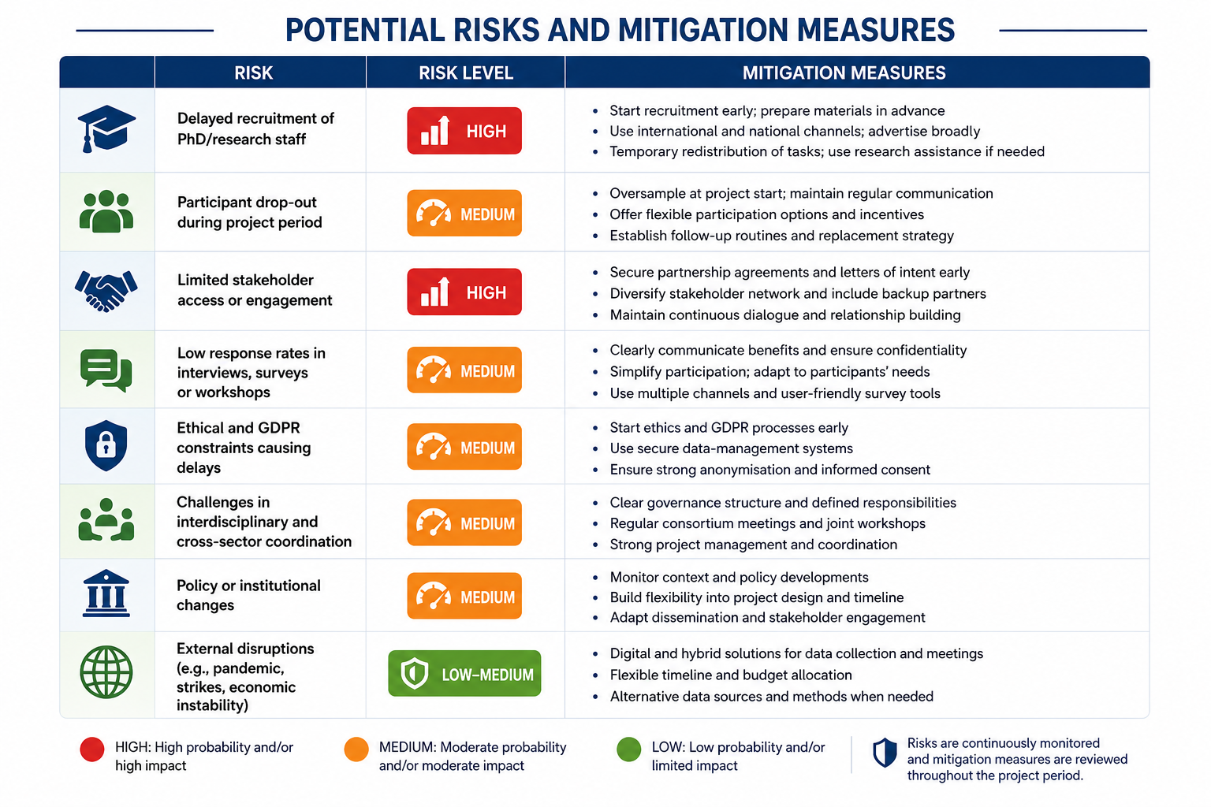
Notes:
When you describe potential risks, you make it clear to the evaluator that you have thought through the possibilities that something could happen differently than planned. This section is primarily about the risk that the project cannot be carried out as planned. Analyze risk based on the probability that something wrong can happen, the impact on the project, and what can be done to counteract it. The reason risks have become increasingly important to describe in project proposals to RCN is because the RCN experience many projects which have lags in progress and have a constant need for extensions and revisions. For the RCN, this section is a way to counteract that tendency.
Figure prepared by Microsoft Copilot.

Slide 23

Thank you!
Kindly use 5 minutes to answer a short survey:
https://nettskjema.no/a/627339

