Slide 1
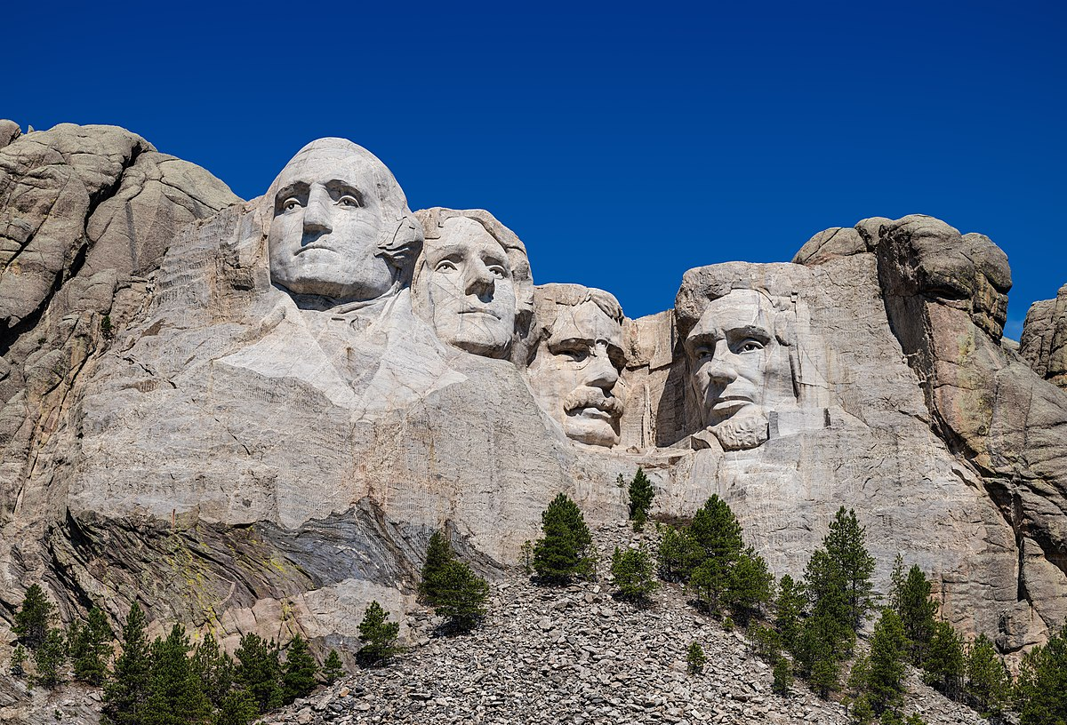
United States Monuments
This Photo by Unknown Author is licensed under CC BY-SA

Slide 2
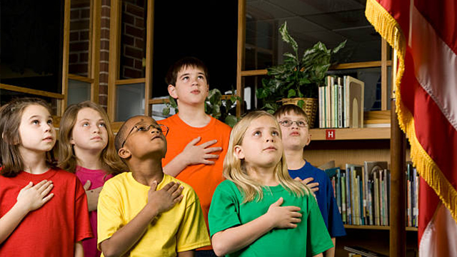
In the morning, before American schools begin, pupils stand and recite the Pledge of Allegiance.
This Photo by Unknown Author is licensed under CC BY-SA-NC

Slide 3
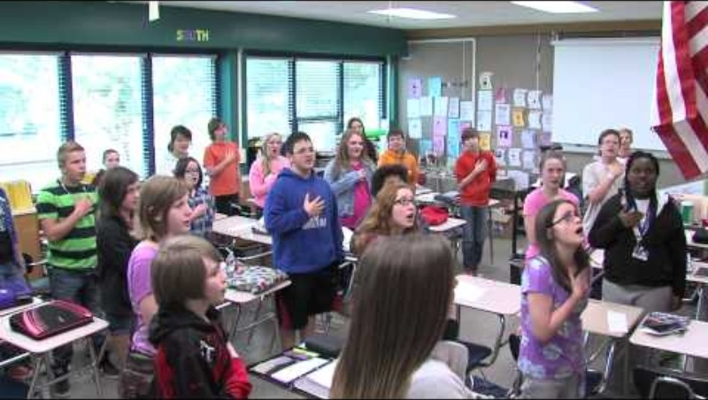

Slide 4
The Pledge of Allegiance
I pledge allegiance to the Flag of the United States of America, and to the Republic for which it stands, one Nation under God, indivisible, with liberty and justice for all.

Slide 5
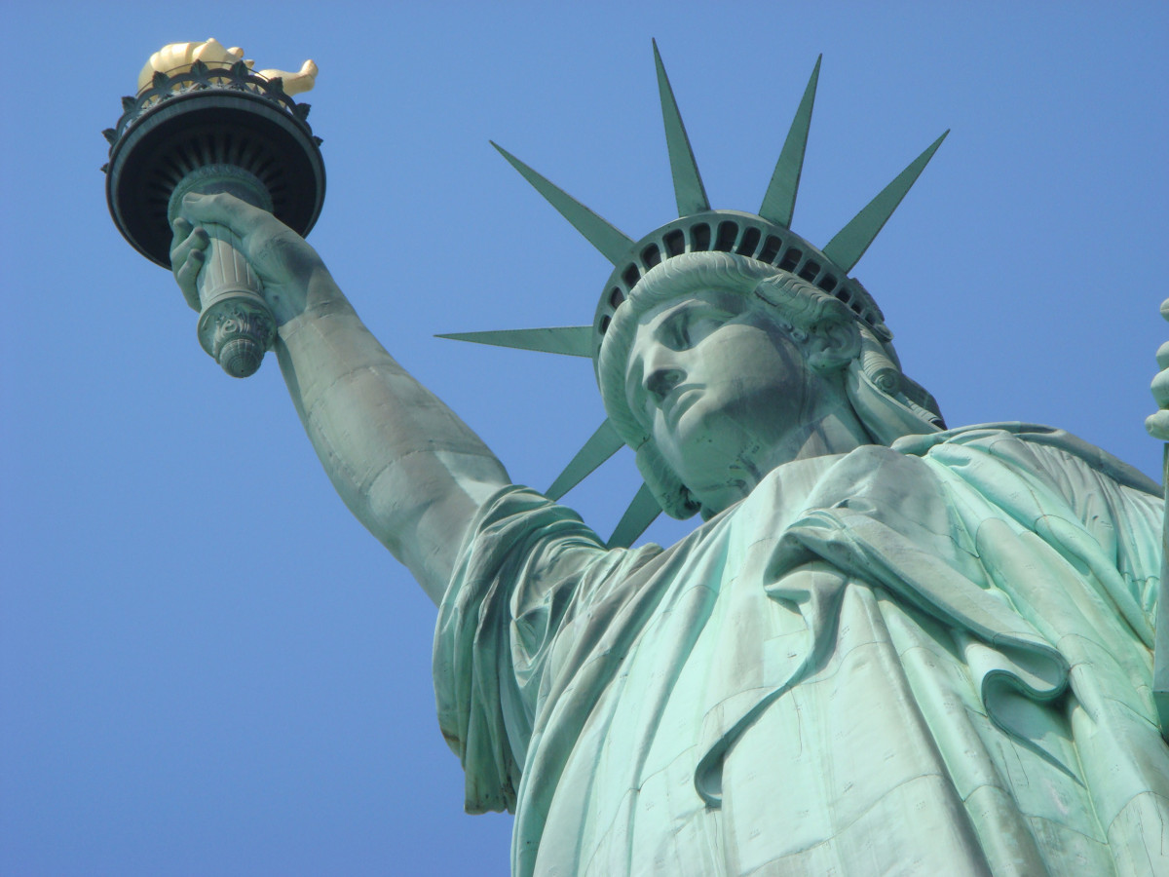
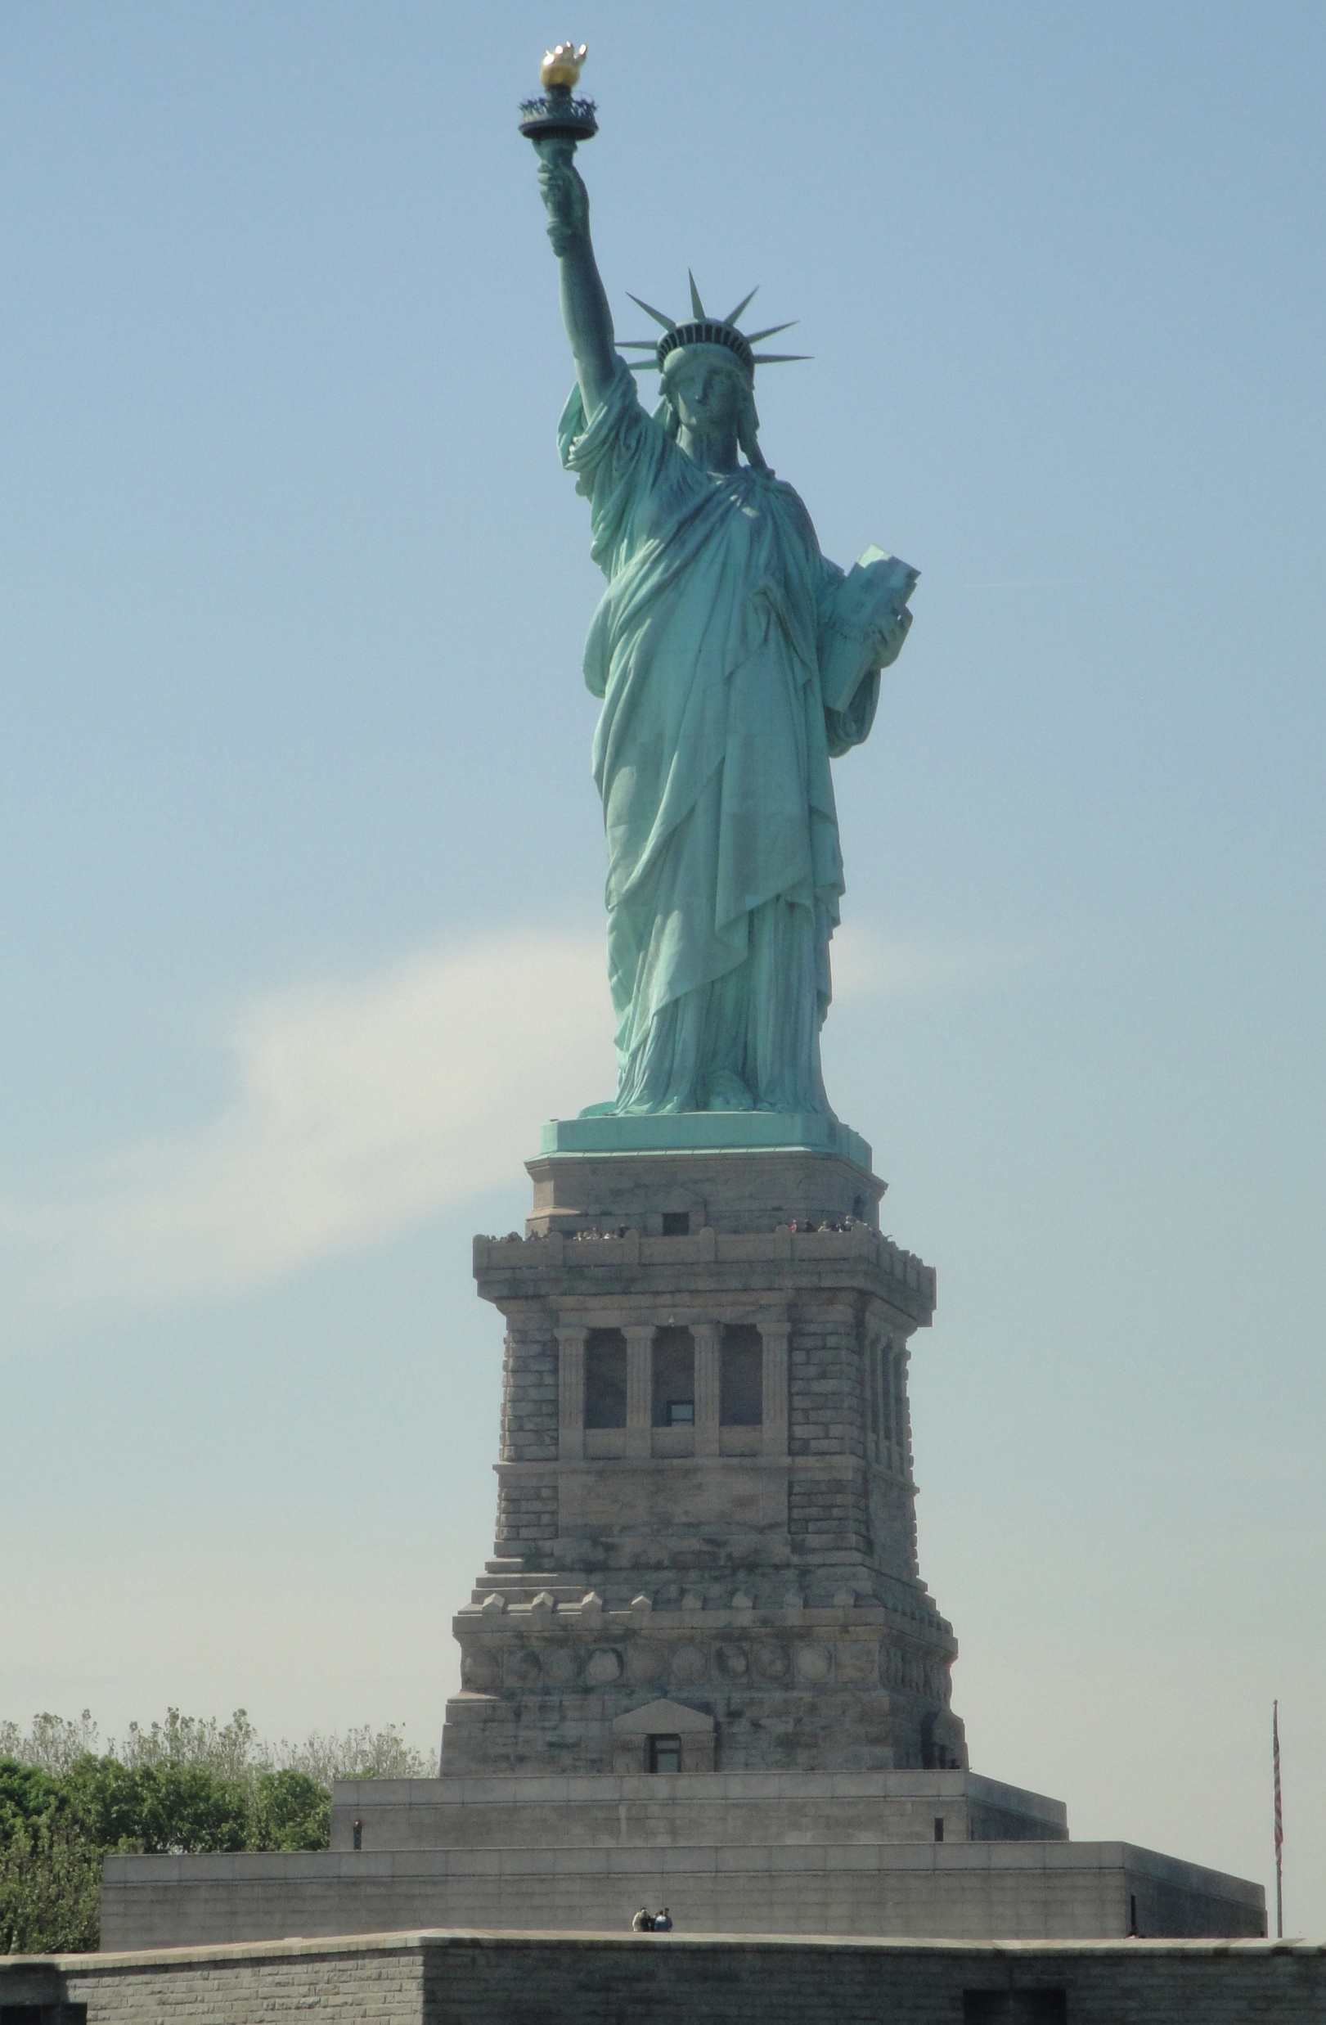
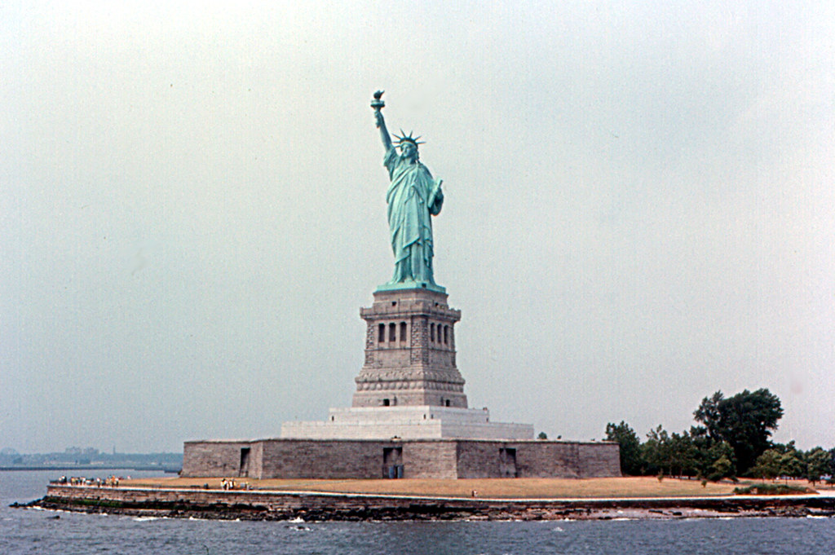
This Photo by Unknown Author is licensed under CC BY-SA

Slide 6
Statue of Liberty
in New York City
The Statue of Liberty is located in New York Harbor.
This Photo by Unknown Author is licensed under CC BY-SA

Slide 7
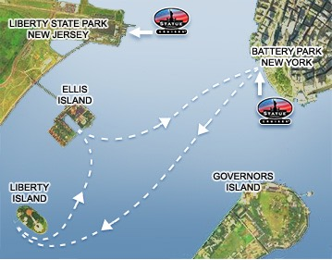
The Statue of Liberty is located in New York Harbor on Liberty Island.
This Photo by Unknown Author is licensed under CC BY-NC-ND

Slide 8
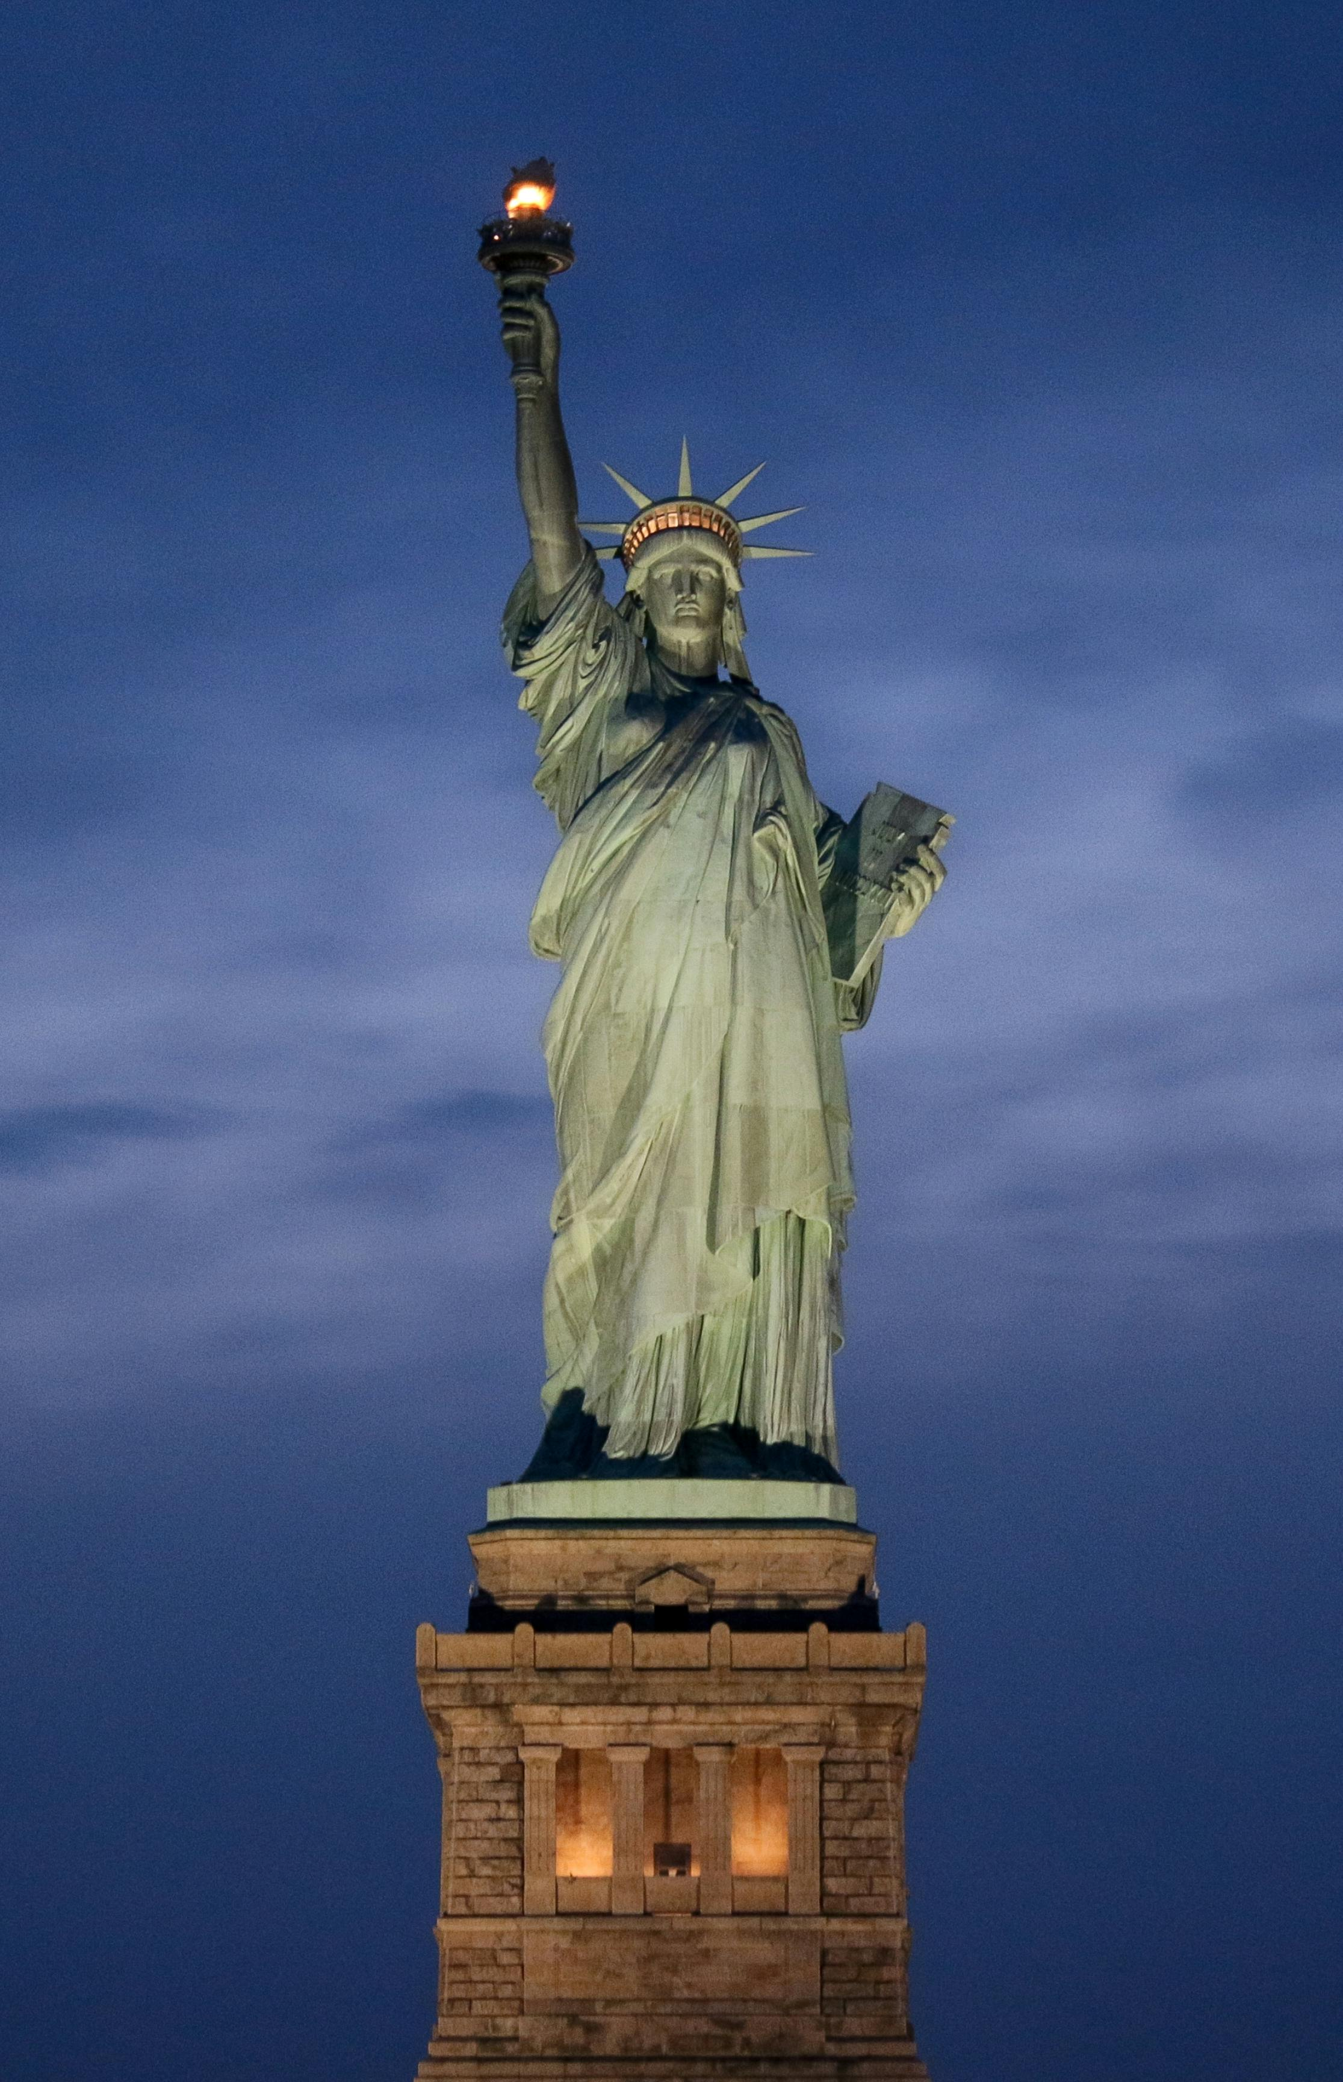
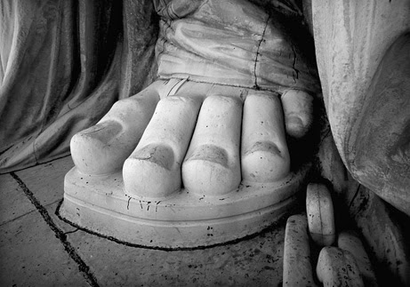
-This is a sculpture on Liberty Island in New York Harbor in New York City
-It is a gift to the United States from the people of France in 1886
-The statue is of a woman holding a torch above her head.
- She carries a tablet in her left hand with the date July 4, 1776 in Roman numerals.
-Her left foot steps on chains to show the end of slavery.
This Photo by Unknown Author is licensed under CC BY

Slide 9
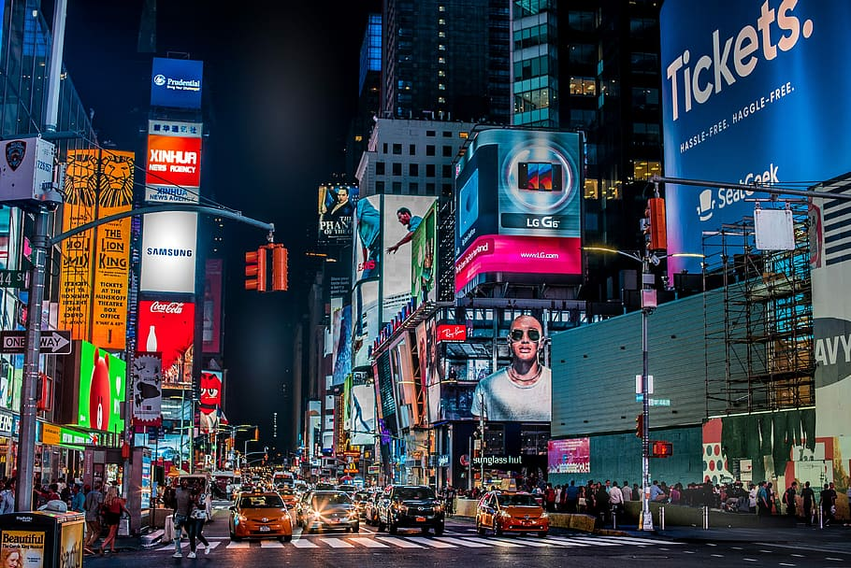
This Photo by Unknown Author is licensed under CC BY-SA​

Slide 10
Times Square
in New York City
This is a neighborhood in Manhattan, in New York City.
This area includes the Broadway Theatre District.

Slide 11
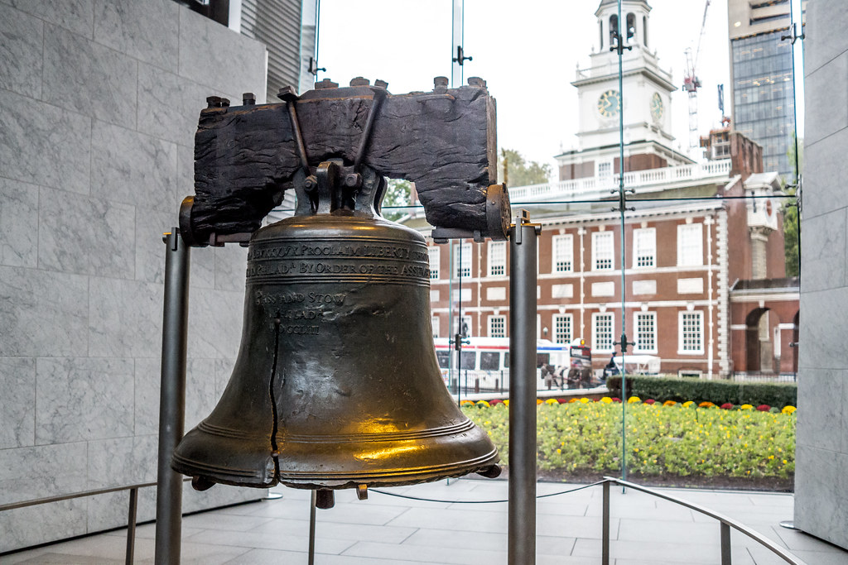
This Photo by Unknown Author is licensed under CC BY

Slide 12
Liberty Bell
in Philadelphia, Pennsylvania
-Symbol of American Independence
-Bell was commissioned in 1752
-Most likely, the bell was rung on July 4, 1776, when the Declaration of Independence was first read to the public.
-The bell was used to warn people of danger or for proclamations.
This Photo by Unknown Author is licensed under CC BY

Slide 13
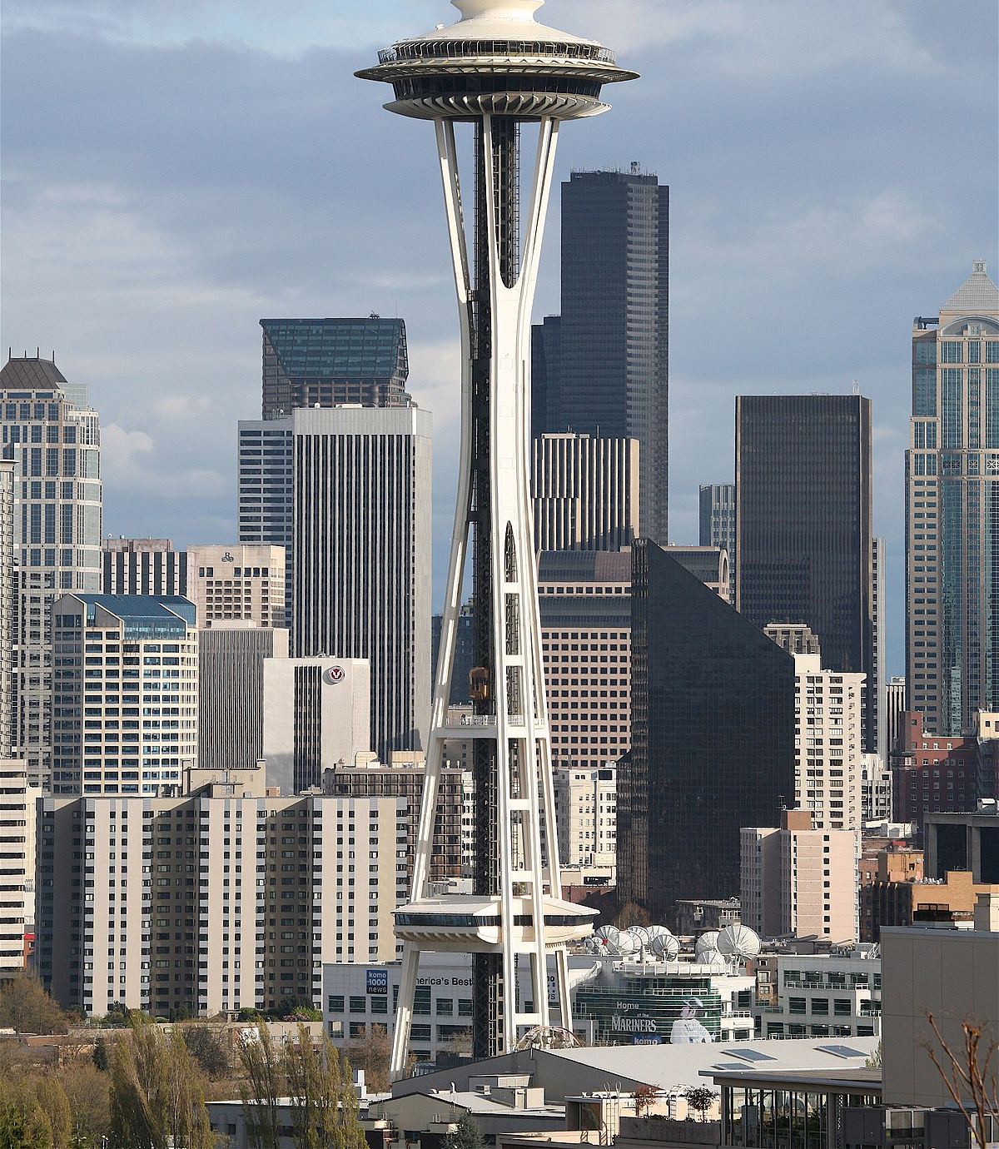
This Photo by Unknown Author is licensed under CC BY-SA

Slide 14
Space Needle in Seattle, Washington
It is an observation tower.
It was built in 1962 for the World’s Fair.
This Photo by Unknown Author is licensed under CC BY-SA

Slide 15
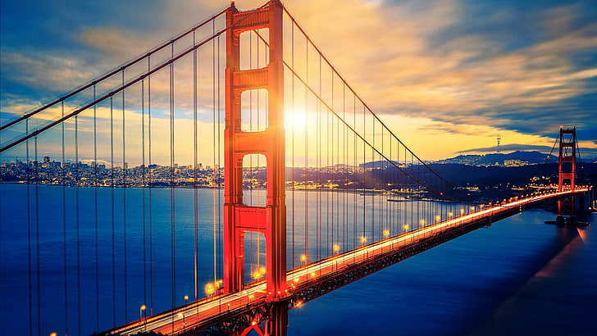

Slide 16

Golden Gate Bridge
in San Francisco, California
The bridge connects the northern tip of San Francisco to Marin County.
It is considered one of the wonders of the modern world.

Slide 17
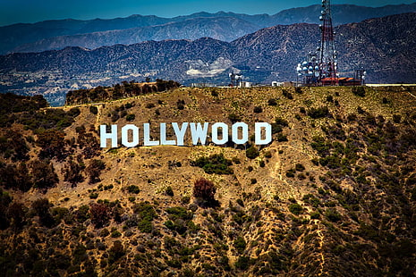

Slide 18
Hollywood Sign
in Los Angeles, California
The letters were mounted in 1923 as advertising for a real estate company.
The original sign was replaced in 1978 with steel letters that are13.7 meters tall.

Slide 19
This Photo by Unknown Author is licensed under CC BY-SA

Slide 20
Mount Rushmore
in the Black Hills of South Dakota
The heads of four U.S. presidents are 18 meters tall.
The four presidents are George Washington, Thomas Jefferson, Theodore Roosevelt, and Abraham Lincoln.
This Photo by Unknown Author is licensed under CC BY-SA

Slide 21
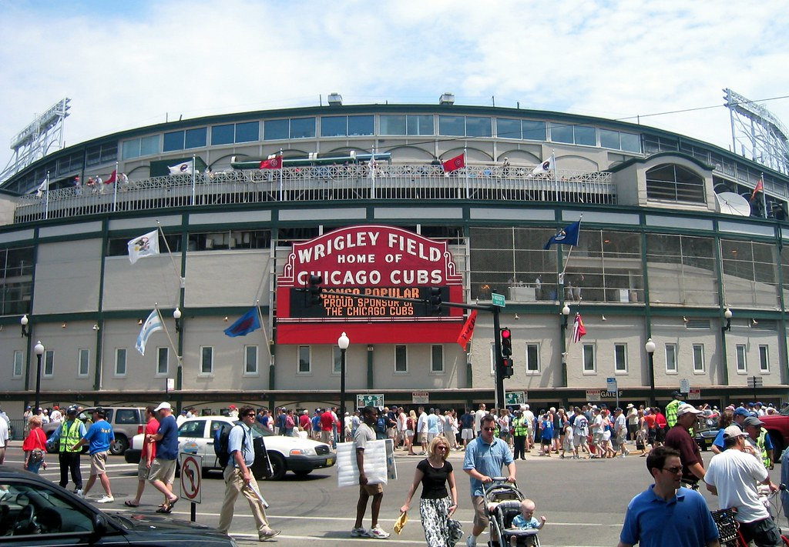
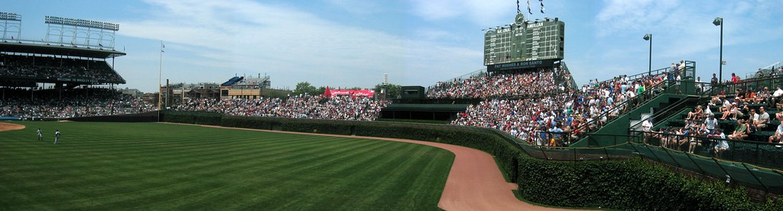
This Photo by Unknown Author is licensed under CC BY-NC-ND
This Photo by Unknown Author is licensed under CC BY-NC-ND

Slide 22
Wrigley Field in Chicago, Illinois
This Photo by Unknown Author is licensed under CC BY-NC-ND

Slide 23
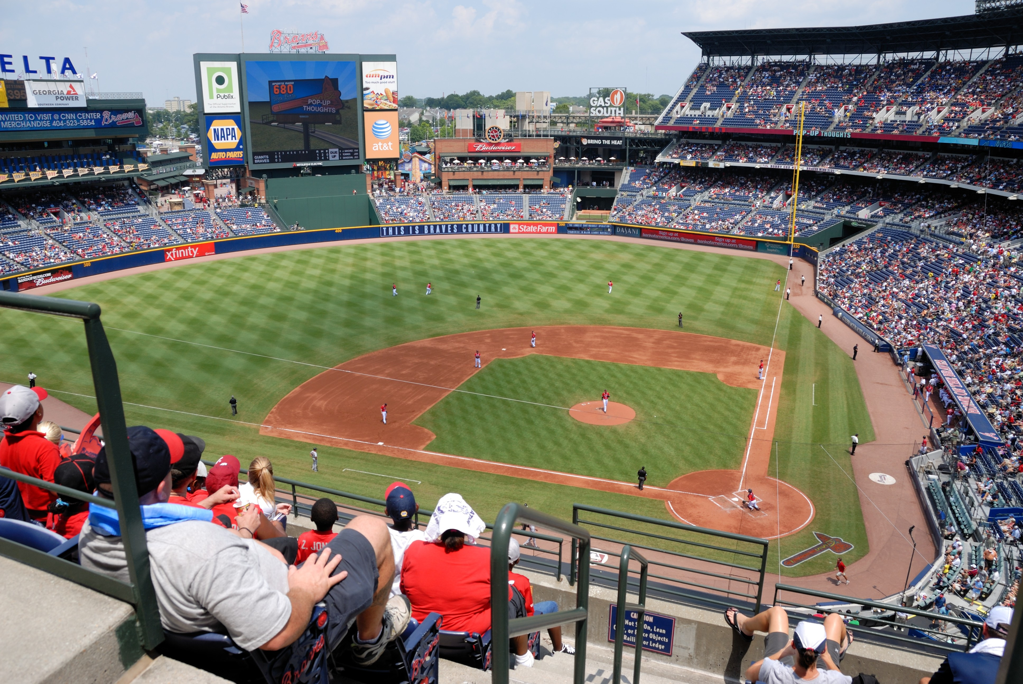
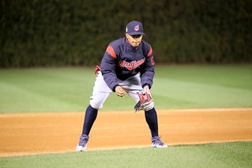
Wrigley Field
It is the home ballpark of Chicago Cubs in Chicago, Illinois.
It opened in 1914.
It was the last major league park to have lights installed for night games- in 1988.
This Photo by Unknown Author is licensed under CC BY
This Photo by Unknown Author is licensed under CC BY

Slide 24
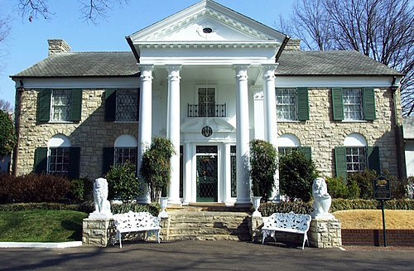
This Photo by Unknown Author is licensed under CC BY-SA

Slide 25
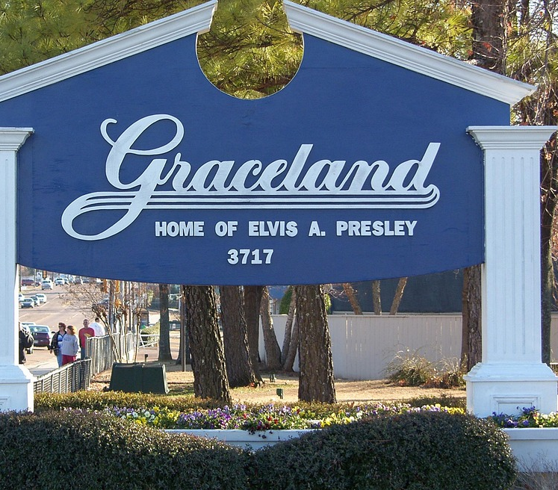
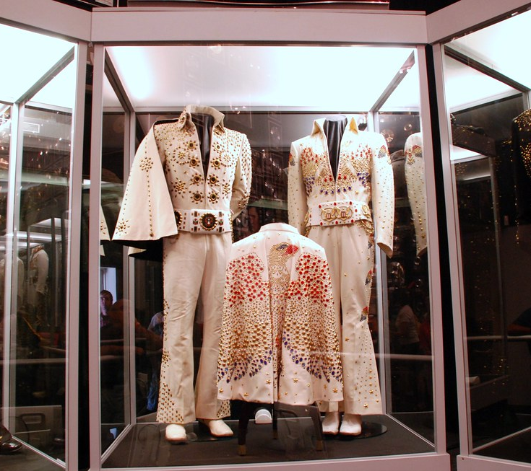
Graceland in Memphis, Tennessee
Graceland is a mansion that was owned by Elvis Presley.
Presley purchased Graceland in 1957.
This Photo by Unknown Author is licensed under CC BY-SA
This Photo by Unknown Author is licensed under CC BY-SA

Slide 26
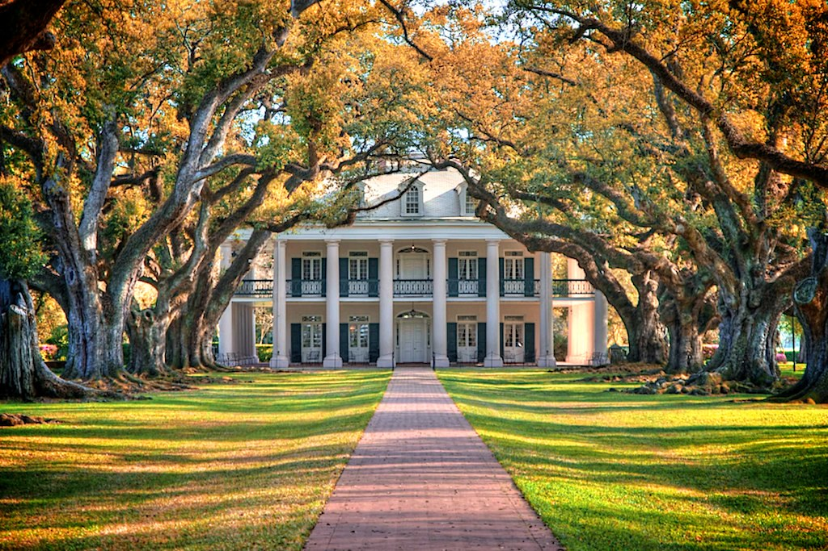
This Photo by Unknown Author is licensed under CC BY-NC-ND

Slide 27
Oak Alley Plantation
in south Louisiana on the Mississippi River.
The mansion was built by slaves in 1839.
There is a double row of southern live oak trees about 240 meters long that runs between the mansion and the Mississippi River.
This Photo by Unknown Author is licensed under CC BY-NC-ND

Slide 28
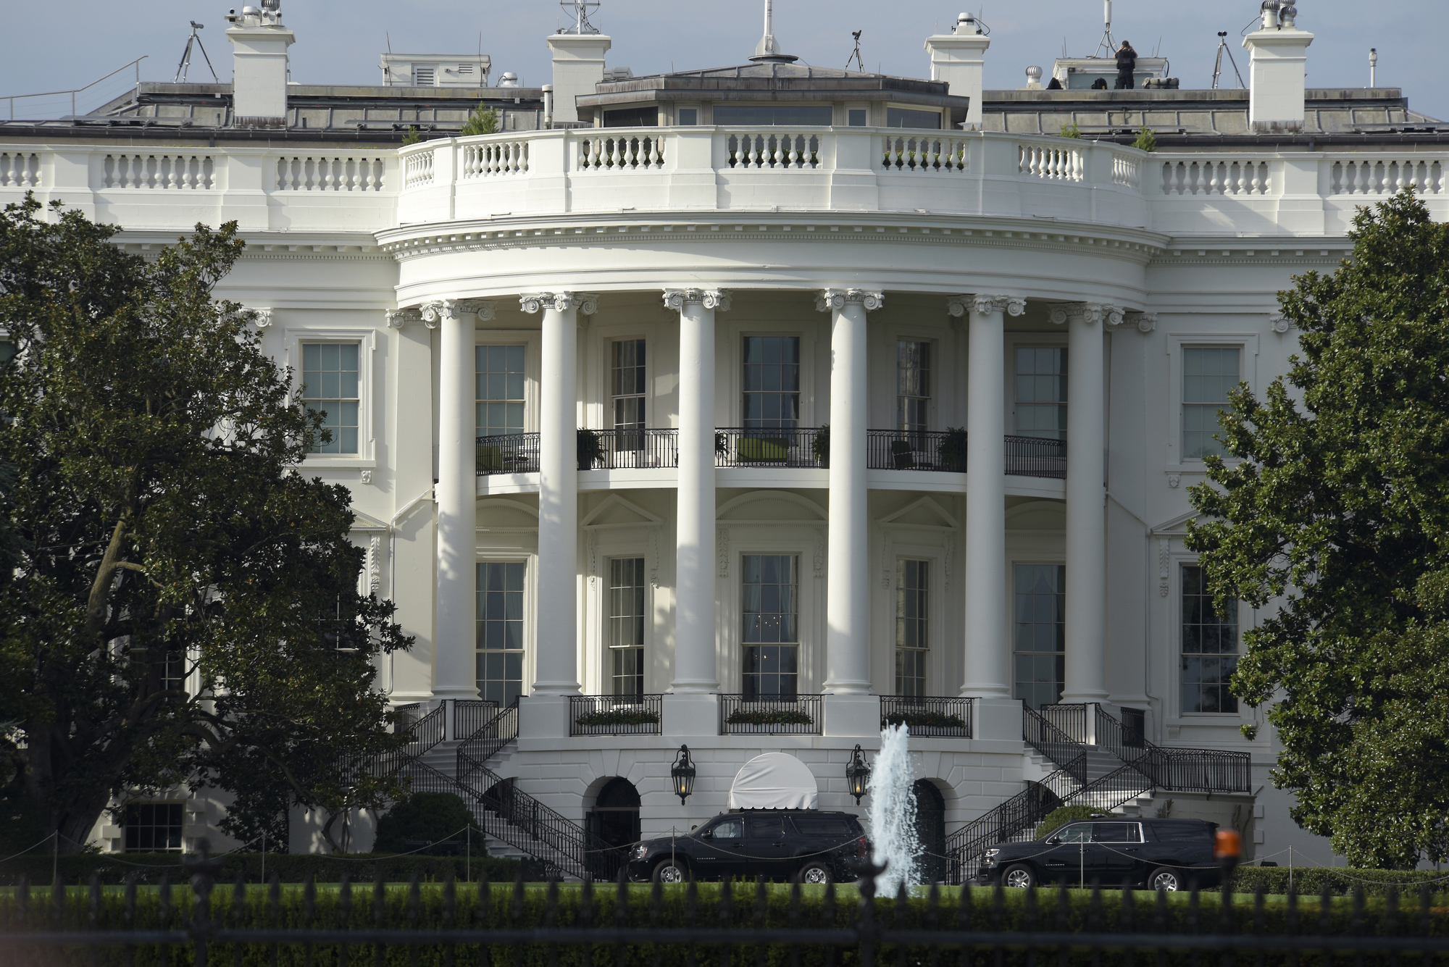
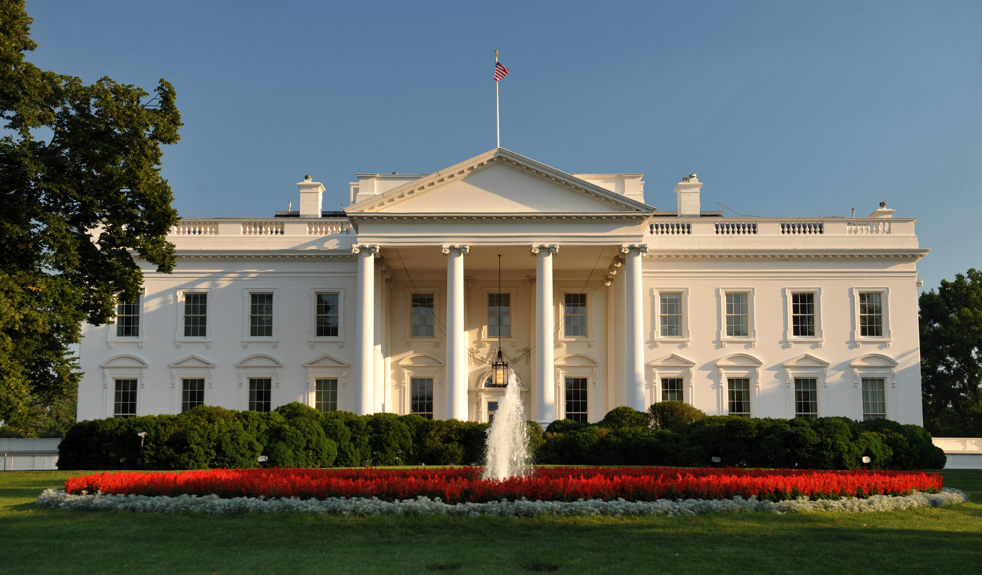
This Photo by Unknown Author is licensed under CC BY-NC
This Photo by Unknown Author is licensed under CC BY-SA

Slide 29
White House
in Washington, D.C.
The official residence and workplace of the president of the United States
It has served as the home of the American president since 1800, when the capital moved from Philadelphia to Washington D.C.
Address: 1600 Pennsylvania Ave NW Washington D.C.
This Photo by Unknown Author is licensed under CC BY-NC
This Photo by Unknown Author is licensed under CC BY-SA

Slide 30
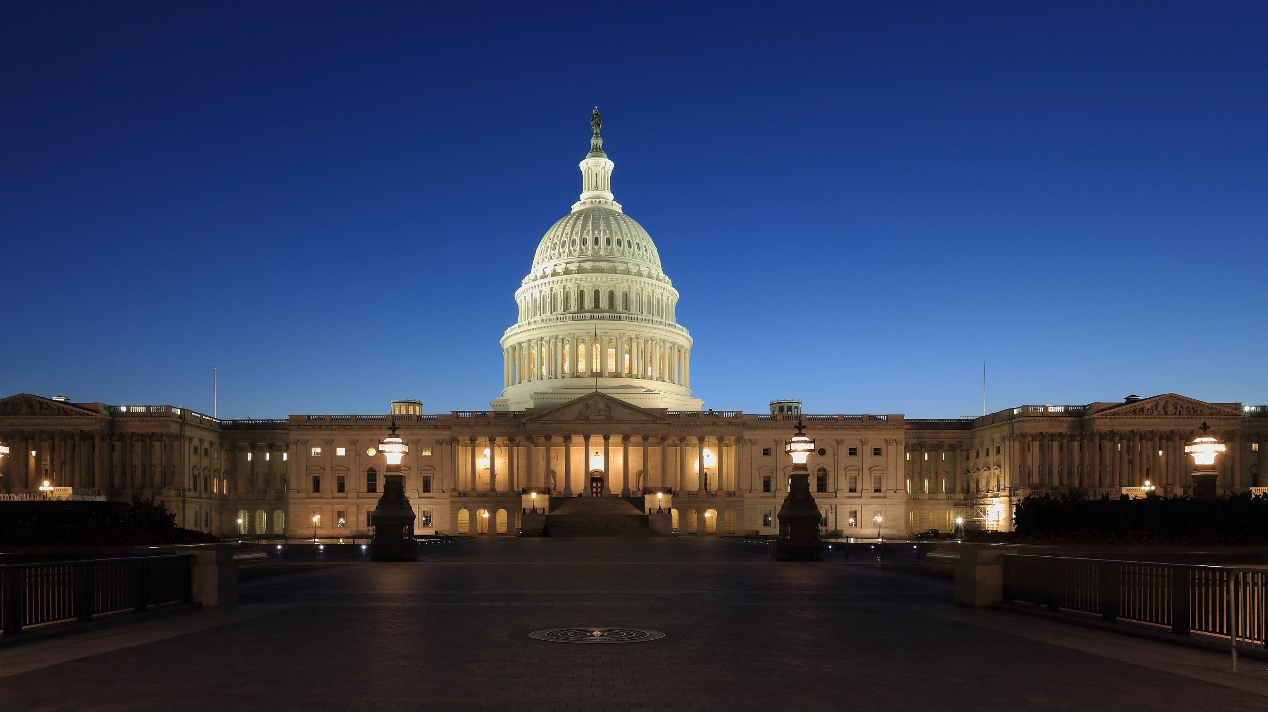
This Photo by Unknown Author is licensed under CC BY-SA

Slide 31
United States Capitol in Washington, D.C.
This is where the United States Congress is located.
Congress is divided into two chambers: the House of Representatives is in the South Wing and the Senate is in the North Wing.

Slide 32
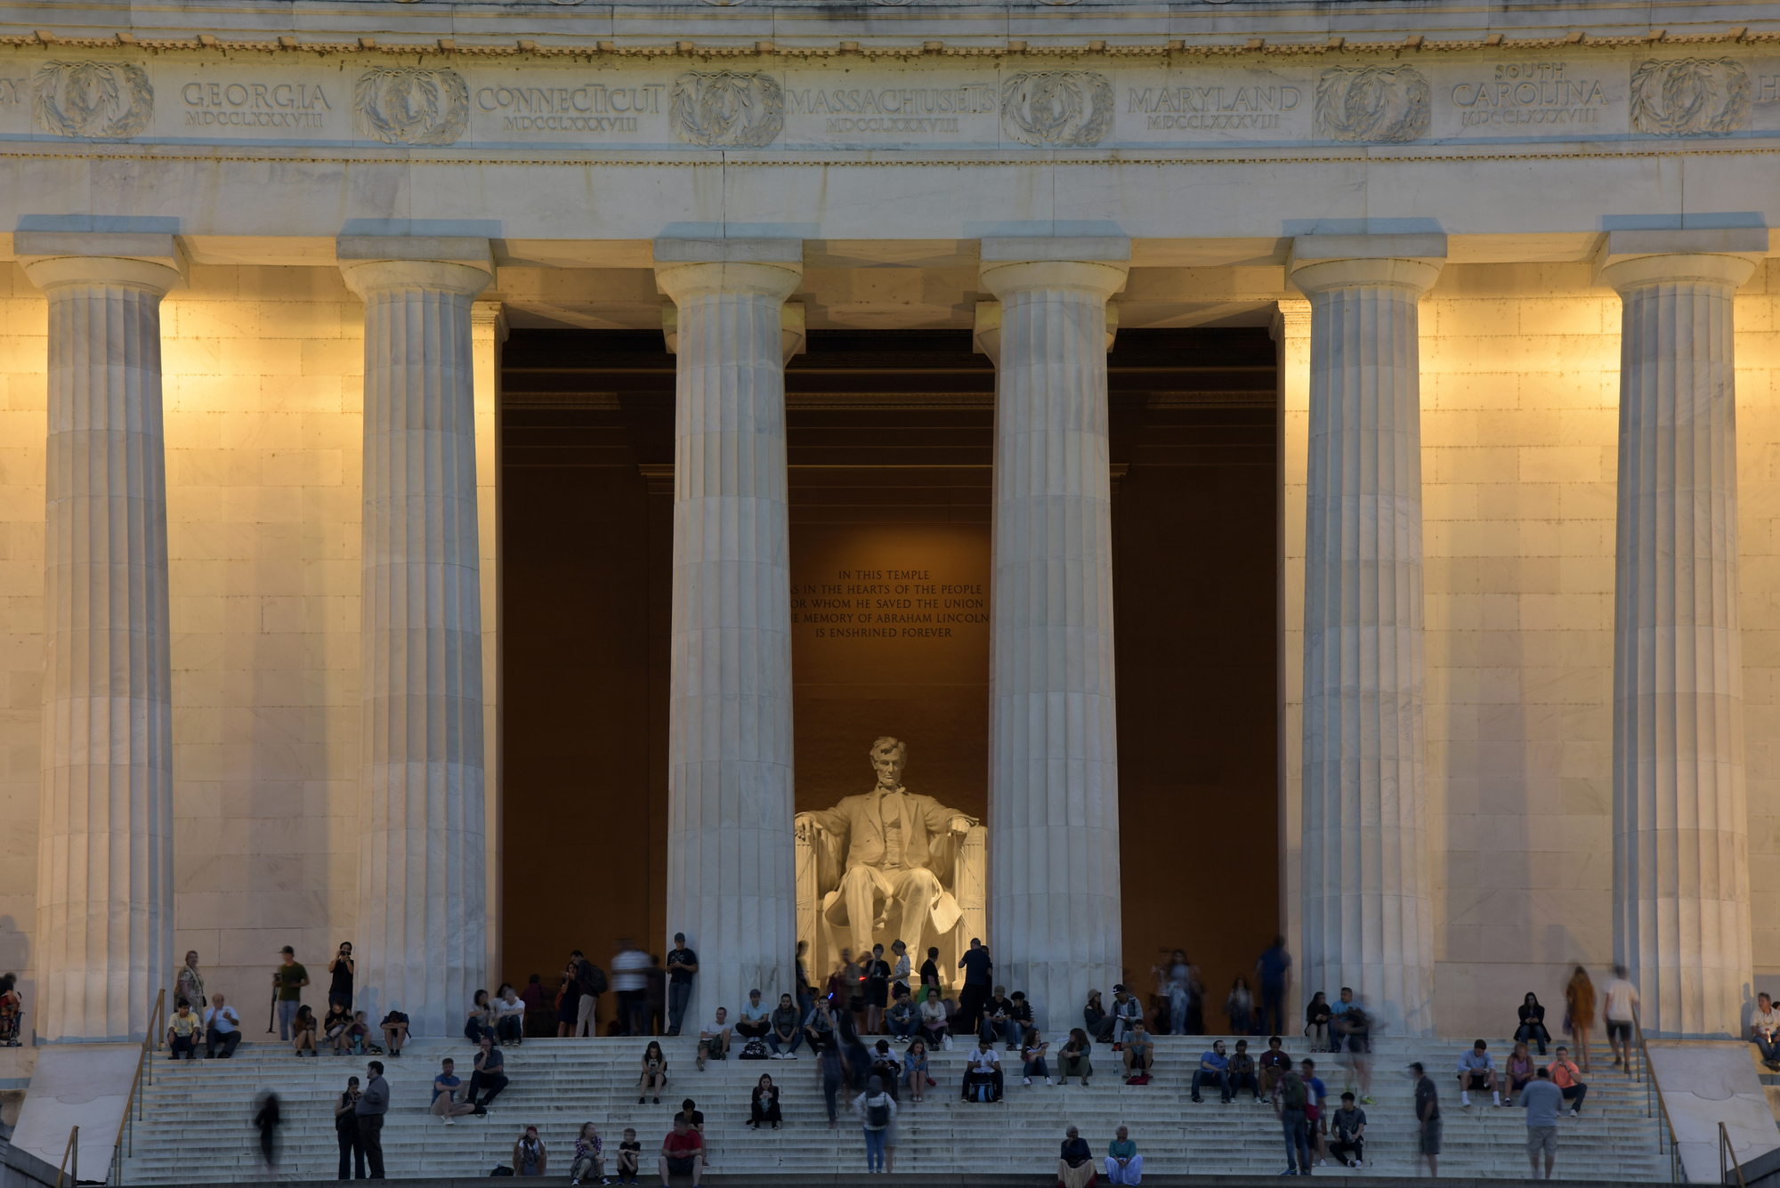
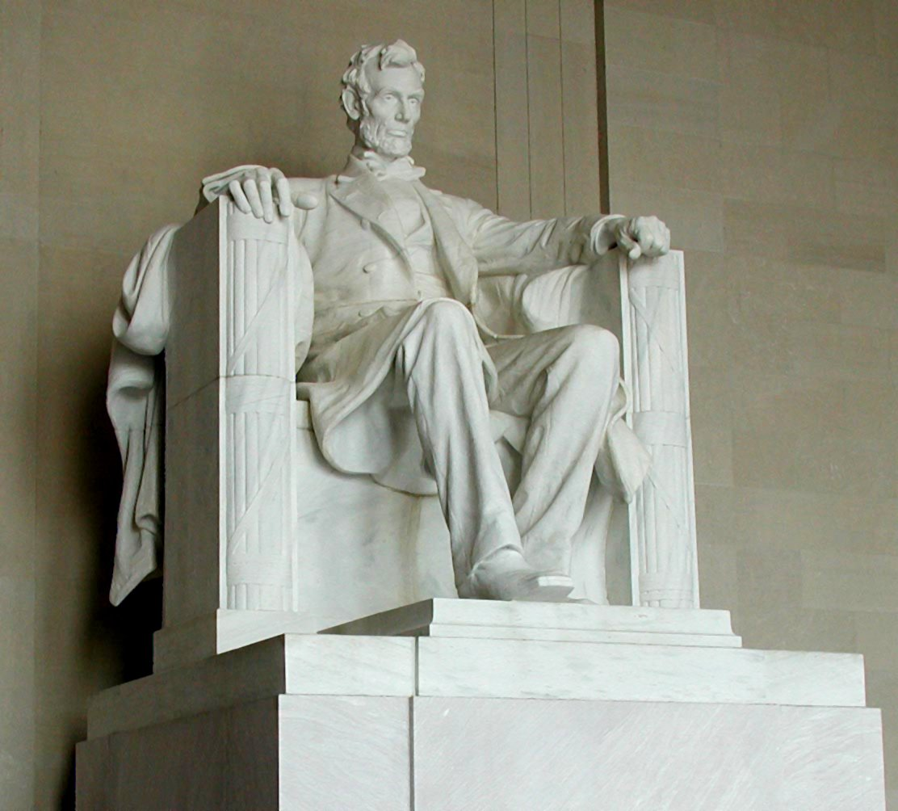
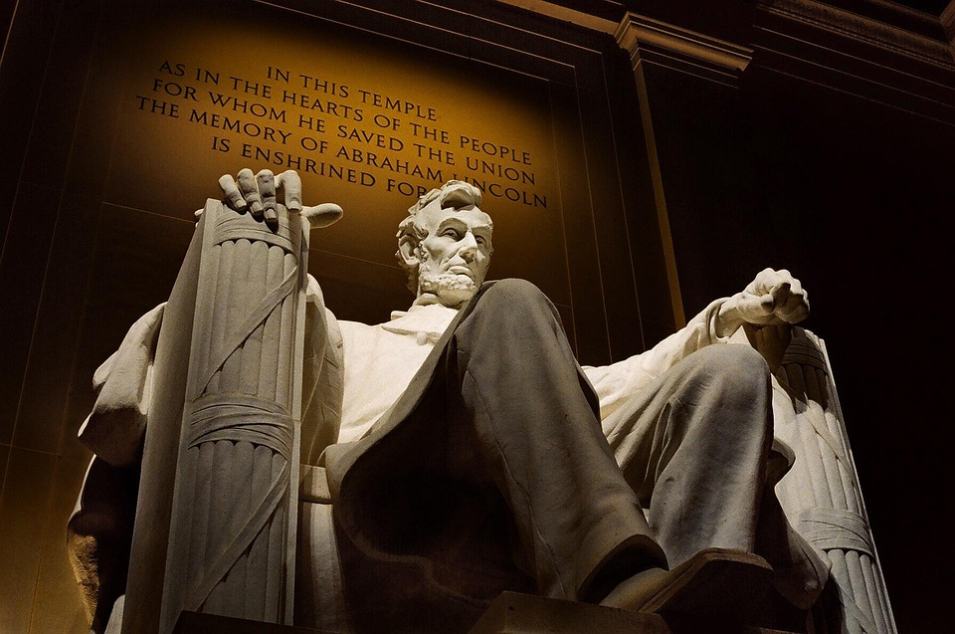
This Photo by Unknown Author is licensed under CC BY-NC
This Photo by Unknown Author is licensed under CC BY-SA

Slide 33
Lincoln Memorial
in Washington, D.C.
Abraham Lincoln was the 16th president of the U.S
This Photo by Unknown Author is licensed under CC BY-SA
This Photo by Unknown Author is licensed under CC BY-NC

Slide 34
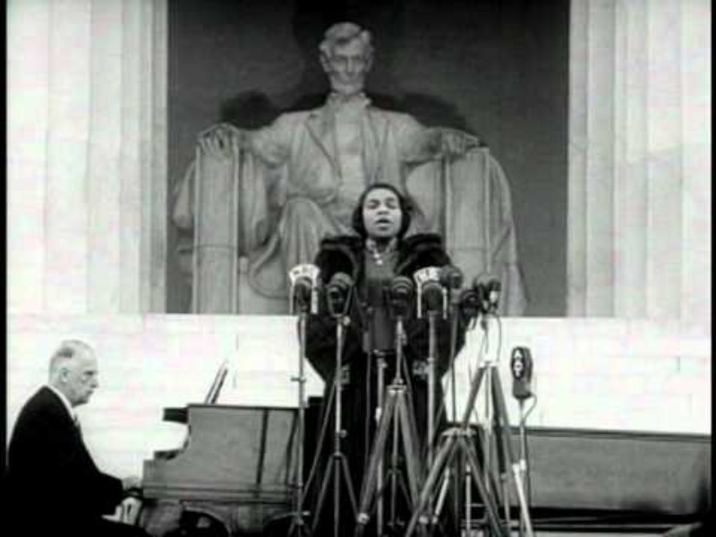

Slide 35
"Marian Anderson Sings at the Lincoln Memorial" Newreel Story – YouTube
In 1939, the Daughters of the American Revolution refused to allow Marian Anderson to sing before an integrated audience at the organization’s Constitution Hall.
At the suggestion of Eleanor Roosevelt, Anderson performed on the steps of the Lincoln Memorial on Easter Sunday to 75,000 people.

Slide 36
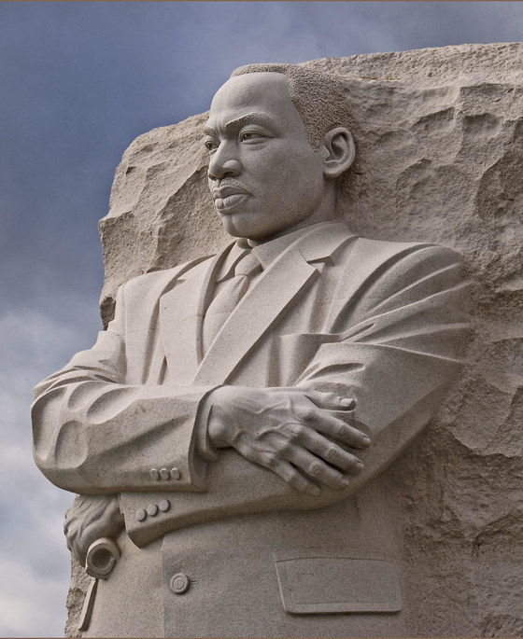
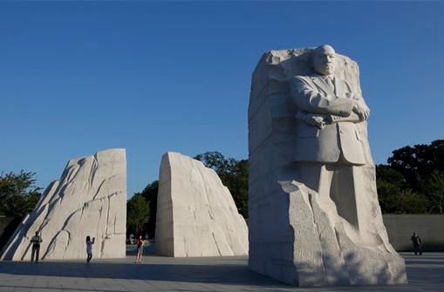
This Photo by Unknown Author is licensed under CC BY-SA-NC
This Photo by Unknown Author is licensed under CC BY

Slide 37
Martin Luther King, Jr. Memorial in Washington, D.C.
The inspiration for the memorial design comes from a line of Martin Luther King’s “I Have a Dream” speech: Out of the mountain of despair, a stone of hope.
This Photo by Unknown Author is licensed under CC BY-SA-NC
This Photo by Unknown Author is licensed under CC BY

Slide 38
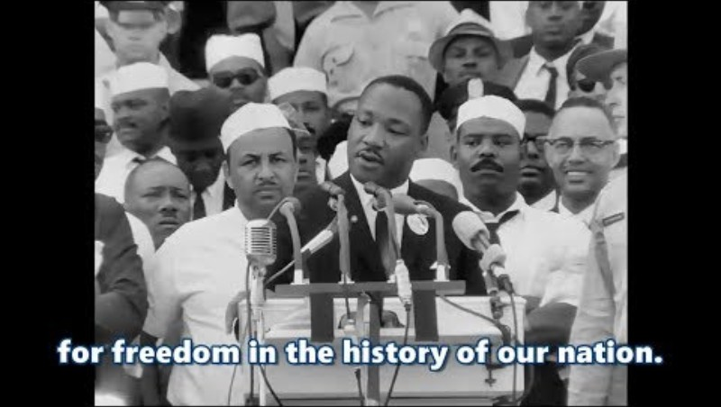

Slide 39
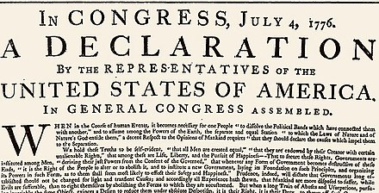
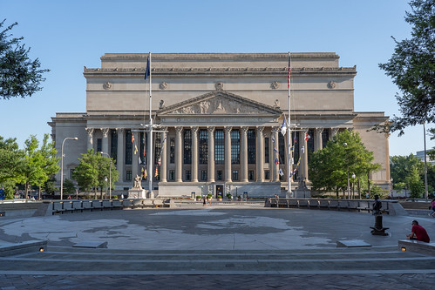
This Photo by Unknown Author is licensed under CC BY-SA
This Photo by Unknown Author is licensed under CC BY

Slide 40
The Declaration of Independence
The Declaration of Independence is located in the National Archives Museum in Washington, D.C.
The Declaration of Independence was signed on July 4, 1776.
This Photo by Unknown Author is licensed under CC BY-SA

Slide 41
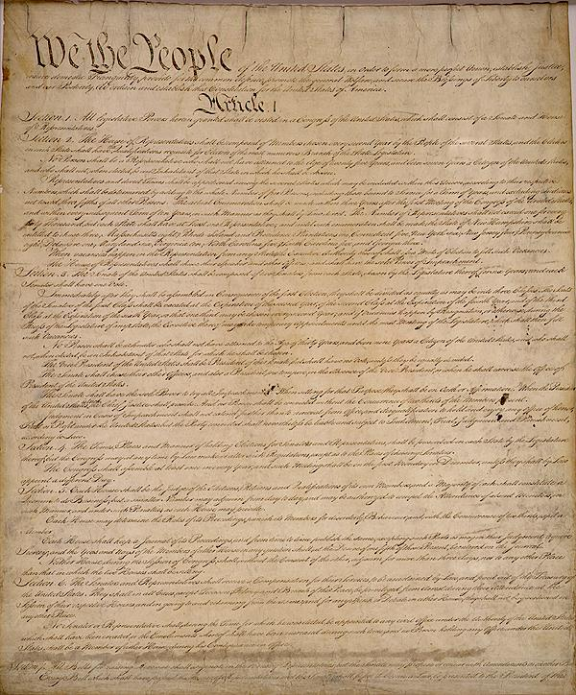
This Photo by Unknown Author is licensed under CC BY
This Photo by Unknown Author is licensed under CC BY-SA

Slide 42
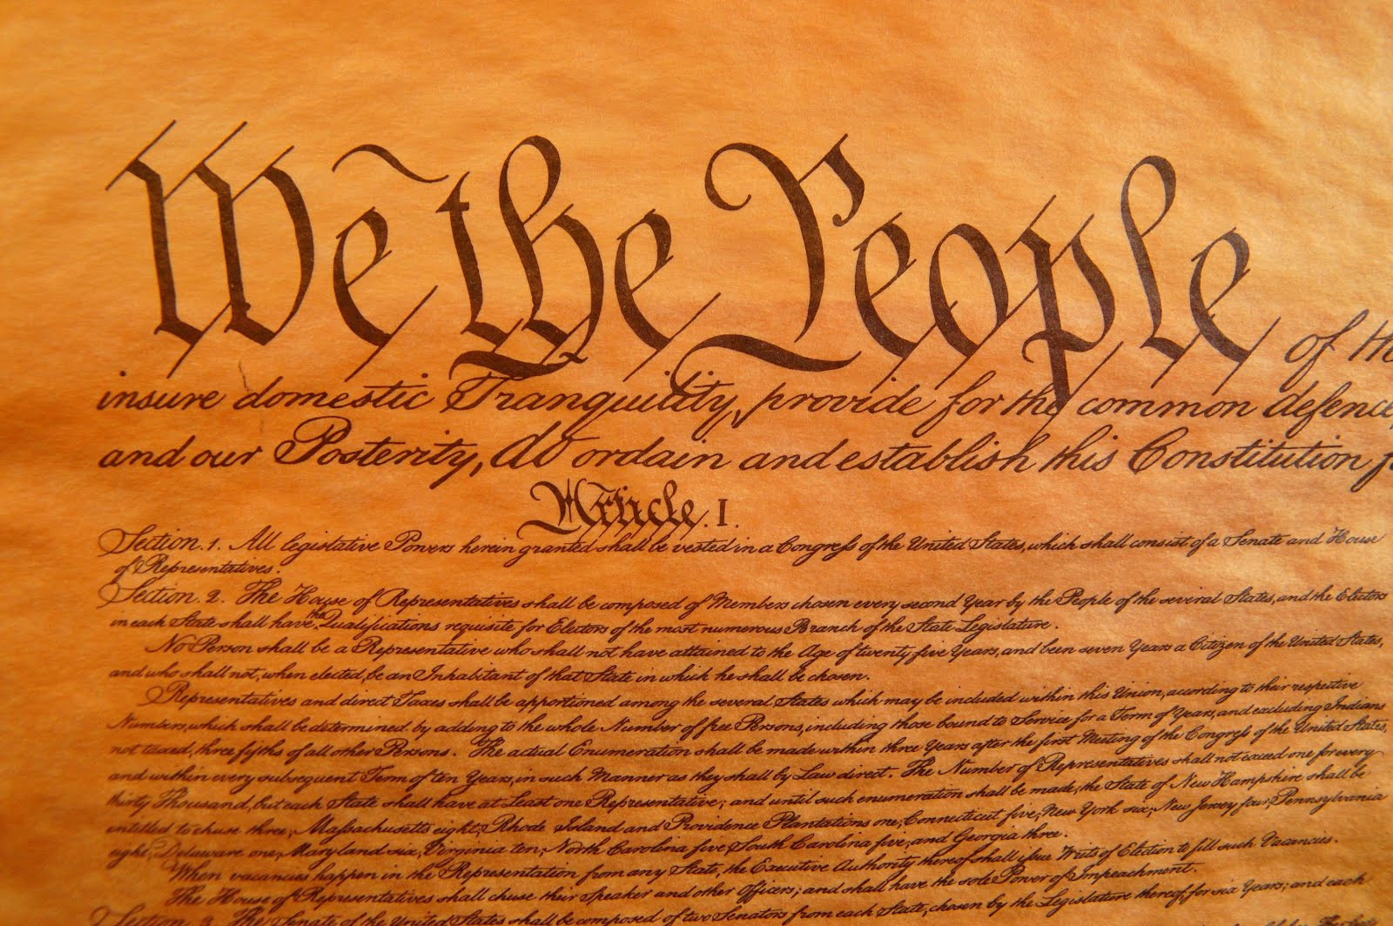
The U.S. Constitution
Written in 1787, it is the supreme law of the United States.
It is the world’s longest surviving charter of government, affirming that the government exists to serve its citizens.
The first ten amendments are called the Bill of Rights and they guarantee individual liberties.
The U.S. Constitution is also located in the National Archives Building.
This Photo by Unknown Author is licensed under CC BY
This Photo by Unknown Author is licensed under CC BY
This Photo by Unknown Author is licensed under CC BY-SA

