Slide 1
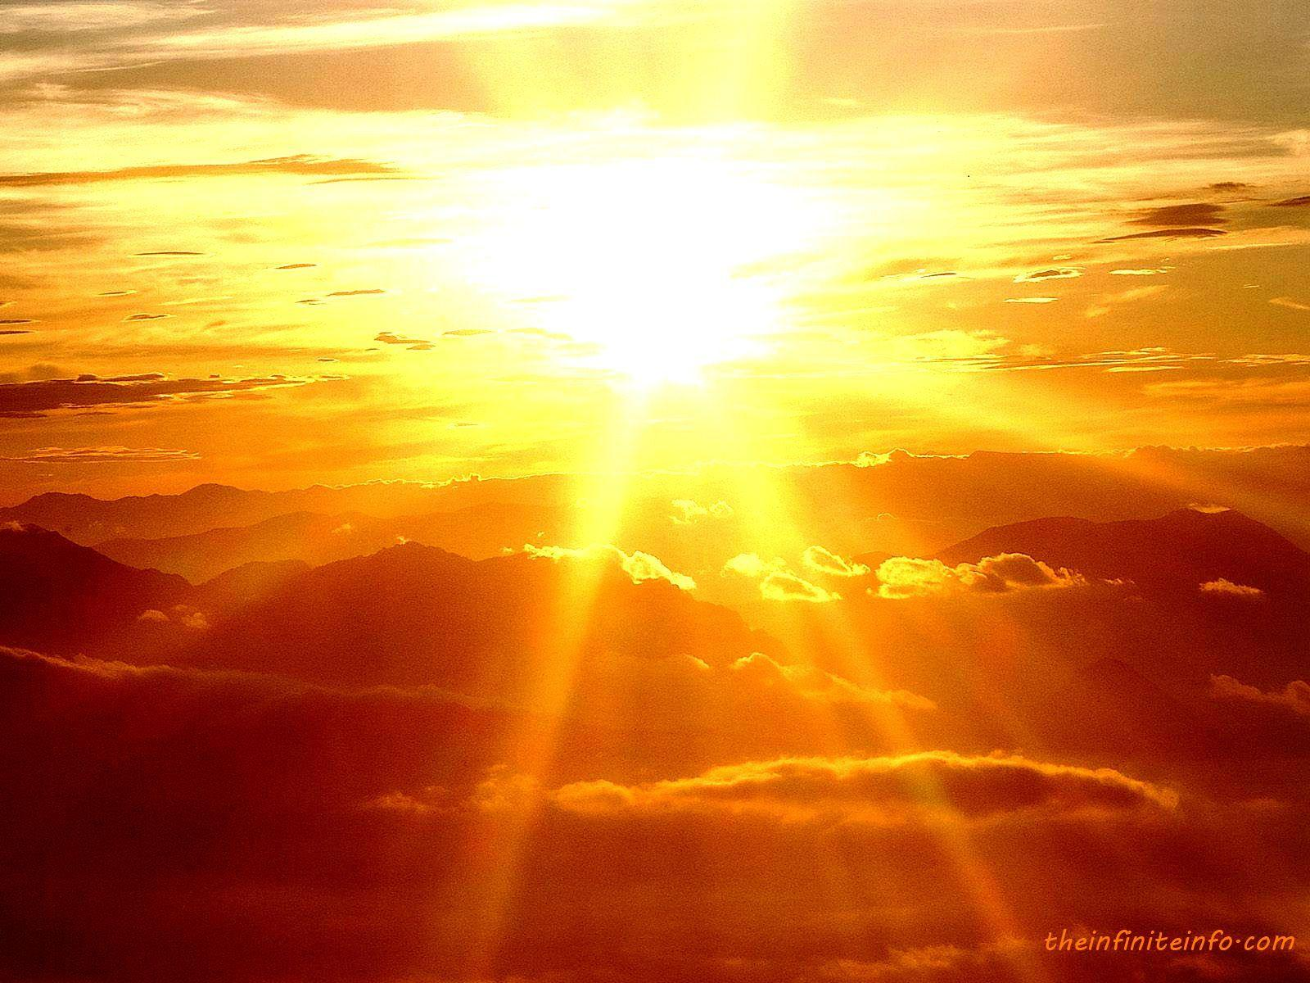
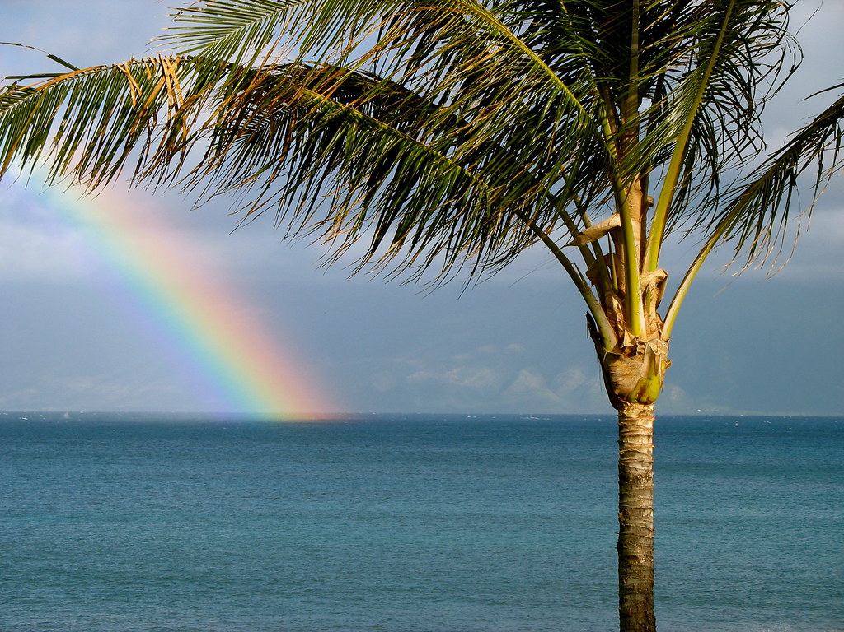
Songs
«You Are My Sunshine»
«Somewhere over the Rainbow»
Dette bildet av Ukjent forfatter er lisensiert under CC BY

Slide 2

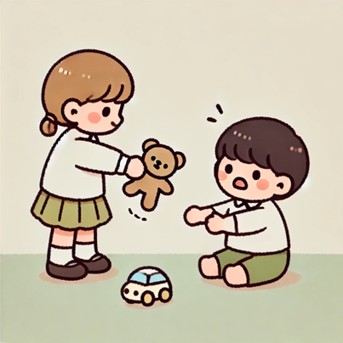

Vocabulary words
Which of these pictures is
sunshine?
grey?
love?
take?
Notes:
Steps for teaching the vocabulary words:
Teacher says the word, pupils repeat
Teacher asks pupils to point to the picture.
Teacher points to the picture to reinforcement – saying the word.

Slide 3

love take
sunshine grey
Notes:
Repeat words. Teacher points to word, says the word or points to the picture and students say the word.
Goal is to repeat the words as several times.

Slide 4
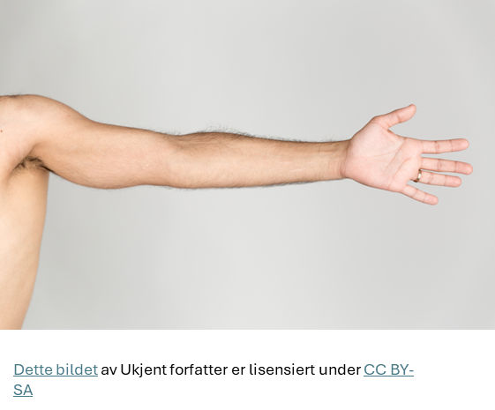
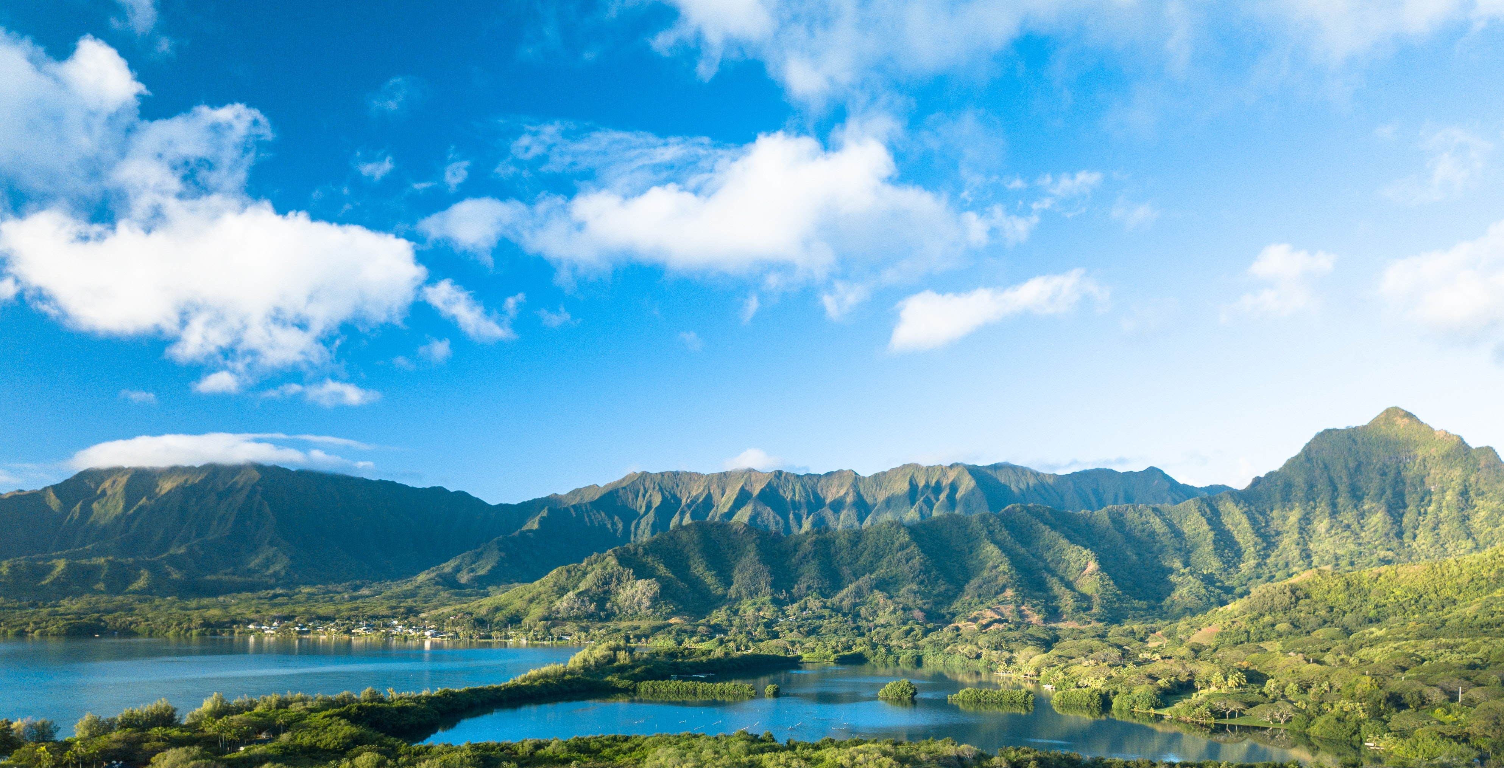
Vocabulary words
Which of these pictures is
Day?
Arm?
Head?
Dette bildet av Ukjent forfatter er lisensiert under CC BY-SA

Slide 5
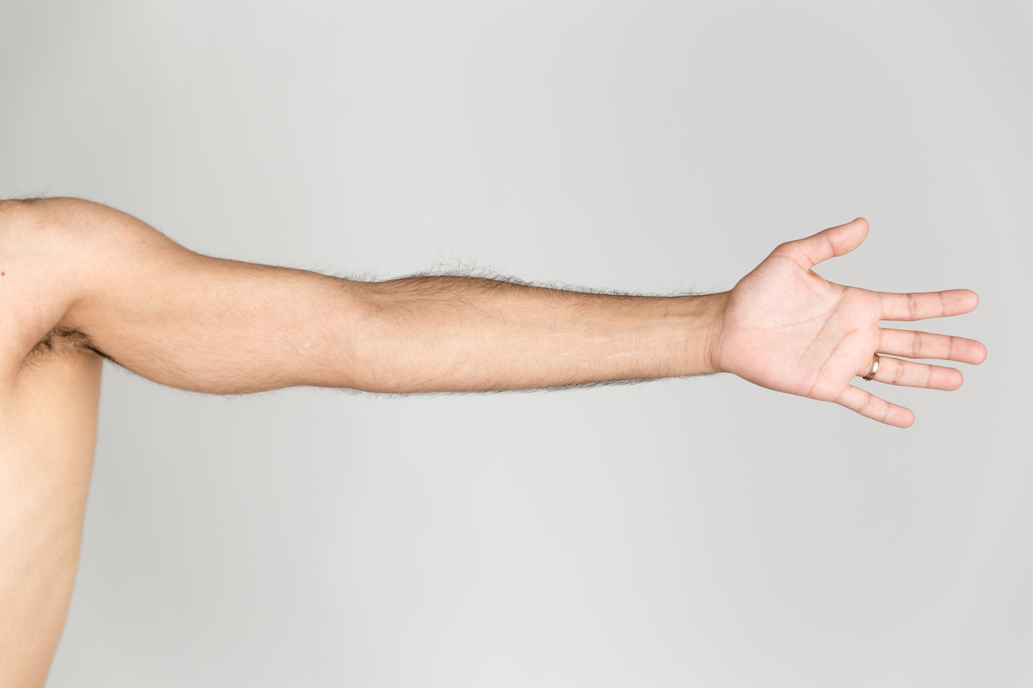
Dette bildet av Ukjent forfatter er lisensiert under CC BY-SA
A
arm day head

Slide 6
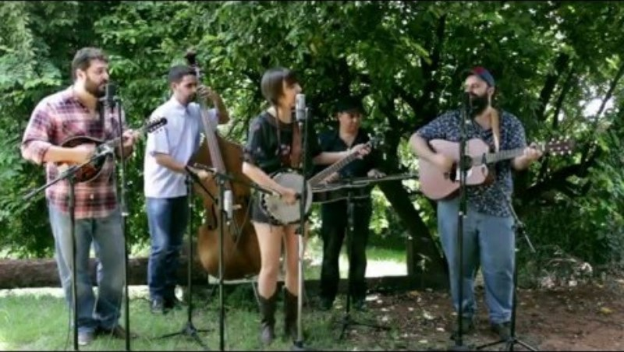
«You Are My Sunshine»
Listen to the song and write the correct words in the blanks provided on your worksheet.
Notes:
You Are My Sunshine – Little Chicken
About the Song:
"You Are My Sunshine" is a classic American song, widely recognized as a standard in old-time and country music, and is also one of the official state songs of Louisiana1. Its authorship is disputed, but it was first published and copyrighted in 1940 by Jimmie Davis and Charles Mitchell. The song has been covered by over 350 artists and translated into 30 languages, becoming one of the most enduring and beloved pieces in American music history1.
About the Singers: Little Chicken
Little Chicken is a music group that performs country-style covers of well-known songs. Their rendition of "You Are My Sunshine" was released in 2016 and is available on platforms like YouTube and SoundCloud234. The group is known for creating accessible, sing-along versions of popular tracks, often featuring simple arrangements suitable for all ages. Their music, including "You Are My Sunshine," is characterized by clear vocals and acoustic instrumentation, making it popular for educational and casual listening contexts53.
Little Chicken’s Version:
Their cover maintains the familiar melody and lyrics of the original, emphasizing a gentle, upbeat country style25.
The arrangement is straightforward, often featuring ukulele or guitar, which aligns with their focus on approachable, family-friendly music5.
The group also offers play-along videos, encouraging audience participation and music learning5.
Notable Details:
Little Chicken’s version has gained significant popularity online, with hundreds of thousands of views on YouTube24.
The group is active on social media and music sharing platforms, where they share both covers and original content34.
https://en.wikipedia.org/wiki/You_Are_My_Sunshine
https://www.youtube.com/watch?v=Y3zWyqv-c6k
https://soundcloud.com/littlechickenoficial
https://www.youtube.com/@LittleChickenOficial
https://www.youtube.com/watch?v=IF_2WV8uLaQ
https://www.tiktok.com/@covernationofficial/video/7392109099363749150
https://lisahoweler.com/2022/02/09/you-are-my-sunshine-is-not-really-a-happy-song-exactly/
https://ukealong.com/video/UMMdEW8GDsI/
https://www.youtube.com/watch?v=5TUzB2fBUpY
https://www.youtube.com/watch?v=tptPct-lBl4

Slide 7
You are my ______, my only sunshine.
You make me happy when skies are _____.
You’ll never know, dear, how much I _____ you.
Please don’t _____my sunshine away.
Notes:
Listen to the first two sentences of the song three times.
With learning partners, fill in the missing words. The pupils have now, listen, spoken and written the words.
Ask pupils to share the whole sentences either individually, in partners or in front of the group.
Once pupils have the correct words, continue to the next two sentences.
When pupils have completed filling in the blanks, play song again and invite pupils to sing along.

Slide 8
You are my sunshine, my only sunshine.
You make me happy when skies are grey.
You’ll never know, dear, how much I love you.
Please don’t take my sunshine away.

Slide 9
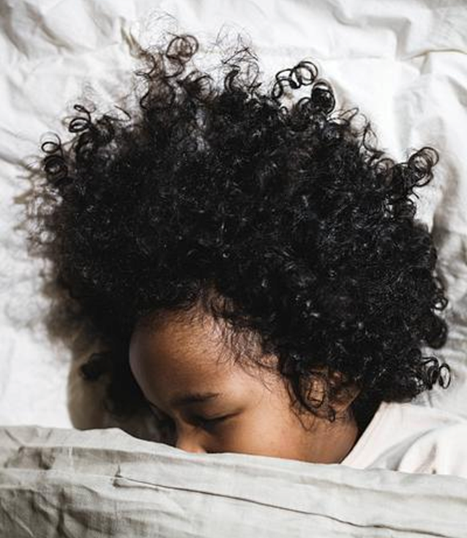
The other _____, dear, as I lay sleeping,
I dreamed I held you in my _____.
When I awoke, dear, I was mistaken.
So, I bowed my ______ and cried.
Notes:
Listen to the first two sentences of the song three times.
With learning partners, fill in the missing words. The pupils have now, listen, spoken and written the words.
Ask pupils to share the whole sentences either individually, in partners or in front of the group.

Slide 10
The other night, dear, as I lay sleeping,
I dreamed I held you in my arms.
When I awoke, dear, I was mistaken.
So, I bowed my head and cried.

Slide 11
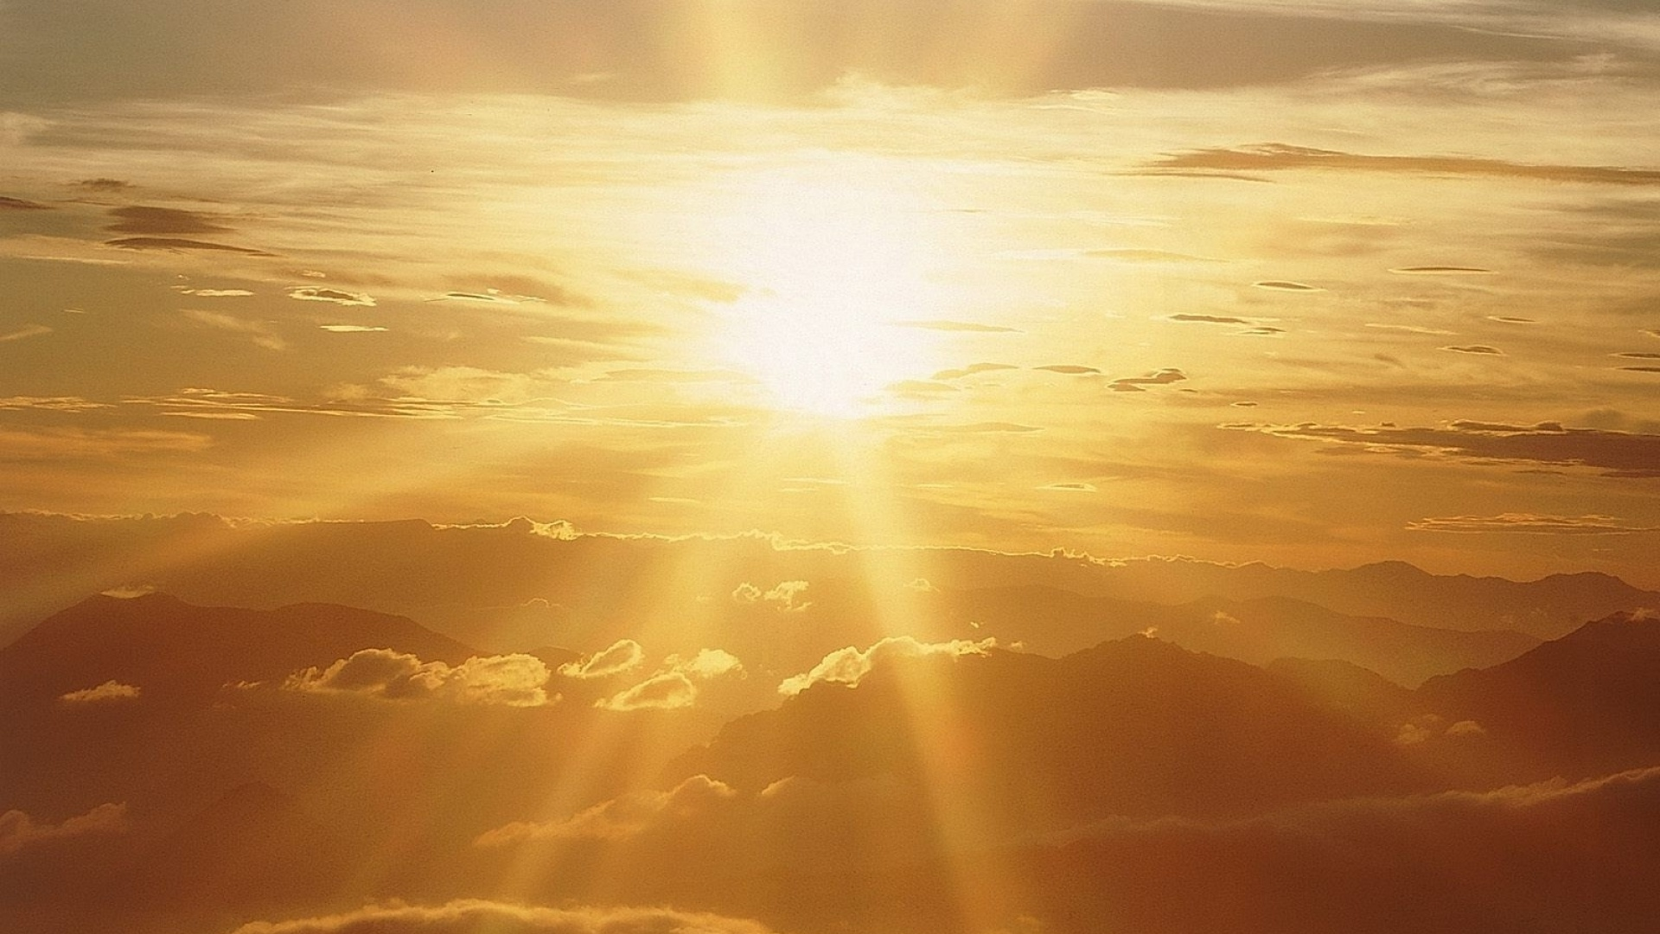
You are my sunshine, my only sunshine.
You make me happy when skies are grey.
You’ll never know, dear, how much I love you.
Please don’t take my sunshine away.

Slide 12

What is your favorite color?
Notes:
How many words do the pupils know?
Elicit vocabulary from their own repertoire.

Slide 13

I have a ______ thumb.

Slide 14

I have a green thumb.

Slide 15
I have a green thumb.
This means that you know how to garden.
You know how to make plants grow.

Slide 16
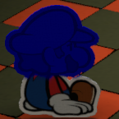
I’m feeling ___________today.
Dette bildet av Ukjent forfatter er lisensiert under CC BY-SA

Slide 17
I’m feeling blue today.
I’m feeling blue today.
This means that you are sad.
Dette bildet av Ukjent forfatter er lisensiert under CC BY-SA
Notes:
To feel blue: Idiom = to feel sad
Sarah felt blue after dog died.

Slide 18
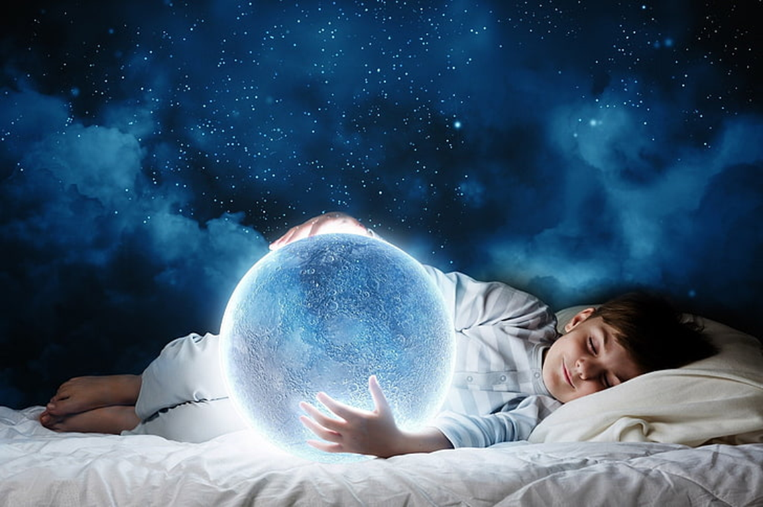
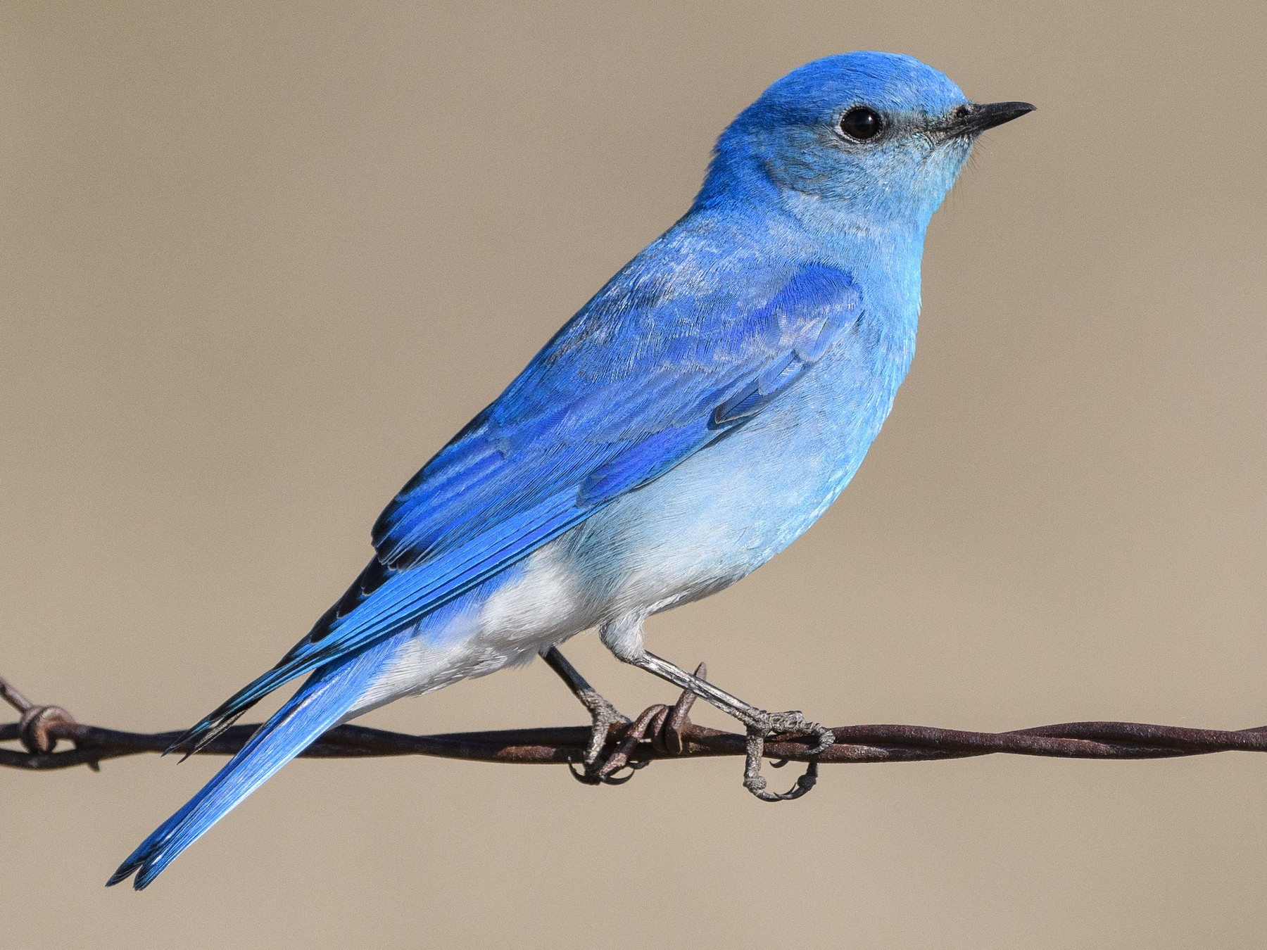
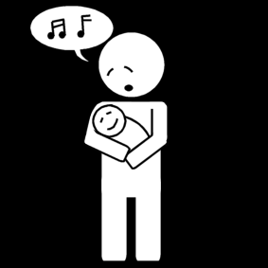
Vocabulary words
Which of these pictures is
Rainbow?
Dream?
Lullaby?
Bluebird?
Dette bildet av Ukjent forfatter er lisensiert under CC BY-NC

Slide 19
rainbow bluebird
dream lullaby
Dette bildet av Ukjent forfatter er lisensiert under CC BY-NC

Slide 20


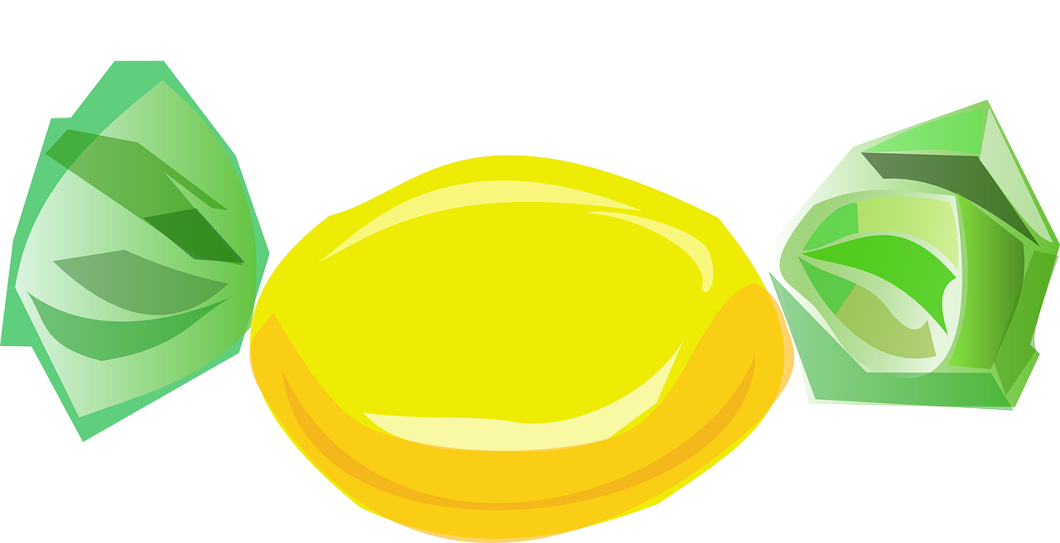

Vocabulary words
Which of these pictures is
True?
Star?
Clouds?
Lemon drop?

Slide 22
Lemon drop true
clouds star

Slide 23
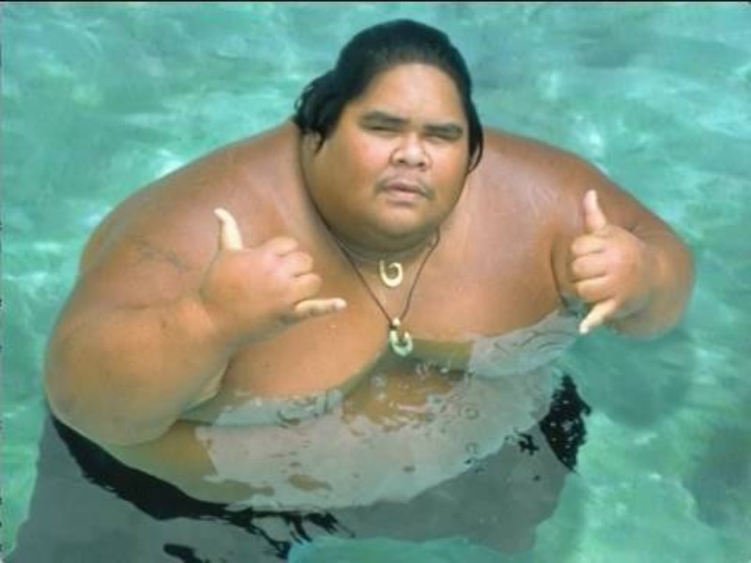
«Somewhere over the Rainbow»
Listen to the song and write the correct words in the blanks provided on your worksheet.
Notes:
Israel "IZ" Kamakawiwoʻole was a renowned Hawaiian musician born in Honolulu in 1959, celebrated for his gentle demeanor, powerful voice, and advocacy for Hawaiian culture and sovereignty12. He became internationally famous for his medley of “Somewhere Over the Rainbow/What a Wonderful World,” which showcases his signature ukulele playing and soulful vocals23. His version, first recorded in a spontaneous late-night studio session, was done in a single take and later featured on his 1993 album Facing Future, helping it become a global classic3.
The official music video for "Somewhere Over the Rainbow" by IZ is deeply evocative and widely recognized. It features footage of the Hawaiian landscape, archival clips of Kamakawiwoʻole, and scenes reflecting his gentle spirit and connection to his homeland4. Notably, the video concludes with a poignant moment: friends and family are shown spreading his ashes in the Pacific Ocean, honoring his wish to return to the land and sea he loved5. This imagery, combined with his hauntingly beautiful rendition, has made the video especially moving for viewers around the world.
IZ’s version of the song has been featured in numerous films and television shows, and its popularity has only grown since his death in 1997, with the video surpassing one billion views on YouTube6. The song and video remain a testament to his enduring legacy as a cultural icon and musical legend from Hawaii16.
https://www.ebsco.com/research-starters/history/israel-kamakawiwoole
https://en.wikipedia.org/wiki/Israel_Kamakawiwo%CA%BBole
https://en.wikipedia.org/wiki/Somewhere_Over_the_Rainbow/What_a_Wonderful_World
https://www.youtube.com/watch?v=V1bFr2SWP1I
https://www.reddit.com/r/Music/comments/13mnwg2/israel_iz_kamakawiwoole_somewhere_over_the/
https://www.billboard.com/music/music-news/israel-ikamakawiwo-ole-somewhere-over-the-rainbow-1-billion-youtube-views-9507664/
https://www.inverse.com/culture/israel-kamakawiwoole-google-doodle
https://www.imdb.com/name/nm0436377/
https://imvdb.com/video/israel-kamakawiwoole/somewhere-over-the-rainbow
https://izhawaii.com/biography/
https://no.wikipedia.org/wiki/Israel_Kamakawiwo%CA%BBole
https://www.liveabout.com/israel-kamakawiwoole-3552763
https://www.npr.org/2010/12/06/131812500/israel-kamakawiwo-ole-the-voice-of-hawaii
https://mabumbe.com/people/israel-iz-kamakawiwoole-age-net-worth-legacy/
https://www.kamakawiwo.net/israel-biography.php
https://www.youtube.com/watch?v=w_DKWlrA24k
https://www.youtube.com/watch?v=RDjb1MdUiGE
https://www.youtube.com/playlist?list=PL2E3D3E9220059169
https://www.youtube.com/watch?v=fahr069-fzE

Slide 24
Somewhere over the ______, way up high
And the _____ that you dream of once in a _____.
Somewhere over the rainbow ______ fly
And the dreams that you dream of, dreams really do come ______.
Someday I’ll wish upon a ______, wake up where the _____ are far behind me.
Where trouble melts like _____ _______high above the chimney top,
That’s where you’ll find me.
Dette bildet av Ukjent forfatter er lisensiert under CC BY
Notes:
Listen to the first two sentences of the song three times.
With learning partners, fill in the missing words. The pupils have now, listen, spoken and written the words.
Ask pupils to share the whole sentences either individually, in partners or in front of the group.
Once pupils have the correct words, continue to the next two sentences.
When pupils have completed filling in the blanks, play song again and invite pupils to sing along.

Slide 25
Somewhere over the rainbow, way up high
And the dreams that you dream of once in a lullaby.
Somewhere over the rainbow bluebirds fly
And the dreams that you dream of, dreams really do come true.
Someday I’ll wish upon a star, wake up where the clouds are far behind me.
Where trouble melts like lemon drops high above the chimney top.
That’s where you’ll find me.
Dette bildet av Ukjent forfatter er lisensiert under CC BY
Notes:
Listen to the first two sentences of the song three times.
With learning partners, fill in the missing words. The pupils have now, listen, spoken and written the words.
Ask pupils to share the whole sentences either individually, in partners or in front of the group.
Once pupils have the correct words, continue to the next two sentences.
When pupils have completed filling in the blanks, play song again and invite pupils to sing along.

Slide 26
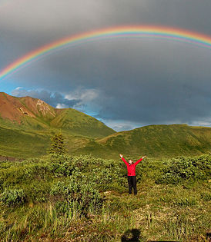
Somewhere over the rainbow bluebirds fly
And the dream that you dare to, oh why, oh, why can’t I?
Someday I wish upon a star, wake up where the clouds are far behind me
Where troubles melt like lemon drops high above the chimney top
That’s where you’ll find me
Somewhere over the rainbow, way up high
And the dreams that you dare to
Why then, oh, why can’t I?
Dette bildet av Ukjent forfatter er lisensiert under CC BY-SA
Notes:
Second verse, advancing to more words to listen for and remember.

