Slide 1
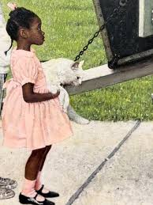

The Curious Eye:
Exploring English Language Learning through Art
Lynda LeBlanc and Gini Lockhart-Pedersen

Slide 2
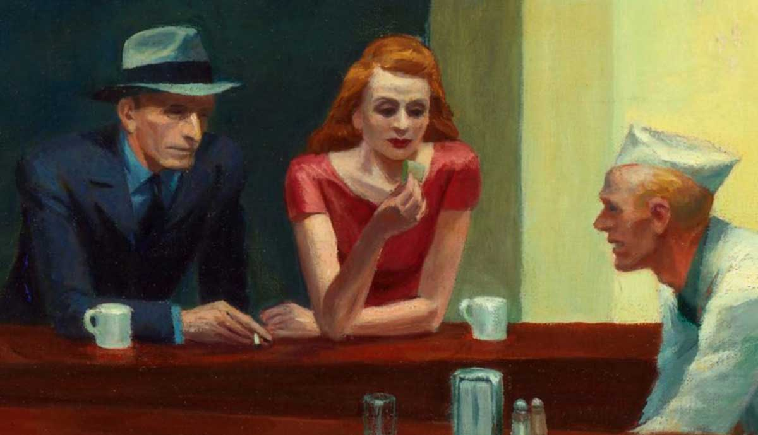
English Subject
Relevance and central values
Knowledge of and an exploratory approach to language, communication patterns, lifestyles, ways of thinking and social conditions
open for new perspectives on the world and ourselves.

Slide 3


What is NOT inquiry-based practices?
Dette bildet av Ukjent forfatter er lisensiert under CC BY-NC-ND

Slide 4
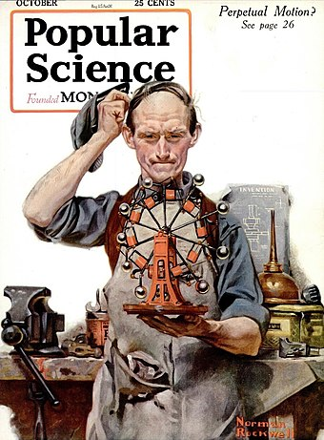
Inquiry-based practices
To explore is about experiencing and experimenting, nurturing curiosity and wonder. Exploring can mean sensing, seeking, discovering, observing, and examining. It can also mean in some cases investigating different aspects of a topic through open and critical discussion. Exploring can also mean testing or trying out and evaluating work methods, products, or equipment.
Ministry of Education and Research, 2018 p.16 – author’s translation/perplexity
Dette bildet av Ukjent forfatter er lisensiert under CC BY-SA

Slide 5
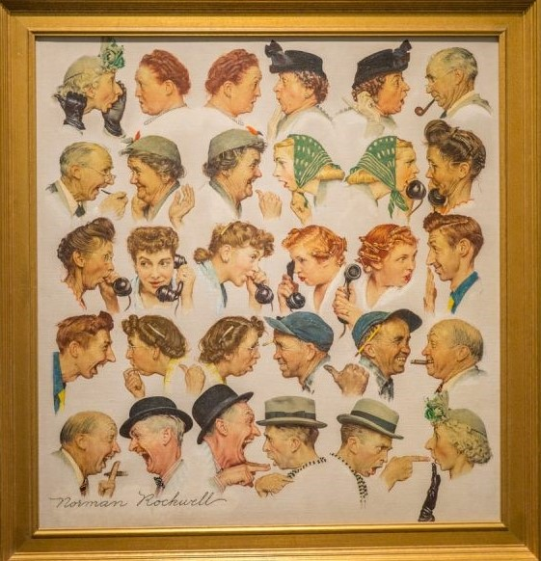
In English, we explore
language
communication patterns
ways of life, mindsets
social conditions
through…
open-ended questions
hands-on activities
collaborative learning
structured Freedom
thesis + research + share
Notes:
The English subject shall contribute to an exploratory approach to language, communication patterns, ways of life, mindsets, and social conditions, opening up new perspectives on the world and ourselves.
Curiosity and Open Inquiry: Students were encouraged to explore open-ended questions, fostering curiosity and independent thinking.
Collaborative Learning: The approach emphasized group work, allowing students to assist each other in finding solutions.
Structured Freedom: While students were given freedom to explore and collaborate, this freedom was clearly defined and structured by the teacher.
Teacher's Role: The teacher played a crucial part in setting boundaries and guidelines for the exploratory learning process.

Slide 6
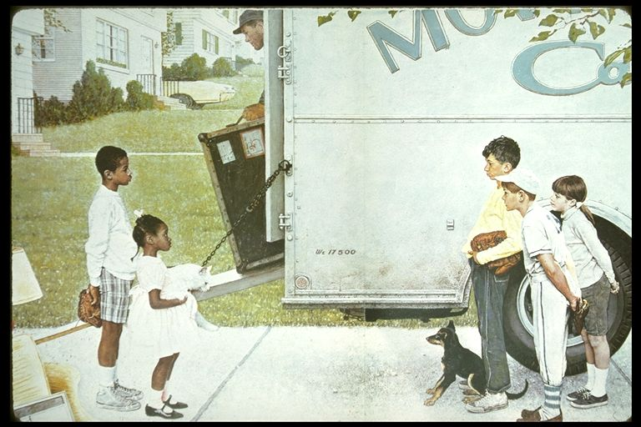
Sound…
Notes:
Be attentive to sights and sounds this picture produces for you.
Write down words, pictures, to help remember the sights and sounds.
Moving Day (1967)
by Norman Rockwell

Slide 7
Questions about Moving Day
Sound
What do you hear?
Do you hear sounds coming from the moving van?
What do you hear from the man in the moving van?
Do you hear any sounds on the street?
What about the children in front of you; do you hear anything from them?
Is there any background noise like a lawnmower or a crying child?
Are there loud sounds, soft daily sounds, or is this scene without sound?’
Write down words or pictures to help you remember these sounds.

Slide 8
Questions about Moving Day
Sight
What do you see? Let’s start in the front of this image. Look at all the characters, big and little, and look at their hands and at what is in their hands.
Look at how everyone is dressed. Why are they dressed like they are?
Look at all of the characters’s expressions. Are they similar? Are they different?
Look at the houses in the background. What do you notice about these houses?
Write down words or pictures to help you remember what you see.

Slide 9
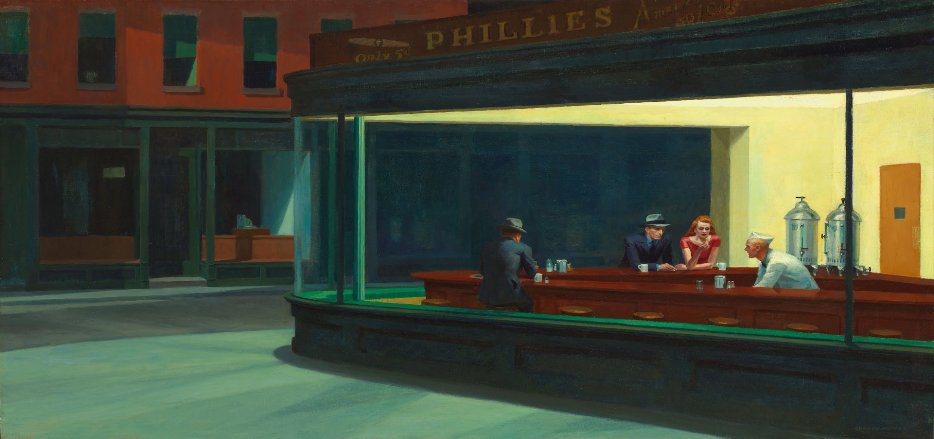
3. Nighthawks by Edward Hopper, 1942
Art Institute of Chicago
Notes:
Be attentive to sights and sounds this picture produces for you.
Write down words, pictures, to help remember the sights and sounds.

Slide 10
Questions about Nighthawk
Sound
What do you hear here? Do you hear any sounds coming from behind the counter, sounds made by the worker in the white hat or sounds from a machine underneath the counter? Are they loud sounds or soft sounds?
Do you hear human sounds? Talking? Whispering? Do you hear movement on one of the round stools?
Go larger. Do you hear sounds coming from the room? For example, do the lights make a sound? Is the door making a sound?
And finally, what sounds do you hear outside the diner? Do you hear a garbage truck or people walking home or people snoring in apartments with open windows?
Write down words or pictures to help you remember these sounds.

Slide 11
Questions about Nighthawk
Sight
What do you see when you look at the worker? Is he talking? To whom? Is he listening? To whom? Is he watching someone or something?
Are the man and woman strangers, or not?
Is the man by himself alone, or not?
Is this scene late at night just before closing or is it simply an unpopular and almost empty diner?
Write down words or pictures to help you remember what you see.

Slide 12
Notes:
We have discussed words, now let’s progress to stories.
Look at the painting on the left?
What do you hear in this painting?
How important are these sounds to the painting’s story?
What details do you see that are important to the story?
Who do you see as the main characters in the story shown on this painting?
There needs to be a problem because in literature, no problem- no story
What do you see as the central conflict in this painting?

Slide 13
Choose one of the paintings.
There is a story in your chosen painting.
In your story, two characters begin a conversation.
Which two characters are speaking and what is their story?
What is the problem or conflict in your story?
Notes:
Use your imagination. Think individually

Slide 14
Share
Share your story with partner.
Listen to your partner’s story.
Create a shared story or use one of the stories already presented.
Notes:
Lynda

Slide 15
Write
Write a conversation of around 10 sentences. In your conversation, there must be a conflict.
Notes:
10/5 min

Slide 16
Share
Share your conversations with a new group
Notes:
Lynda

Slide 17
In English, we explore
language
communication patterns
ways of life, mindsets
social conditions
through…
open-ended questions
hands-on activities
collaborative learning
structured Freedom
thesis + research + share

Slide 18
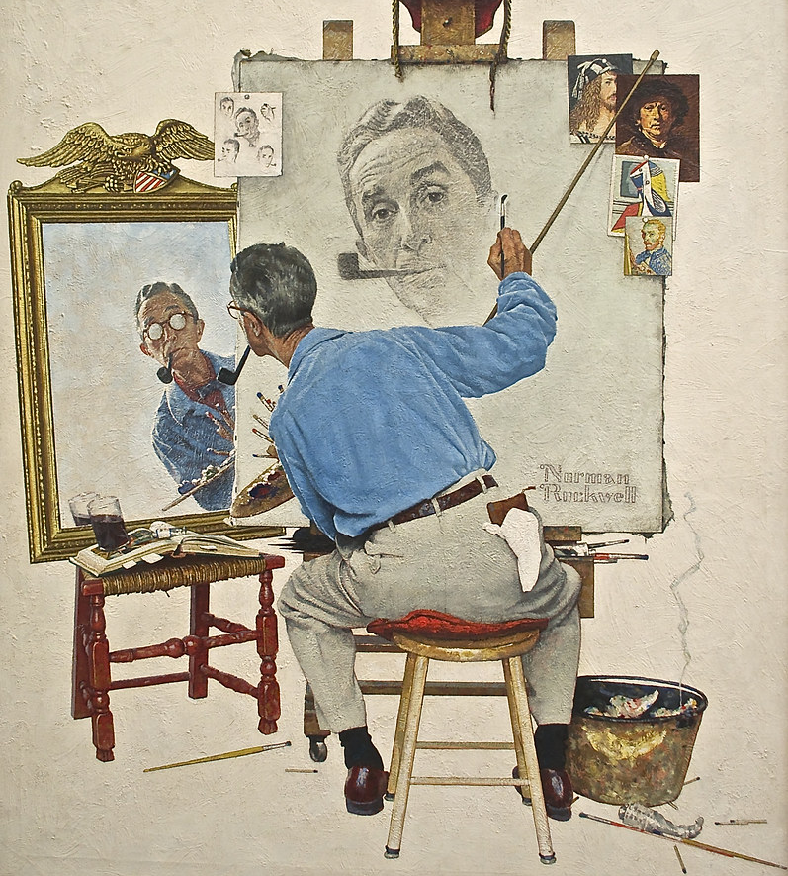
Reflection
Inquiry based?
How might these activities facilitate language learning?
LK20?
Challenges?
Dette bildet av Ukjent forfatter er lisensiert under CC BY-NC
Notes:
How did you journey through sights and sounds inform the conversation?
How did the word exercise inform the conversation?
What is inquiry based and how is it applied in these exercises?
How might these activities facilitate language learning

Slide 19
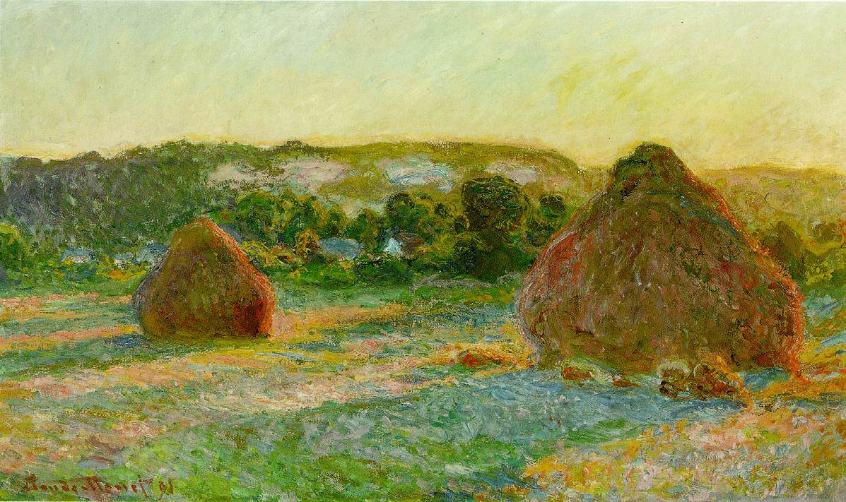
Possible extensions of this lesson

Slide 20
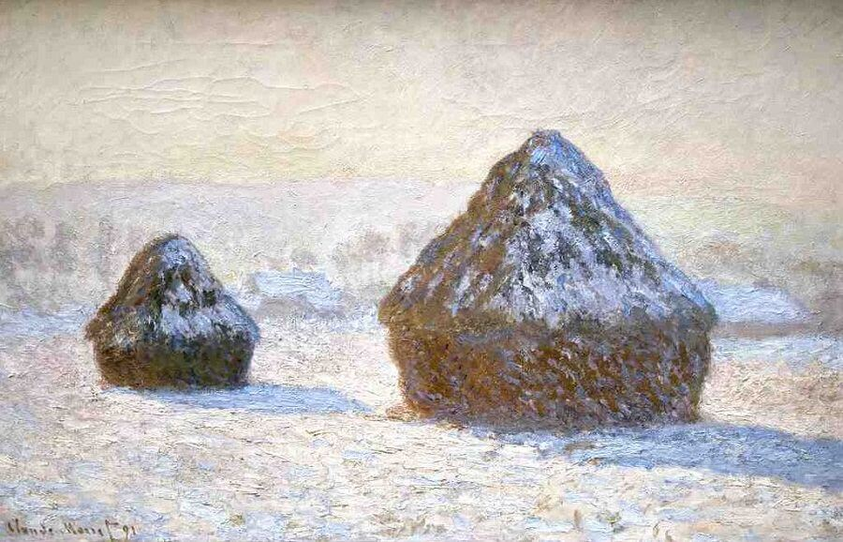
Monet painted a series of stacks of harvested wheat.
He painted the same subject but in different seasons and different light.

Slide 21
Your story has shed a new light on Rockwell’s or Hopper’s painting.
Like Monet, create a painting with the same subjects but in a new light.

Slide 22


Slide 23
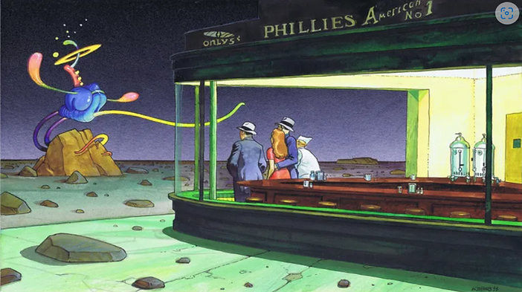

Slide 24
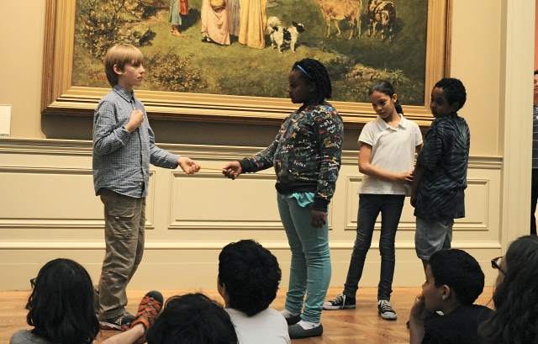
Create a living tableau or a tableau vivant.

Slide 25
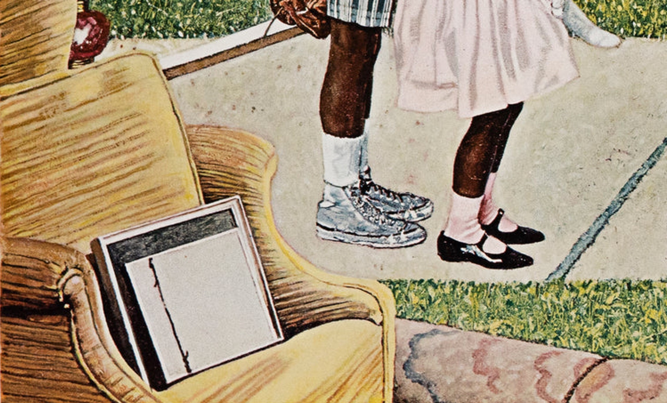
Highlight one part of the picture

Slide 26
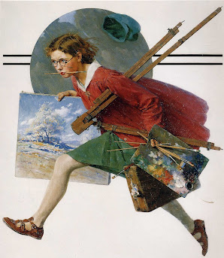
Now it’s your turn!
Thank you!
Dette bildet av Ukjent forfatter er lisensiert under CC BY-NC-ND

Slide 27
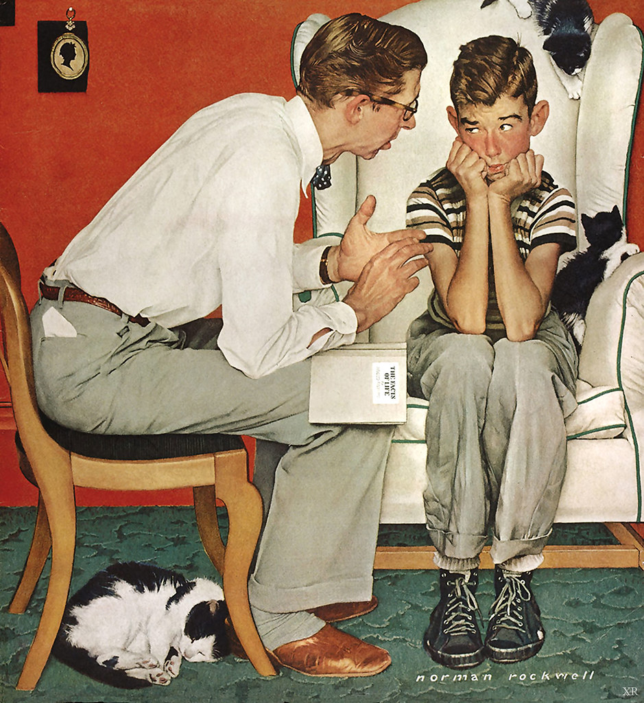
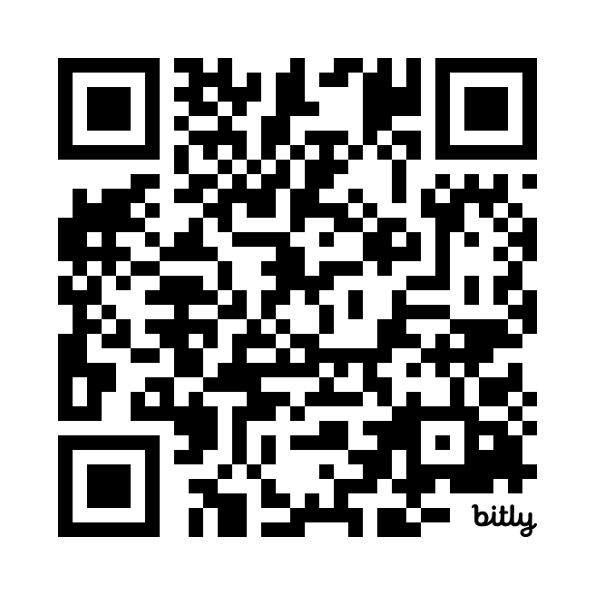
Conference
Evaluation https://nettskjema.no/a/451101
Dette bildet av Ukjent forfatter er lisensiert under CC BY-SA-NC

