Slide 1
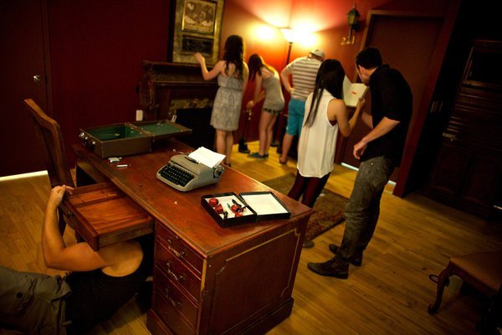
Presentasjon av Fremmedspråksenteret
“I want to do this again!”
7th grade pupil
Hybrid escape room
Anne-Lene Løvig Glomsrød -
Virginia (Gini) Lockhart-Pedersen
Fornavn Etternavn

Slide 2
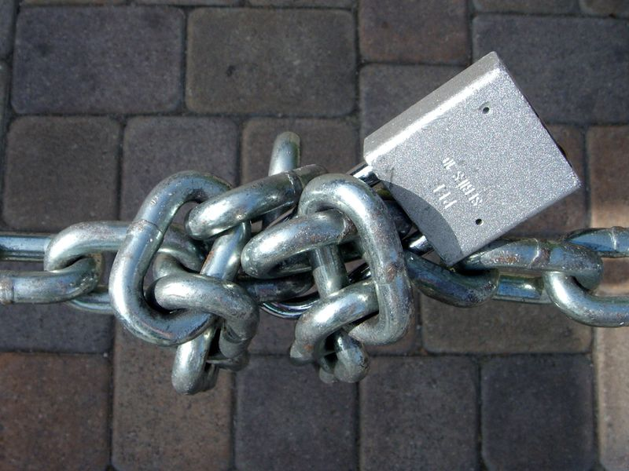
Døra er last
UDIR
Kontroll
Dette bildet av Ukjent forfatter er lisensiert under CC BY-NC-ND

Slide 3

The task
Can you unlock the door?
Follow your colors.
Find your collaborative group.
Together you need to create ONE word as the answer key.
3 tasks give you letters to create the ONE word answer.
Write the word on a piece of paper.
Bring the word to the UDIR Control.
Dette bildet av Ukjent forfatter er lisensiert under CC BY
Notes:
Anne-Lene

Slide 4


Escape room
Notes:
12 mi
Klarer å finne et godt sammarbeid
Klokken starter etter 2 min
Kommer fram til et løsningsord
4 oppgver som gir bokstavene til å lage ordet

Slide 5


Slide 6

Dette bildet av Ukjent forfatter er lisensiert under CC BY-NC-ND

Slide 7

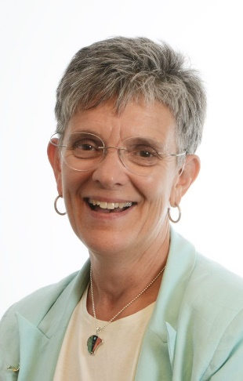
Who are we?
Notes:
Introduce ourselves

Slide 8
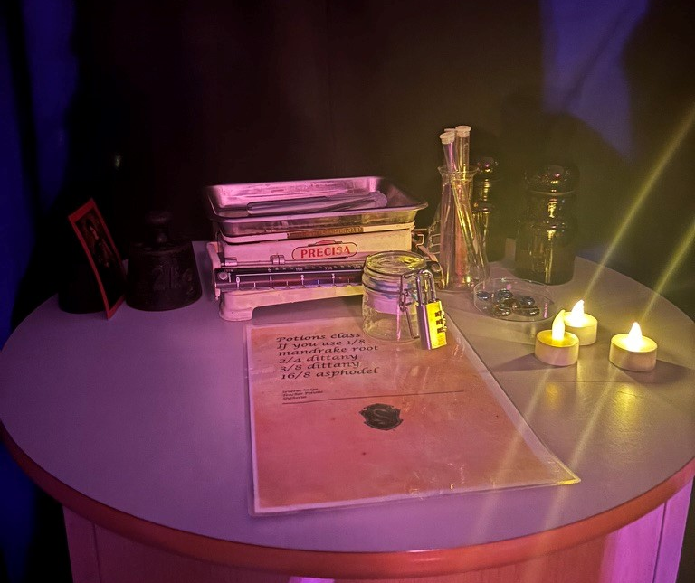
What is an escape room?
“live-action team-based games where players discover clues, solve puzzles, and accomplish tasks in one or more rooms in order to accomplish a specific goal (usually escaping from the room) in a limited amount of time” (Nicholson, 2015, p. 1)
Picture: Anne-Lene Løvig Glomsrød
Notes:
Anne-Lene

Slide 9
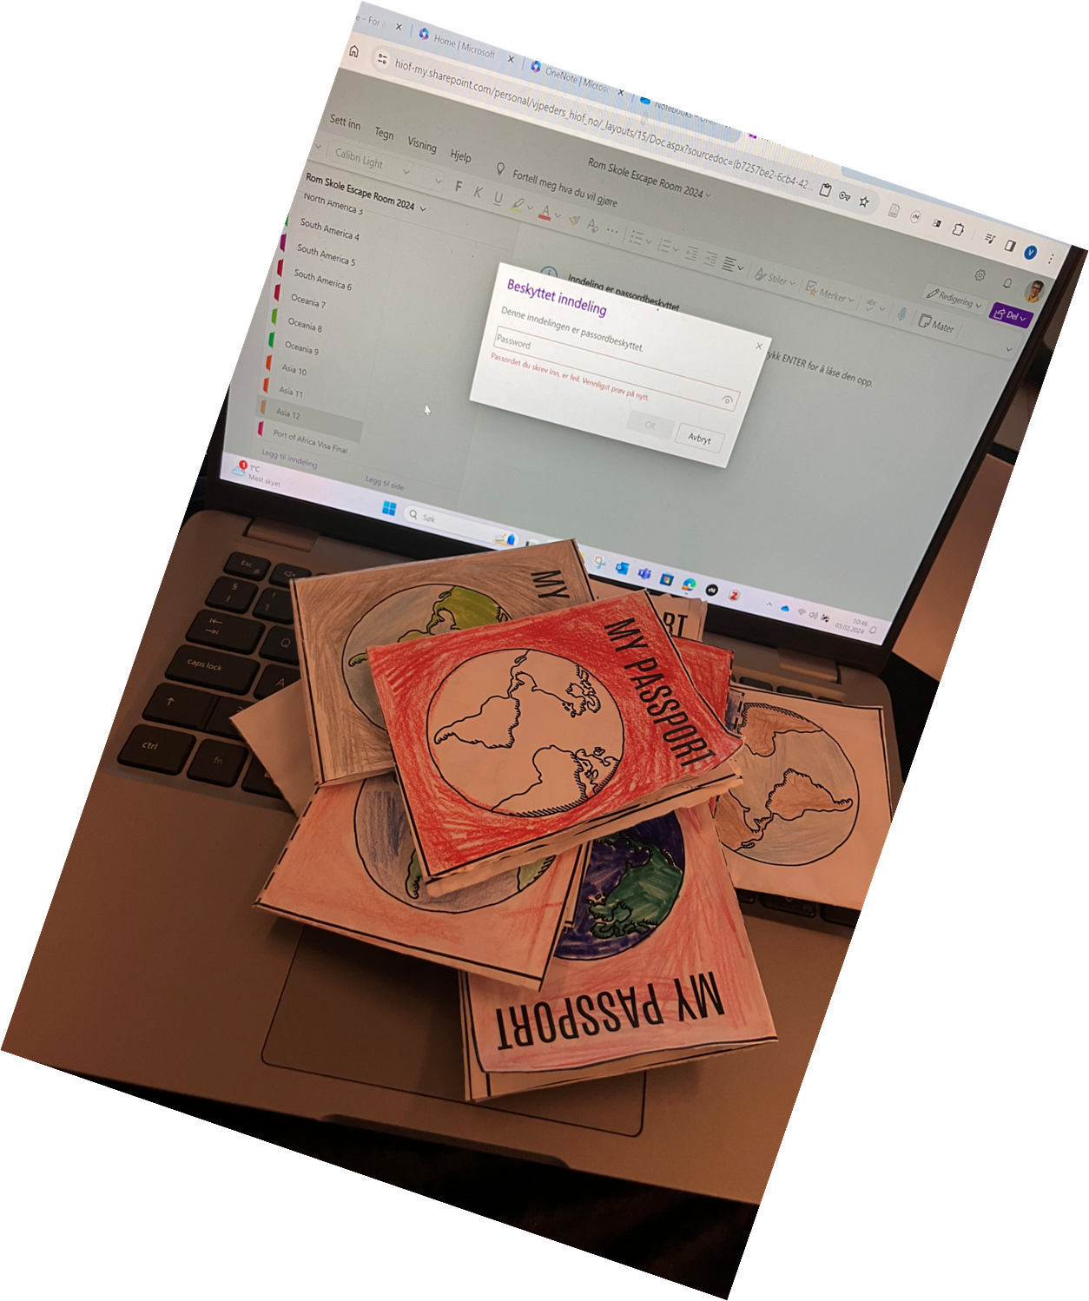
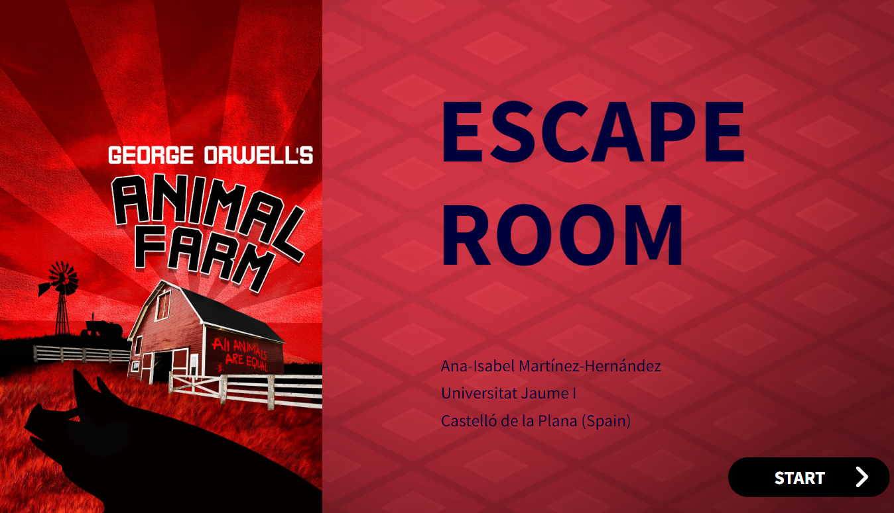
Escape room – Different types
Physical escape room
Digital escape room
Hybrid/digilog
Escape game activities
Notes:
Gini
Escape game activities
Hybrid –Digilog Digital og analog
The clues are completed by solving digital locks.
Typically, these are just locks in a form that must be answered correctly to unlock the next clue (or set of clues).

Slide 10

Digital Escape Room- Animal Farm
Notes:
Gini

Slide 11

Inquiry-based practices
To explore is about experiencing and experimenting, nurturing curiosity and wonder. Exploring can mean sensing, seeking, discovering, observing, and examining. It can also mean in some cases investigating different aspects of a topic through open and critical discussion. Exploring can also mean testing or trying out and evaluating work methods, products, or equipment.
Ministry of Education and Research, 2018 p.16 – author’s translation/perplexity
Notes:
Gini

Slide 12

In English, we explore
language
communication patterns
ways of life, mindsets
social conditions
Through…
open-ended questions
hands-on activities
Collaborative learning
“Structured” Freedom
Theisis + research + share
Dette bildet av Ukjent forfatter er lisensiert under CC BY
Notes:
Gini
The English subject shall contribute to an exploratory approach to language, communication patterns, ways of life, mindsets, and social conditions, opening up new perspectives on the world and ourselves.
Curiosity and Open Inquiry: Students were encouraged to explore open-ended questions, fostering curiosity and independent thinking.Collaborative Learning: The approach emphasized group work, allowing students to assist each other in finding solutions.Structured Freedom: While students were given freedom to explore and collaborate, this freedom was clearly defined and structured by the teacher.Teacher's Role: The teacher played a crucial part in setting boundaries and guidelines for the exploratory learning process.This translation highlights the balance between student-led exploration and teacher-guided structure in the learning environment, emphasizing curiosity, collaboration, and well-defined freedom as key elements of the educational approach.

Slide 13
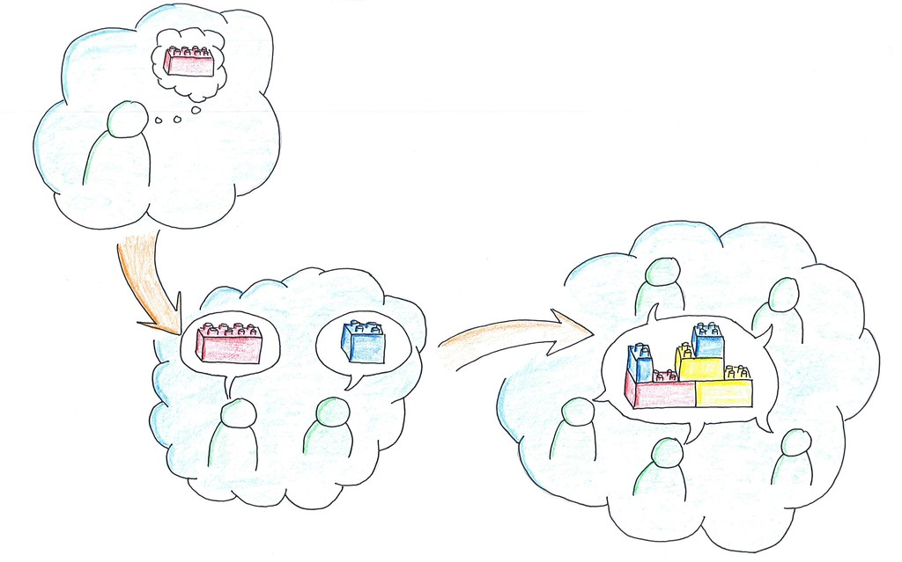
Use your experience from today: Where might you find elements of inquiry-based practices in English?
Think (2 min)
Pair (3 min)
  Anything surprising? New?
Share (5 min)
Notes:
Gini

Slide 14


Inquiry-based process, method
Inquiry-based tasks
Notes:
Anne-Lene
Follows a series of phases or stages (e.g., orientation, conceptualization, investigation, conclusion, and discussion)
Is more open-ended and can span longer periods
Emphasizes the development of skills like critical thinking, problem-solving, and independent research

Slide 15
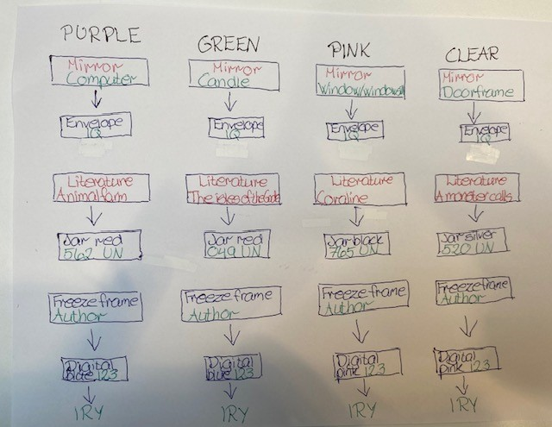
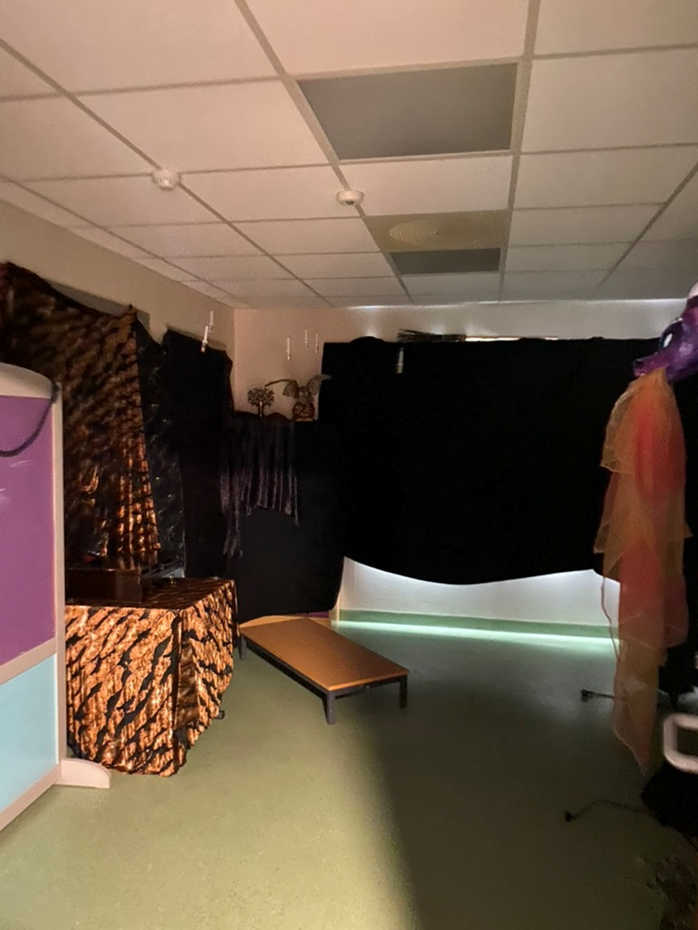
Planning an escape room
Pictures: Anne-Lene Løvig Glomsrød
Notes:
Anne-Lene
Inquiry based tasks. process
Plan escape room activities
Show box
Show box

Slide 16
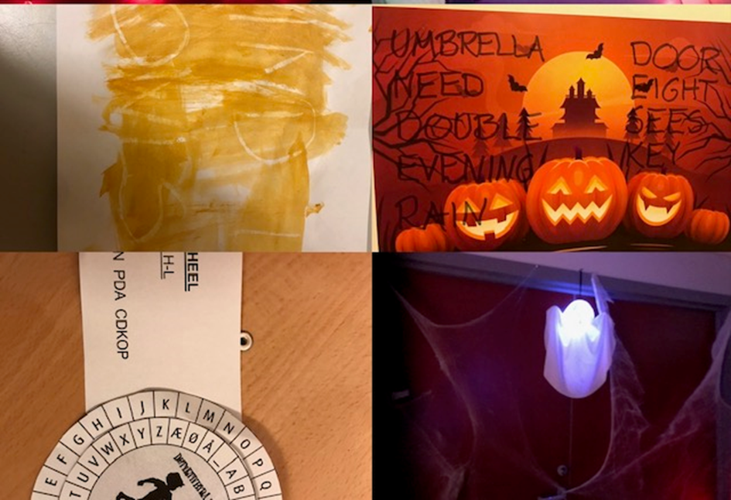
Experiences
Make and test hypotheses –enhance communicative skills
Work both physically and mentally
All pupils were active –use each other's strengths
Motivation
Group dynamic
Picture: Anne-Lene Løvig Glomsrød

Slide 17


Hybrid Escape room
Dette bildet av Ukjent forfatter er lisensiert under CC BY-SA-NC
Dette bildet av Ukjent forfatter er lisensiert under CC BY-SA-NC
Notes:
The clues are completed by solving digital locks.
Typically, these are just locks in a form that must be answered correctly to unlock the next clue (or set of clues).

Slide 18

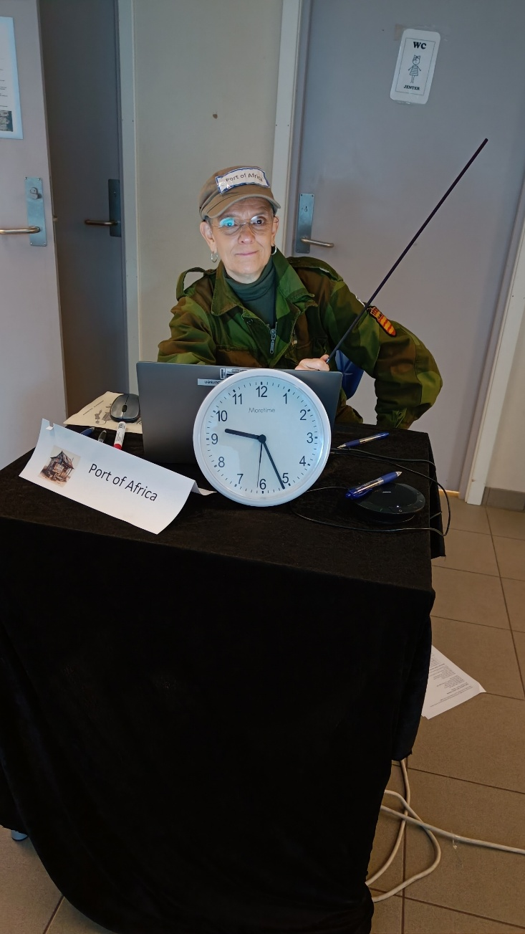
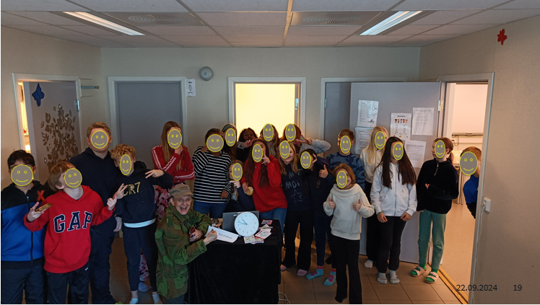
Around the World: travel together to each continent
North America
South America
Oceania
Asia
Africa
Norway
Notes:
North America
South America
Oceania
Asia
Africa
Norway

Slide 19


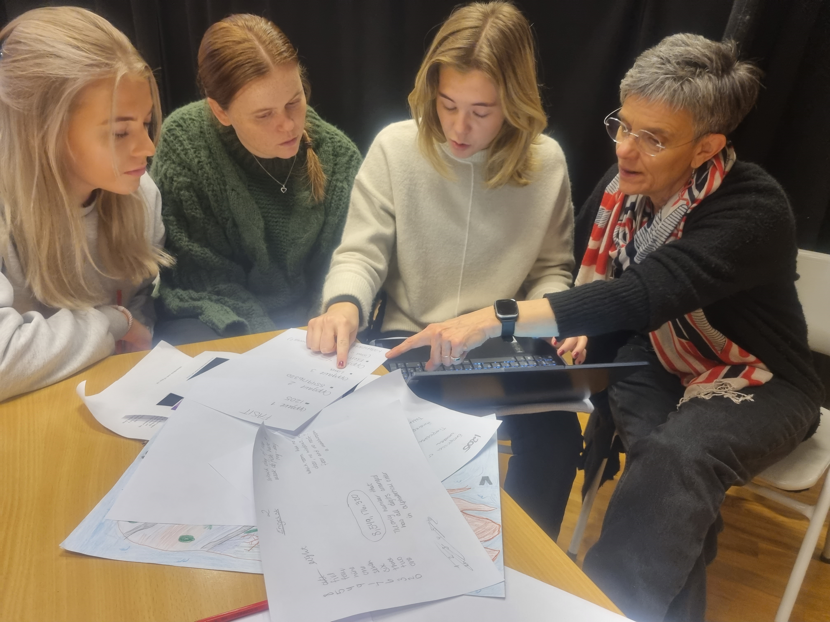
Storyline and escape room- Chapter on inclusion
Storyline Demokrati og medborgerskap
Mellomtrinn
(coming soon!)

Slide 20

Thank you!
Dette bildet av Ukjent forfatter er lisensiert under CC BY-SA

