Slide 1

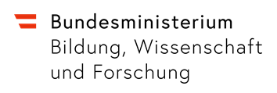

Country Report Austria
State of current developments
INNLAC Meeting 2019, Budapest

Slide 2
Main Issues in Austria
Current developments at the ÖSZ / in Austrian education
  Digital tools and competencies
  Transition from German as a Second Language the Language of Schooling
ECML project call
Teacher education in Austria
  Teacher education
  Teacher training

Slide 3
Current developments: Digital tools & competencies
National plan for the enhancement of digital education („Masterplan Digitalisierung“)
  Field of Action 1: Curricula and learning contents
  Field of Action 2: IT management and equipment
  Field of Action 3: Teacher training
Development of materials and strategies in line with requirements for the use of digital tools within schools (open and free tools, no use of commercials)
Challenge: different degrees of familiarity with digital tools amongst teachers and lack of resources (tablets, wireless lan)

Slide 4




ÖSZ developments: eRom
Use of digital tools in language learning
Focus on French, Italian, Spanish (2nd foreign language)
www.oesz.at/erom

Slide 5
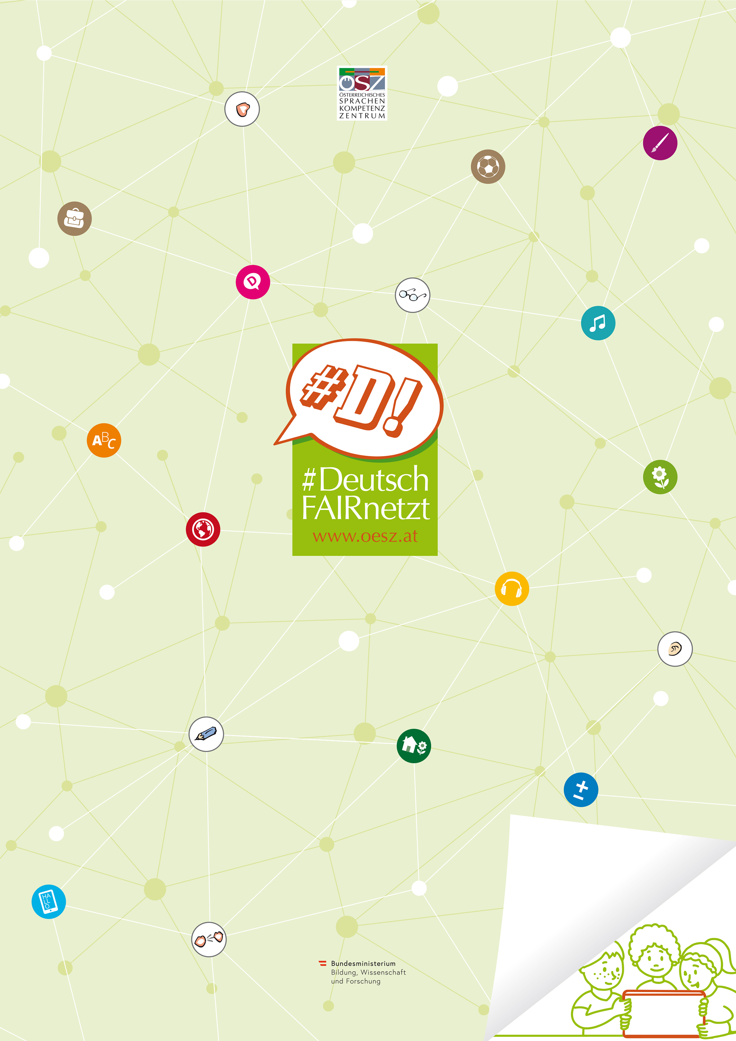
ÖSZ developments: #Deutsch FAIRnetzt
Focus on transition processes from 2nd language learning to language of classroom
Sensibilisation and materials for fair(er) opportunities in a whole-school perspective (students, teachers of different subjects, school)
Materials development:
  Poster on school development
  Non-digital materials for quick, differentiated speaking activities
  Digital materials for further activities
www.oesz.at/deutschfairnetzt

Slide 6

ECML Project call
5th ECML Programme ends in 2019
Call for 6th ECML Programme for 2020-2023
Promotion and dissemination activities for project call:
  Website and Social Media
  National promotion event at the ECML, Graz
  Analysis paper for Austrian language education experts and practitioners „ECML projects in a nutshell“
www.oesz.at/ncp

Slide 7
Initial teacher training in Austria
Teacher education reform started in 2009 in line with Bologna reform
Until 2015
From 2015
Teacher education for different school types institutionally separated:
  Primary school (Volksschule) & secondary lower school teachers (Hauptschule/Neue Mittelschule)
  > Practice-oriented during studies, at Schools of Education, less academic
  Secondary academic school teachers (Gymnasium)
  > Academic; at university; student teacher year after graduation
Cooperation of Universities and Schools of Education in four regional clusters
Initial teacher training courses as Bachelor and Master Degrees
One-year induction phase after Bachelor level, need to complete Master within 5 years
Source: Website of Ministry of Education, Science and Research. (Link)

Slide 8
Further teacher training (1): General information
Training of up to 15 hours per year outside teaching hours can be made compulsory since 2013
Schools of Teacher Education (Pädagogische Hochschulen) in charge of teacher training (not universities)
Organisation of Austrian teacher training ist characterized by:
  Headteachers as pivotal point in staff and school development („school autonomy“);
  Schools of Teacher Education in close contact to stakeholders (schools, region, regional administration, Ministry of Education, Science and Research);
  Lack of support staff relevant for school and instructional development.
Challenge: accelerated, large-scale and on-going re-structuring of school administration and processes in Austria.
Source: National education survey 2018 (Link)
Notes:
Generell: kaum empirische Befunde; keine Informationsmöglichkeiten, auch seitens Schulaufsicht; Schulleiter/innen können Infos über die WB ihrer Lehrer/innen abrufen.
Mit Dienstrechtsnovelle 2013 mit Möglichkeit, alle Lehrer/innen zu FB von max. 15 Stunden pro Jahr außerhalb der Unterrichtzseit verpflichten zu können (davor nur Pflichtschule, eklatante Unterschiede); wird noch weiterbestehen da nur im neuen Dienstrecht verpflichtend

Slide 9
Further eacher training (2): Formats
Variety of formats on offer
  Standard training courses at Schools of Education at federal or regional level: different topics, one to two days, individual teachers enroll; popular topics:
    Teaching students with special needs,
    Learning and teaching methods in subjects,
    Dealing with disciplinary problems.
  School-internal training (SCHILF): topics relevant teachers or staff of one school
  Trainings across schools (SCHÜLF): teachers of several schools attend
  Training and master degrees: several semester courses (e.g. educational leadership, gifted education, transition, literacy,…)
  Participating in (action) research and development projects
Notes:
Generell: kaum empirische Befunde; keine Informationsmöglichkeiten, auch seitens Schulaufsicht; Schulleiter/innen können Infos über die WB ihrer Lehrer/innen abrufen.
Mit Dienstrechtsnovelle 2013 mit Möglichkeit, alle Lehrer/innen zu FB von max. 15 Stunden pro Jahr außerhalb der Unterrichtzseit verpflichten zu können (davor nur Pflichtschule, eklatante Unterschiede); wird noch weiterbestehen da nur im neuen Dienstrecht verpflichtend

Slide 10
Teacher training (3): Figures
A little more than 2/3 of Austrian teachers participated in one to two training courses
More than 50% of registrations from primary and lower secondary school teachers
Strong preference for short, one-shot trainings: 80% of training courses last 1-2 half-days
Discrepancy in readiness to attend trainings:
  83% of teachers would attend half-day trainings; 90% of head teachers
  > challenges are staff management (substitute lessons) and lack of effectiveness (input,
  practice, reflection)
  50% of teachers would attend 2-3 half-day trainings; 64% of head teachers
Notes:
Analysis of Schools of Education 2014/15

Slide 11
Teacher training (4): Implications
Need to have longer/repetitive formats, in which teachers get to reflect practices, receive feedback and coaching.
Focus on combination with e-learning/virtual course formats (e.g. offers by Virtual School of Education)
From individual training towards cooperative formats relevant for schools;
Professionalisation of head teachers;
Organisation of teacher training outside working hours.

Slide 12
Thank you very much for your attention!
Elisabeth and Gunther
www.oesz.at
www.sprachsensiblerunterricht.at

