Slide 1

Mette Skovgaard Andersen
Hanne Wacher Kjærgaard
Directors NCFF (east & west)

Slide 2
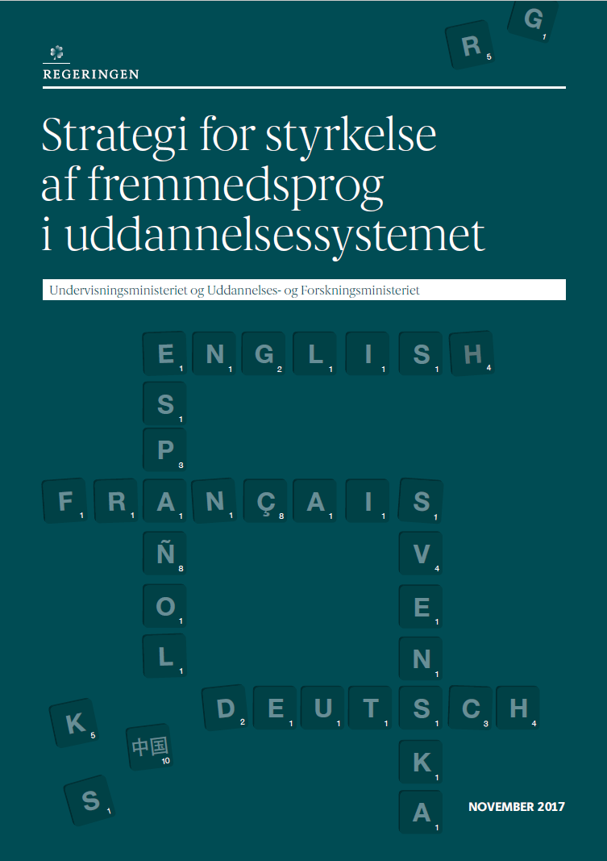
The National Strategy for Foreign Languages
Late 2017
Other countries before
  Norway 2005
  England 2002
  France 2016
  Ireland 2016
Norge and Denmark are often compared

Slide 3
Aims of the strategy
An overall view of foreign languages in the educational system
Provide support for initiated reforms and other initiatives
Start new initiatives
Increase motivation for languages
Promote ”good” language teaching
Increase coherence along educational levels
Increase the relation between subject areas and languages
Notes:
The aims are the following
You might think that the politicians making the policy already did that, but nobody has done that before us – the Danish educational system for foreign languages is steered by two ministries – the ministry of education steering the Folkeskole and and the Gymnasium and the ministry of of education and research steering the universities and the professionshøjskoler (university colleges)
Reforms – like for instance a newly implemented Gymnasiereform
MOTIVATION How? What we know from research is that one of the most important motivational factors are good teachers that understand their pupils and students
Very important to know what that is. We know a little but we need more knowledge – good language teaching is very dependent on purposes with the teaching
The coherence along the educational system is not good enough. We know that the different levels hardly know anything about each other – and more aggravating they do not seem to be very interested.
Also with regards to the cooperation and relation between subject areas and languages you could wish for a lot more integration

Slide 4
The educational language teacher circle
University. colleges
‘Folkeskole’ 0.-9. grade
‘Gymnasier,
10.-12. grade
Job/Education
Job/Education
Universi-ties
Job/Education
Notes:
Teacher education is – as you can see – very central to the strategy. In Denmark teacher education is divided into two – universities educate teachers for the Gymnasiums/upper secondary schools (10.-12. grade) and the so-called professional colleges educate teachers for Folkeskolen (from 0.-9. grade). What we know from research and investigations is that the teachers of foreign languages in both high school and lower secondary school/folkeskolen are not always equipped to tackle the challenges they meet in school, be it pedagogical, didactical or linguistic challenges. In Folkeskolen the teachers lack proficiency and fluency in their language and many teachers lack new pedagogical knowledge about language acquisition – having been teachers for a long time, i.e. they need continuing professional development In high school the teachers tend to teach a lot of literature and text analysis meaning that the high school students are taught more or less the same in all foreign language classes just in different languages. Consequently, the students have difficulties understanding what they can use the languages for and they do no choose foreign languages as study object. This is a very bad circle that we will have to break because the whole educational system is interdependent with regards to foreign languages. I have tried to illustrate this: Students from Prof. Colleges teach in Folkeskolen and students from Universities teach in Gymnasium and their teaching is very important to the students’ choises. In the national centre we realise that we do not have time for waiting for the teacher education to be adjusted but have to focus also on CPD even though we will not offer courses ourselves.

Slide 5

Aims of the strategy
”Aim no. 1: More students (all levels) should choose foreign language (FL) subjects and achieve substantial language competences in FL subjects in addition to English
Aim no. 2: Language programs are to be academically strong and relevant programs which attract and retain the strongest, most able students. This is also the case tor teacher training.
This strategy and the initiatives in it will not, in themselves, solve the challenges we are facing in the area of languages. It is a long haul that must be anchored in the municipalities and the educational institutions, but it is our hope that we may now, by collaborating, turn the negative development around.

Slide 6
The Initiatives in the strategy
National center for foreign languages (appr. 100 mio. – 5 years!)
Encourage local language strategies – municipalities and educational institutions
Educational ”experiments” in teacher education and at universities
Master’s - Conference interpreting
Mapping of existing opportunities for language education
Småfagsråd

Slide 7
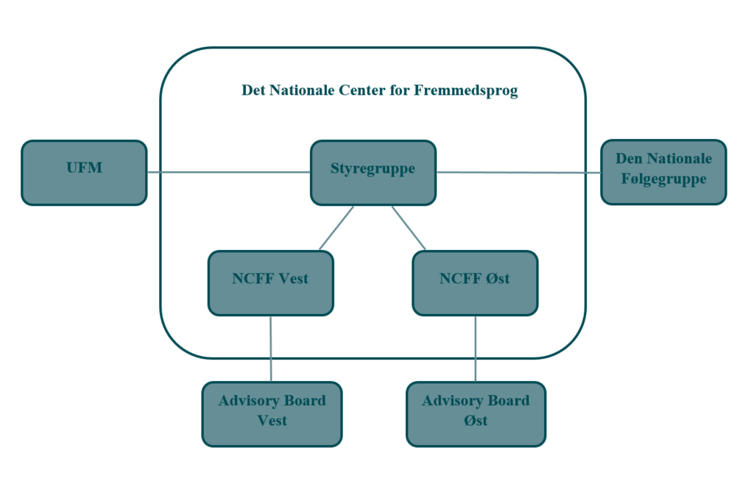
Det Nationale Center for Fremmedsprog - NCFF
National
Has two homes but is independent
  Hanne Wacher Kjærgaard, west
  Mette Skovgaard Andersen, east
As far as at all possible, act as one:
  Joint initiatives
  Coordinated initiatives
  Local initiatives
Steering committee and ”monitoring” group, two ministries
Two advisory boards

Slide 8
The tasks of the center
Improve (”Løfte”) the language ‘area’ as such
Provide info on relevant R&D
Carry out quality assurance initiatives and contribute to the raising of quality
Facilitate knowledge sharing and the development of PD
Build strong collaborative relations and networks
Facilitate the upkeep of language competences
Support/facilitate language ‘offers’ in non-language educational programs (add-on competences)
Gather and share knowledge of language components in other educational programs
Contribute to the development of local language strategies

Slide 9
Status
Stakeholder involvement from the start
  Language teachers at all levels, students, educational institutions, municipalities, businesses, politicians, society at large
Principles for funding established
www.ncff.dk
Facebook page
Advisory boards established
Steering committee meetings
“Annual” report 2018
Action plans for 2019
Ambition: from activity center → resource center

Slide 10
Initiatives….
Inspirational (local) seminars for K-13 teachers
Annual conference (transitions)
Investigations into needs of teachers (DE, FR, ES)
Development of diploma module for FLT at K-13 level
(Co-)Administration of bilateral exchange programs
(FR, ES, (DE))
#UpWithLanguages day
Generation Global (Erasmus+)
ECML – support for applications
Practice placements abroad – support for language and intercultural competences
Compilation of “good stories”
Two interns
Business life involvement and investigations into needs
Sharing of results from FL pedagogical master’s theses
Project development support

Slide 11
Obstacles and barriers at various levels
Primary and lower secondary (K-10):
The different status of English, German and French → often only German
Late start of second FL
Language view, pedagogy and aims differ from those of the Gymnasium (lack of progression, integration and need to build bridges)
Teacher identity (not language teacher identity)
Upper secondary (10-12):
Many technical restrictions to languages at high level
Few study “programs” with languages (studieretninger)
Few collaborations among language teachers and between language teachers and teachers of other subjects
Authenticity
Notes:
So far NCFF has tried to get an overview over the problems and tried to find out, what to do and how to do it. In order to get this overview and building networks we have had a lot of meetings with all kinds of stakeholders from the whole educational system. The meetings have pointed to several other major challenges at the different levels, some of these challenges are structural and in principle we cannot do anything about them expect for pointing to them and some of them are of different kinds.
In Folkeskolen the different status of English, French and German has huge impact on how many classes have German and French. In reality often only German is offered and even though it is nice that German is now offered from the 5th grade it might still be rather late. From the 7th grade electives in other languages can be offered, but they are not always established and with yet another recent reform these foreign language electives are most likely to disappear. Also the language view, pedagogy and aims differ from those from the gymnasium and in general there is a lack of progression and bridging from one level to the next. and also within levels.This goes for all levels and NCFF is therefore in the next year going to focus much on bridging the different levels and interests, horizontally and vertically . Many young people have the experience when going to Gymnasium that everything they learned in Folkeskolen was wrong. This is not very motivating. In Gymnasium there are many restrictions that have an influence on the language choice. In Denmark we have three language levels in Gymnasium A-B and C, C being one year, B two years and A three years. Students have to have English at at least B-level. But they also have to choose whether they want to pursue a language already known or a beginner’s language. As the first: Many choose German, some French, few had Spanish in Folkeskolen. As the second: Other languages can be offered like Russian, Italian, Japanese and Chinese but if they chose these languages they have to study these languages at A-level and there must be students enough to offer these languages. In Gymnasium we have different bundles of study object and only af few of these socalled ‘studieretninger’ have build-in languages. From our meetings we also knew that the teachers would like to learn more about concepts like CLIL and learn how the language teaching gets more authentic.

Slide 12
Obstacles contd….
Professional colleges:
Only 30 ECTS → lack of fluency and confidence in speaking/writing
Recruitment
Universities:
Recruitment
Relevance?
Literature
History
Language and culture
Notes:
In teacher education at the university colleges one big problem is that the amount of hours offered for language teacher education is not big as they only have 30 ECTS for languages. This means that many teachers don’t feel comfortable speaking and writing the languages. The biggest challenge is however the recruitment. Far too little young people want to become language teachers. This is a very big problem because many of the present teachers are middle aged and more than middle aged.
The primary challenge at university level is also a recruitment one. This is of course closely related to the experience of the student not being able to see the relevance of the programmes offered. University programmes of the traditional languages german, french, english and spanish are generally conceptualised from a philological tradition and seen from a native speaker perspective with which many students do not identify themselves. With other words there is a mismatch between the students’ expectations and the programmes offered.
For NCFF this all means that we have some fundamental problems to resolve: bridging the gaps between the levels, discussing the concept of relevance, discussing the aims and the content of language education, meaning that we need a discussion about what it does mean to study a language and if we should reconsider the philological approach. And every discussion should take its starting point in the fact that we want to strengthen language competencies and language education in Denmark.

Slide 13
How?
Because of present situation NCFF will in the beginning be action oriented
NCFF has financial resources
  For development projects that can further the language competences and the language programs in Denmark
  Two pools of funds (open themes and restricted themes)
    Local language strategies
    The identity, didactics and language view of the subject areas
    The cognition of language students and pupils
    CLIL
    The need for foreign languages
Notes:
How will we work. Because the language milieus have been under a great pressure for a long time NCFF has decided to follow an action oriented strategy in the beginning, meaning that we will start a lot of projects to gain knowledge of what works and what doesn’t. We have some financial resouces for ..
We work with two pools – one that is open for suggestions and one where we want different projects to be done, for instance with in…
We hope to be able to offer packages for the stake holders: how to…packages that can be easily implemented and that are tested and evaluated.
After the end of the 5 years period we hope to have become such an important voice and knowledge pool that nobody would dream of not letting us continue the good work and dream of implementing any reforms or major changes in FL education without consulting us.

Slide 14
Dilemmas…
Research and development – how to prioritize funds?
Should we prioritize (funds) one level over the others?
Should we prioritize some languages over others?
Should we prioritize top down or bottom up initiatives?
Should we prioritize many small or few large projects?
Should we stay action-oriented or should we aim to be a research and knowledge based institution?
How should we prioritize language education per se and language-involving programs?
Should we trust people’s (organizations’, individuals’) own perceptions of language needs?

