Slide 1
Nuffic
The dutch organisation for internationalisation in education
Meet the world.
Marie-Louise Lubbers, 10 juni 2024
Notes:
Nuffic is the main expertise and service centre for internationalisation in Dutch education, from primary and secondary education to higher professional and academic higher education and research
Strengthening French and German language education
LinQ and Van assistant tot docent

Slide 2
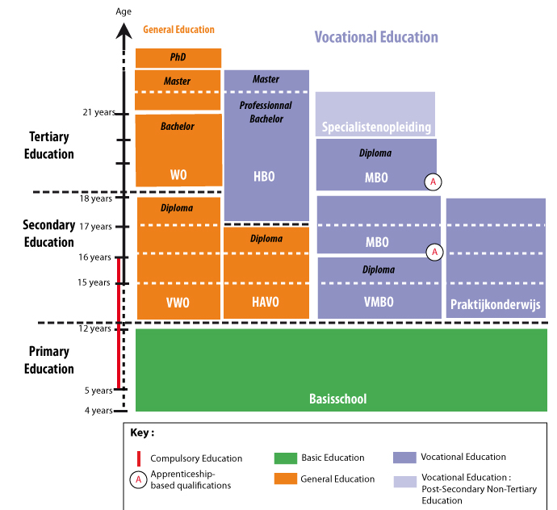
Schoolsystem

Slide 3
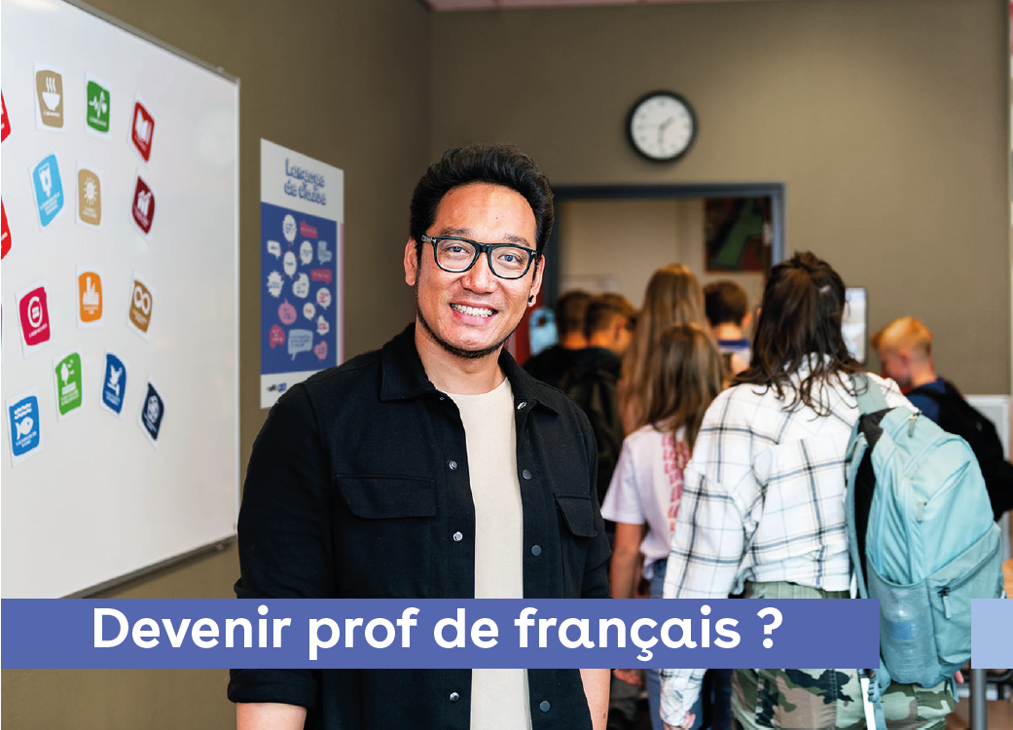

Becoming a language teacher in NL
Secundaire schools
University of applied sciences or University
Subject
Students between 12 and 18

Slide 4
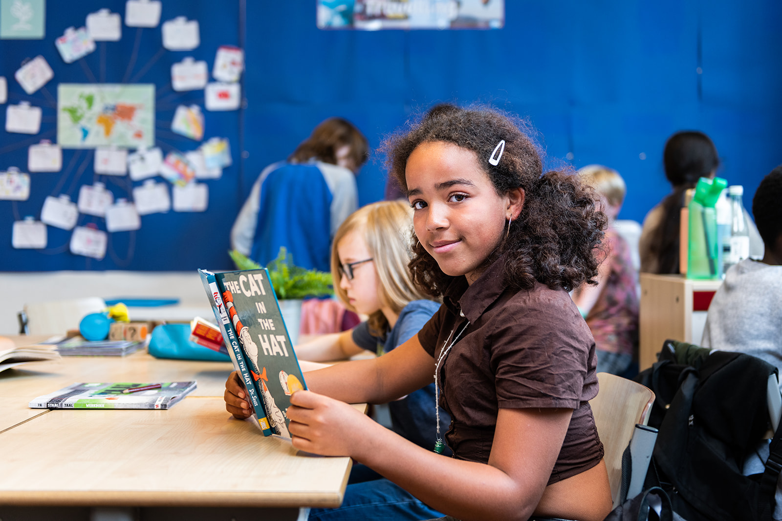
Language subjects
Secundaire schools
Keysubject and electivesubject
Secundaire schools English, German, French
Other languages Greek, Latein, Spanish, Turkisch, Arabic, Fries etc.

Slide 5
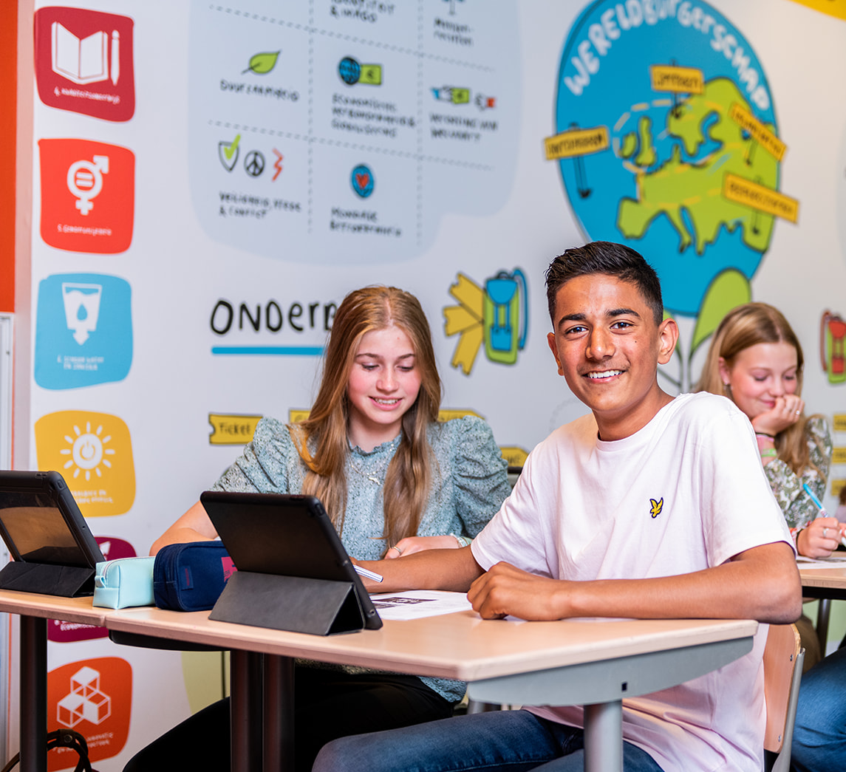
Issues
Workload
Pedagogical challenges
Examens – curriculum
Temporary contracts
“Teacher leak”
Shortage

Slide 6
Shortage German and French
 | 2023 | 2028 | 2033
German | 6,4% | 11% | 15%
French | 5,3% | 13% | 21%
Degrease fulltime students
Lateral entry program in goverment

Slide 7
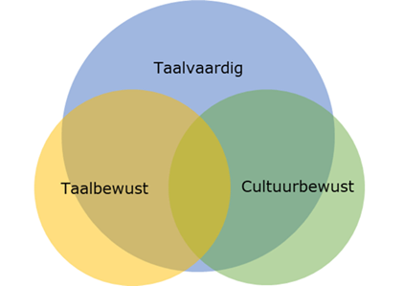
Renewal Examprogram
All Modern foreign languages
Made working teacher groups, university and SLO
Languages skills
Languages awareness
Cultural awareness
Notes:
Languages awareness
Cultural awareness

Slide 8

LinQ program
Building blocks
Communicative language
Use of authentic language situations
Doeltaal – voertaal (Target and main languages)
Attention for Land, cultural awareness and current affairs
CEFR

