Slide 1
Presentation of Østfold University College

Slide 2
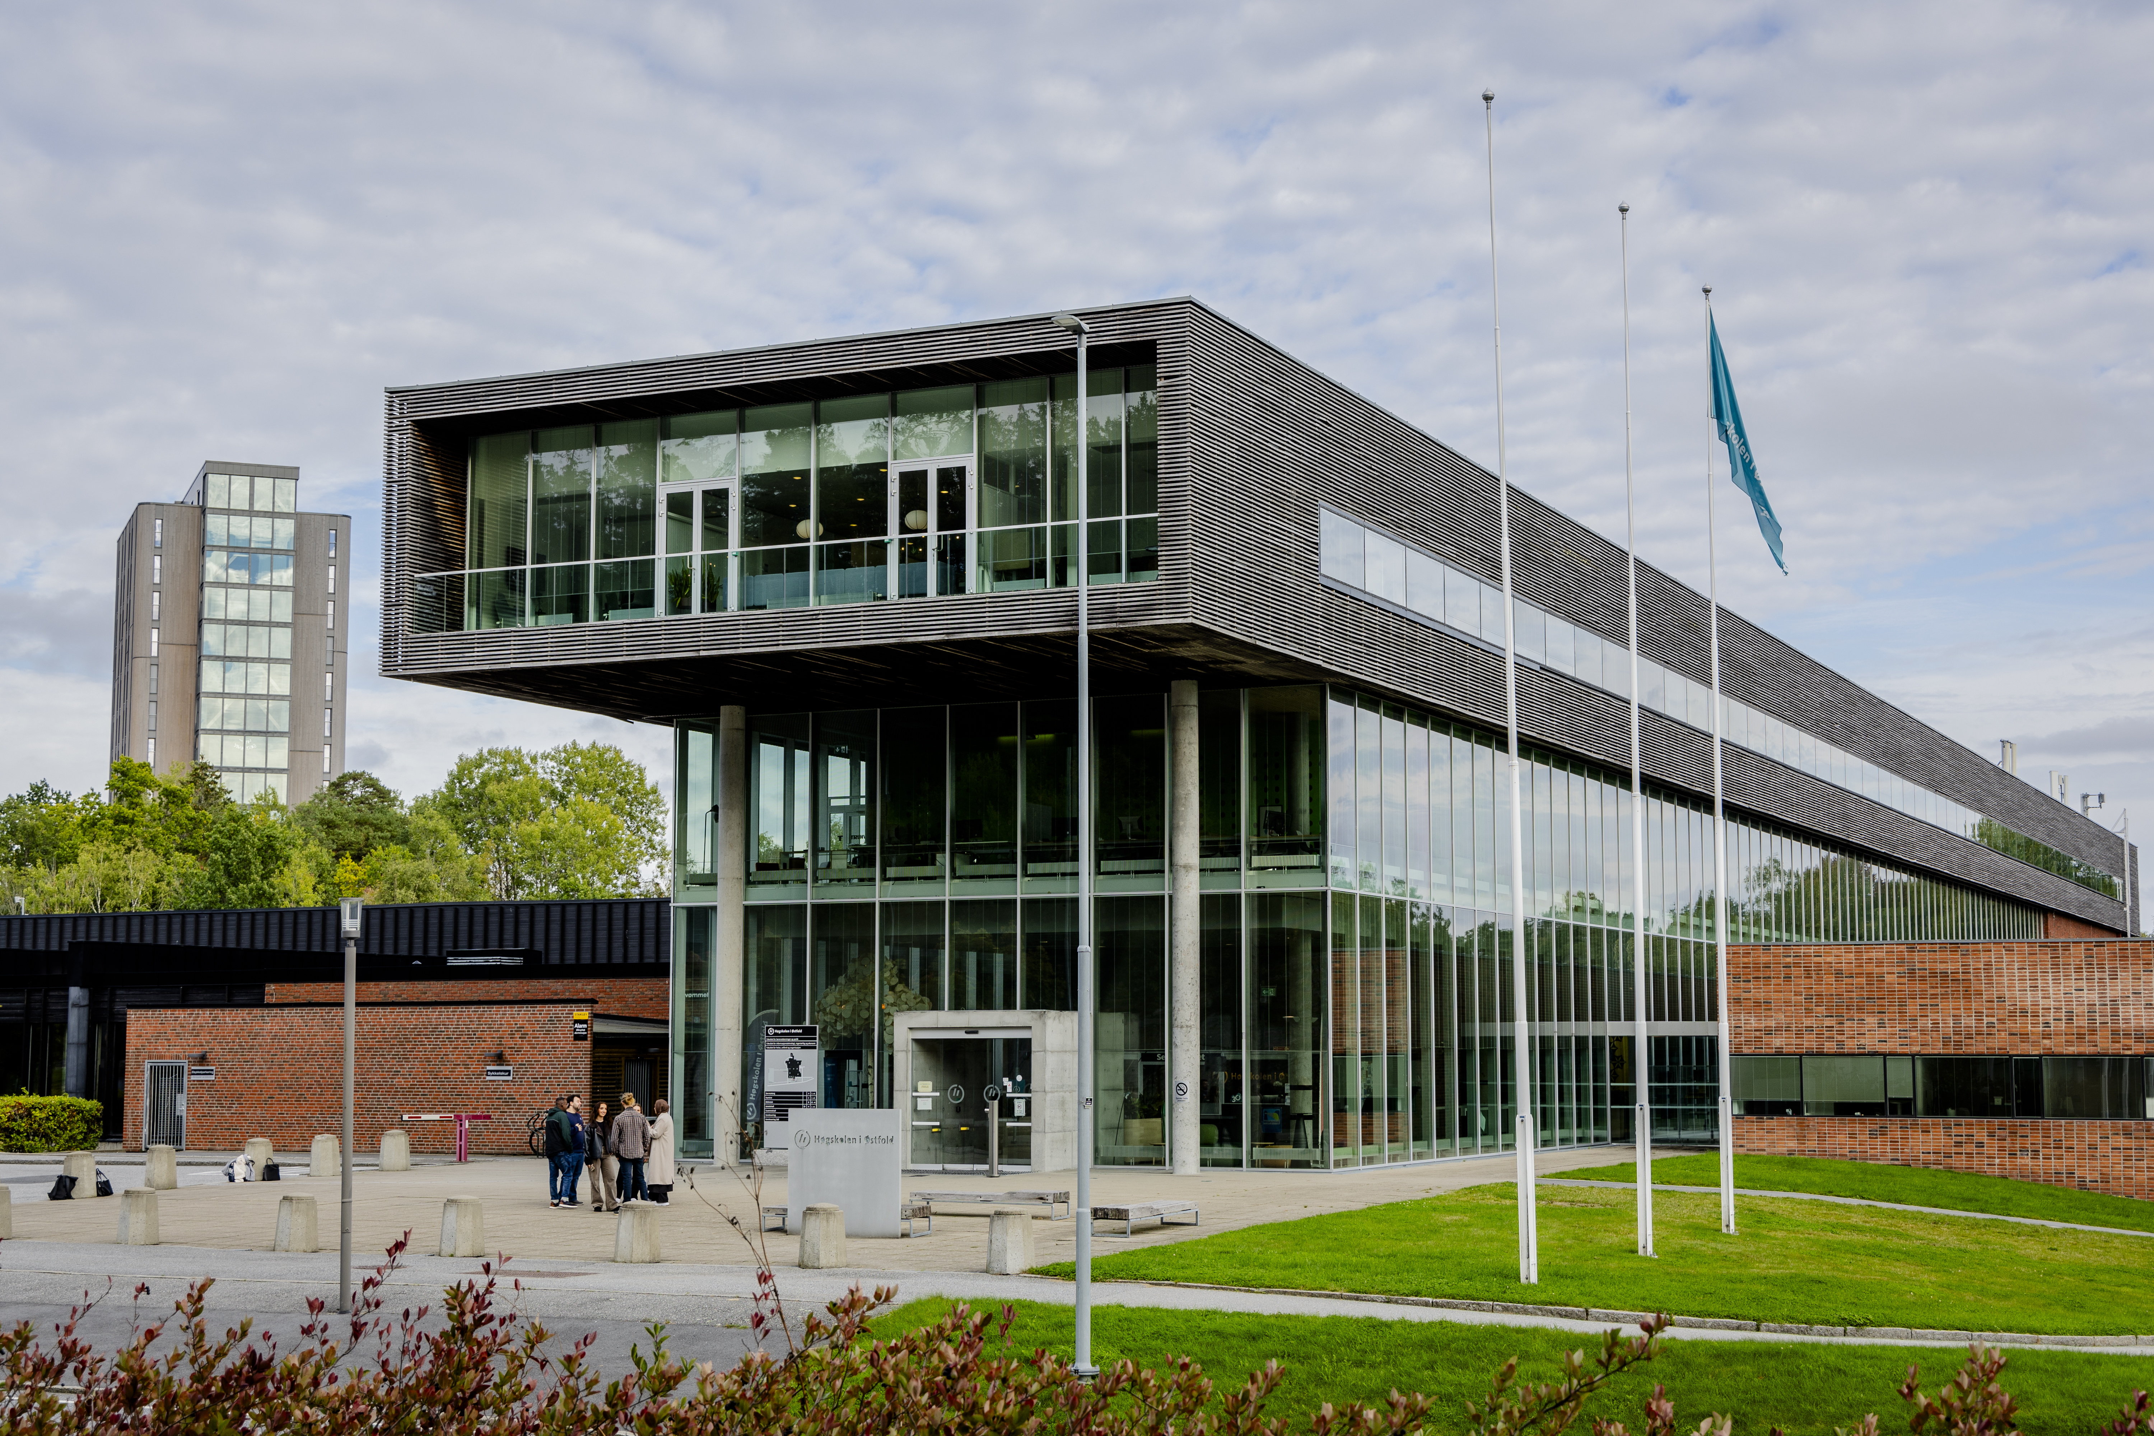
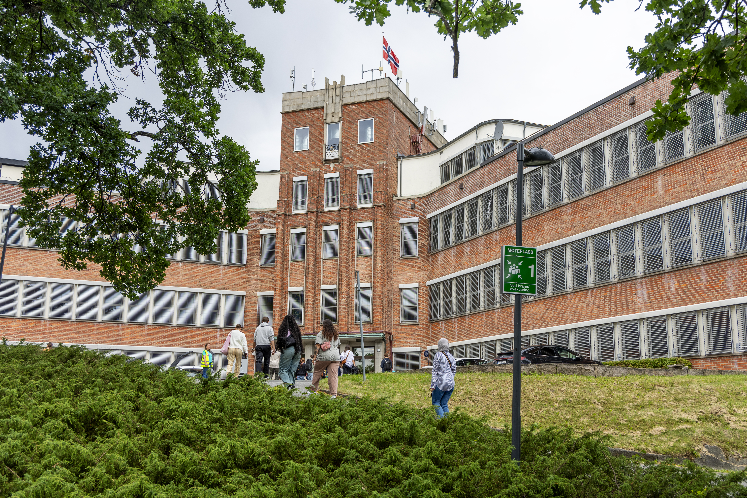
About Østfold University College
Over 100 study programs in Halden and Fredrikstad.
Over 7,100 regular students and approx. 650 full-time equivalents
The Rector is the university college's highest leader
Research focus areas:
  The Digital Society
  Language in Education

Slide 3
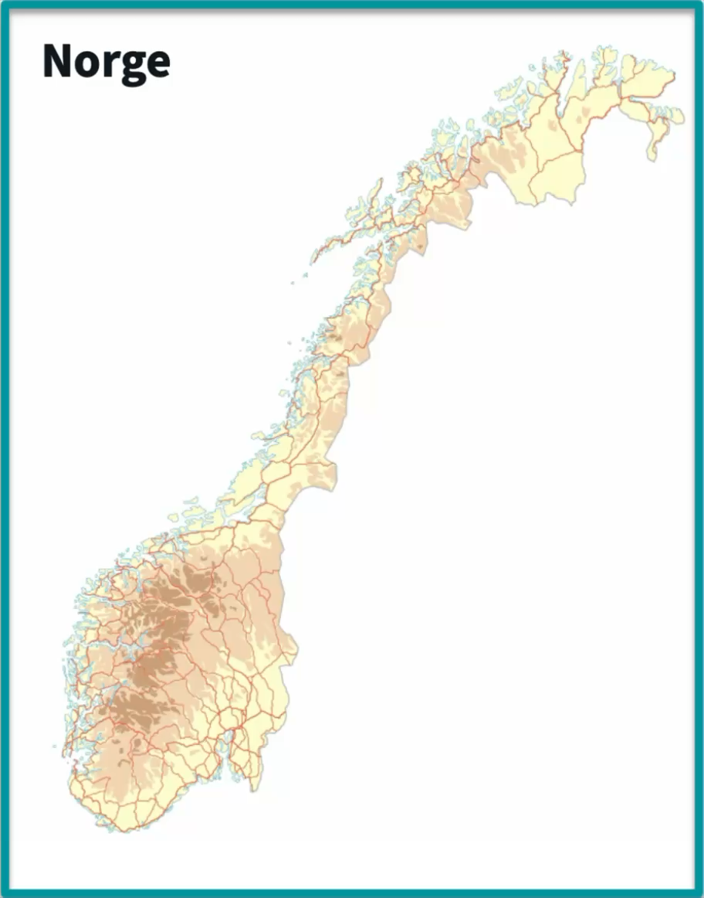
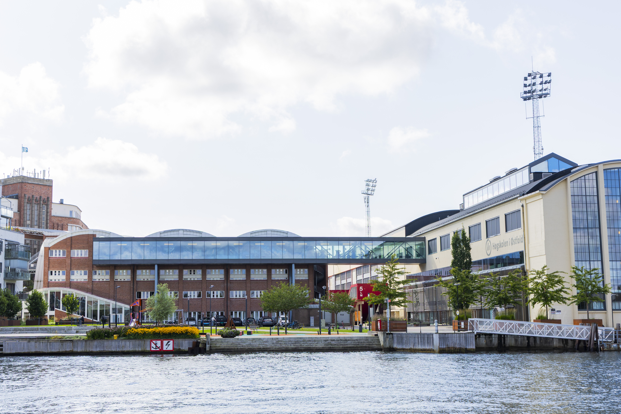
Where are the campuses?
Campus Fredrikstad
  1 hour from Oslo
  30 min from Sweden
Campus Halden
  1,5 hour from Oslo
  5 mins from Sverige

Slide 4
Leadership | Key Figures | Vision

Slide 5
Knowledge for human development and a sustainable society
Vision of Østfold University College

Slide 6
Board and Leadership
The University Board is the highest governing body
  External chair: Anne Borg, appointed by the Ministry of Education
  Composition:
    3 external members (appointed by the Ministry)
    4 academic staff members
    1 technical-administrative staff member
    2 student representatives
The Rector is the board secretary
The college has a hired Rector and two Pro-Rectors (all on fixed terms)

Slide 7
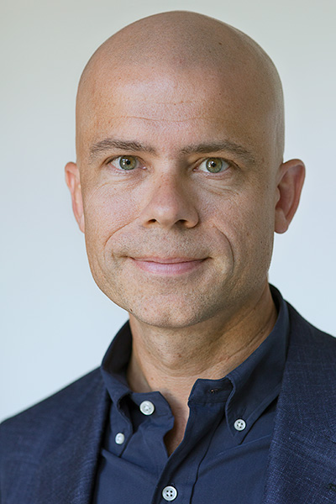
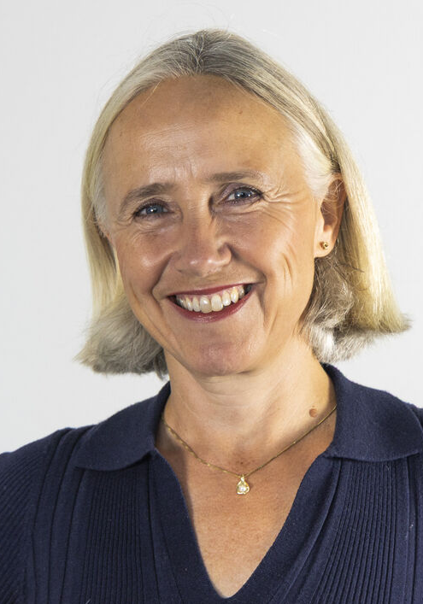
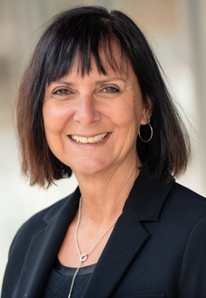

Leadership Team
Lars-Petter Jelsness-Jørgensen, Rector
Ellen-Marie Forsberg, Pro-Rector for Research
Elisabeth Jeppesen, Pro-Rector for Education and Community Engagement

Slide 8
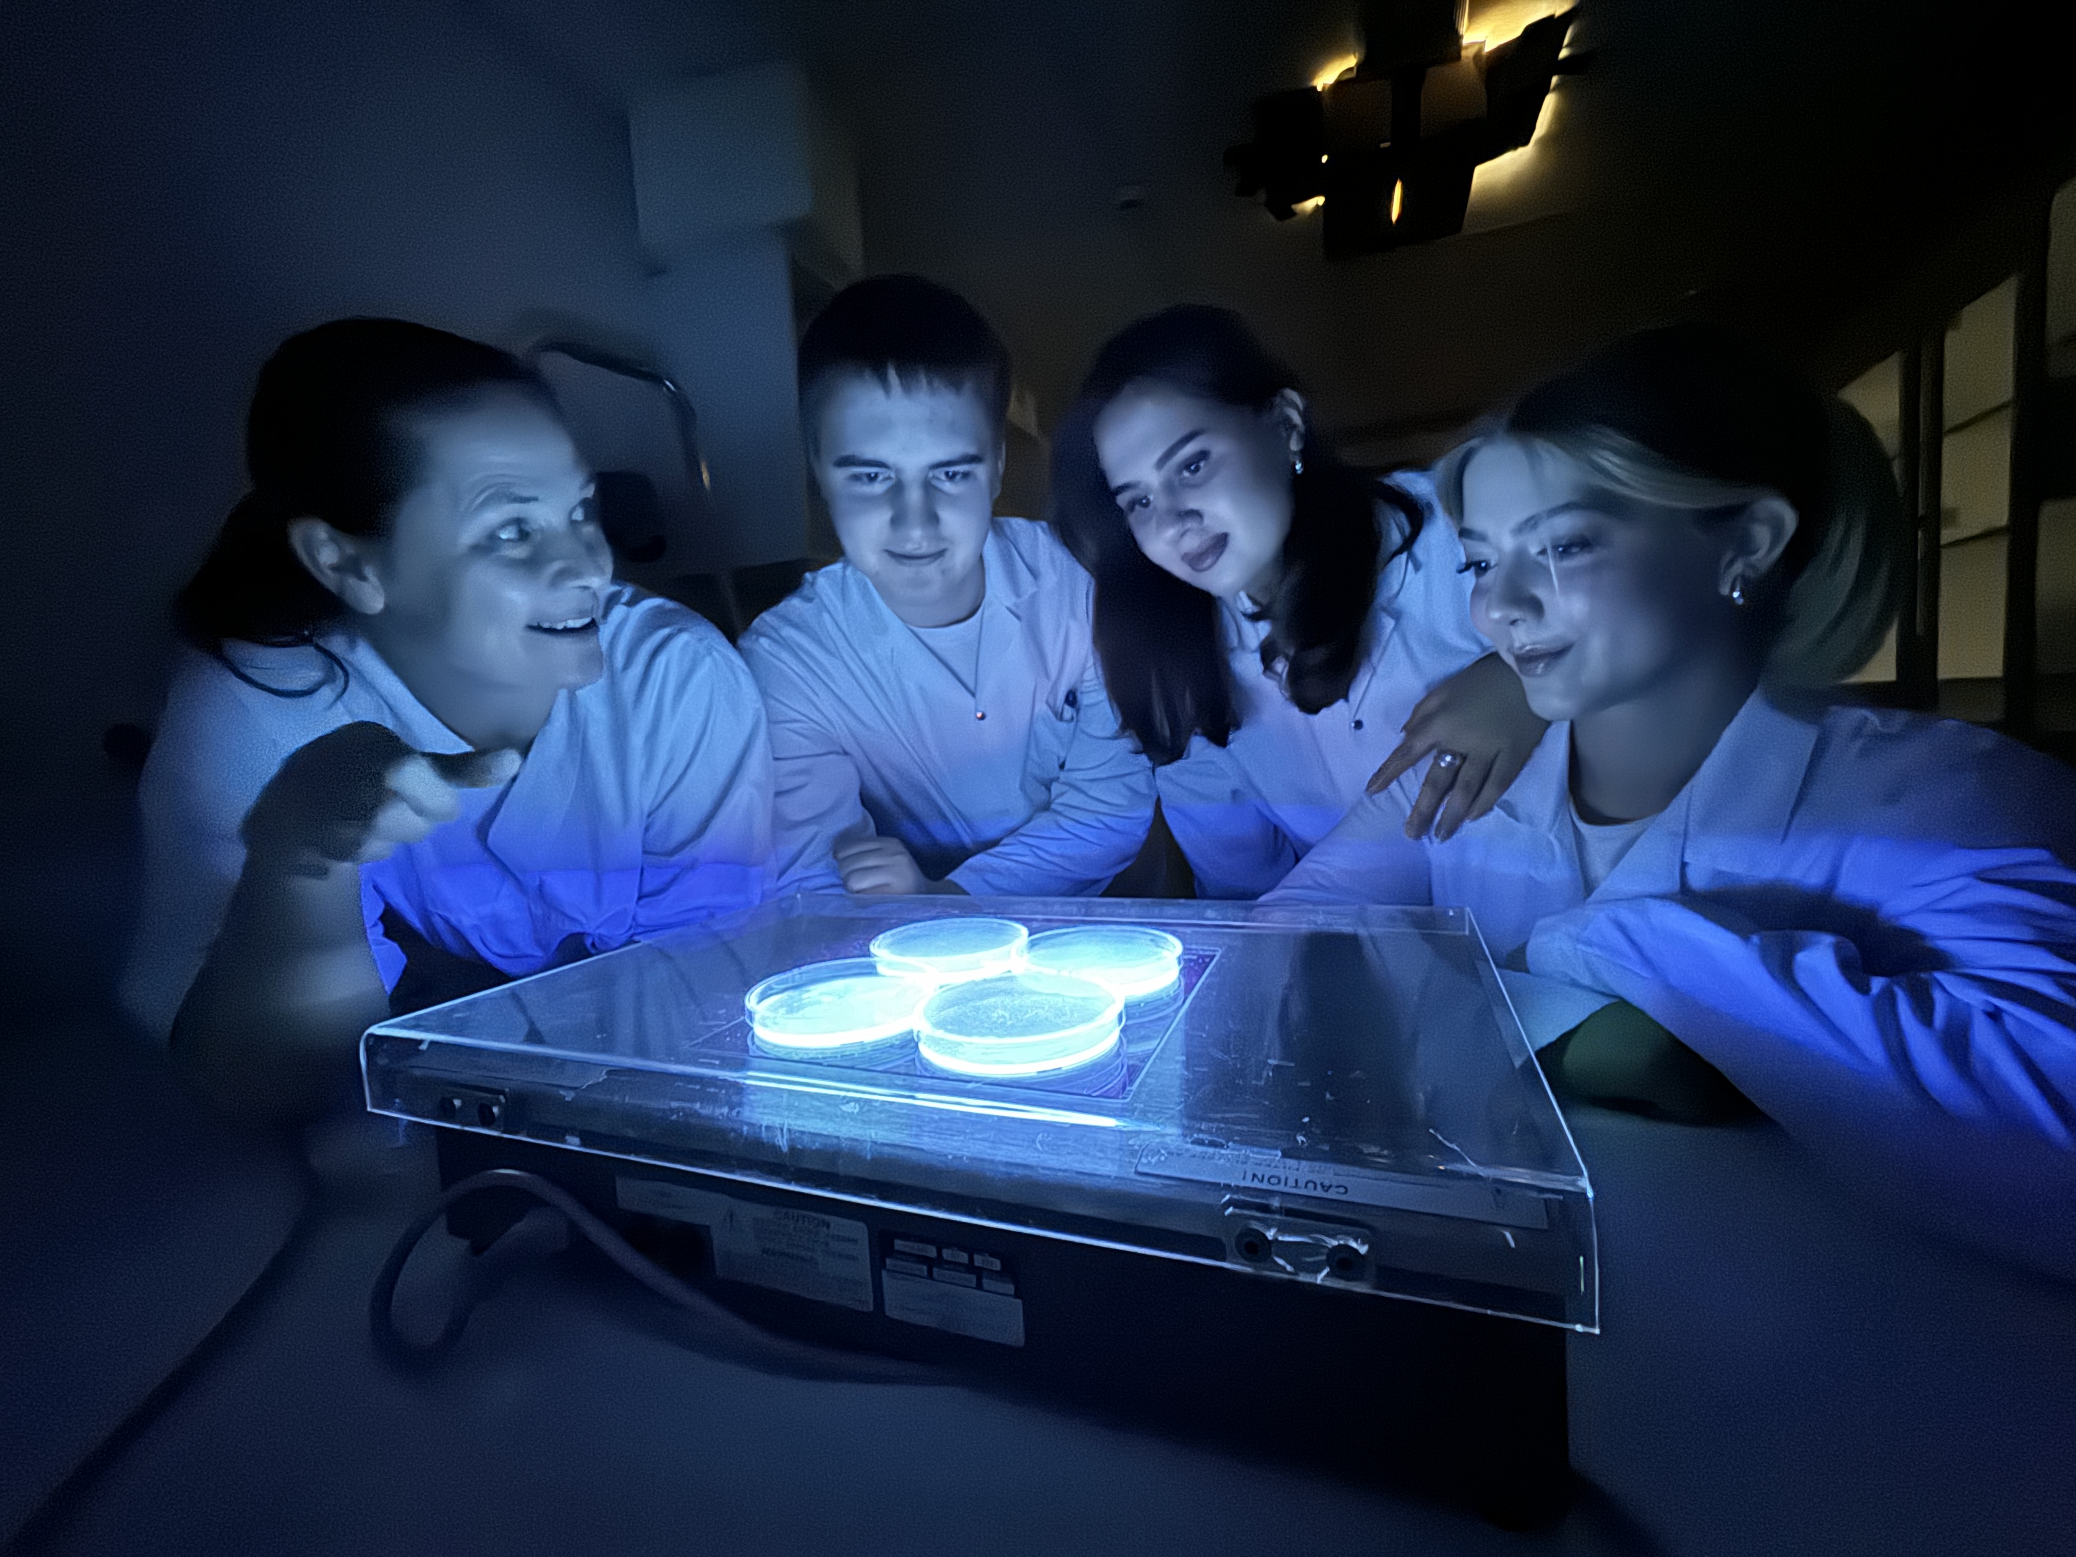
Research and Development
Staff conduct applied research, professional research, basic research, and/or development work
Activities are carried out in collaboration with regional, national, and international partners

Slide 9
Academic Structure:
3 faculties
8 departments
1 national center

Slide 10
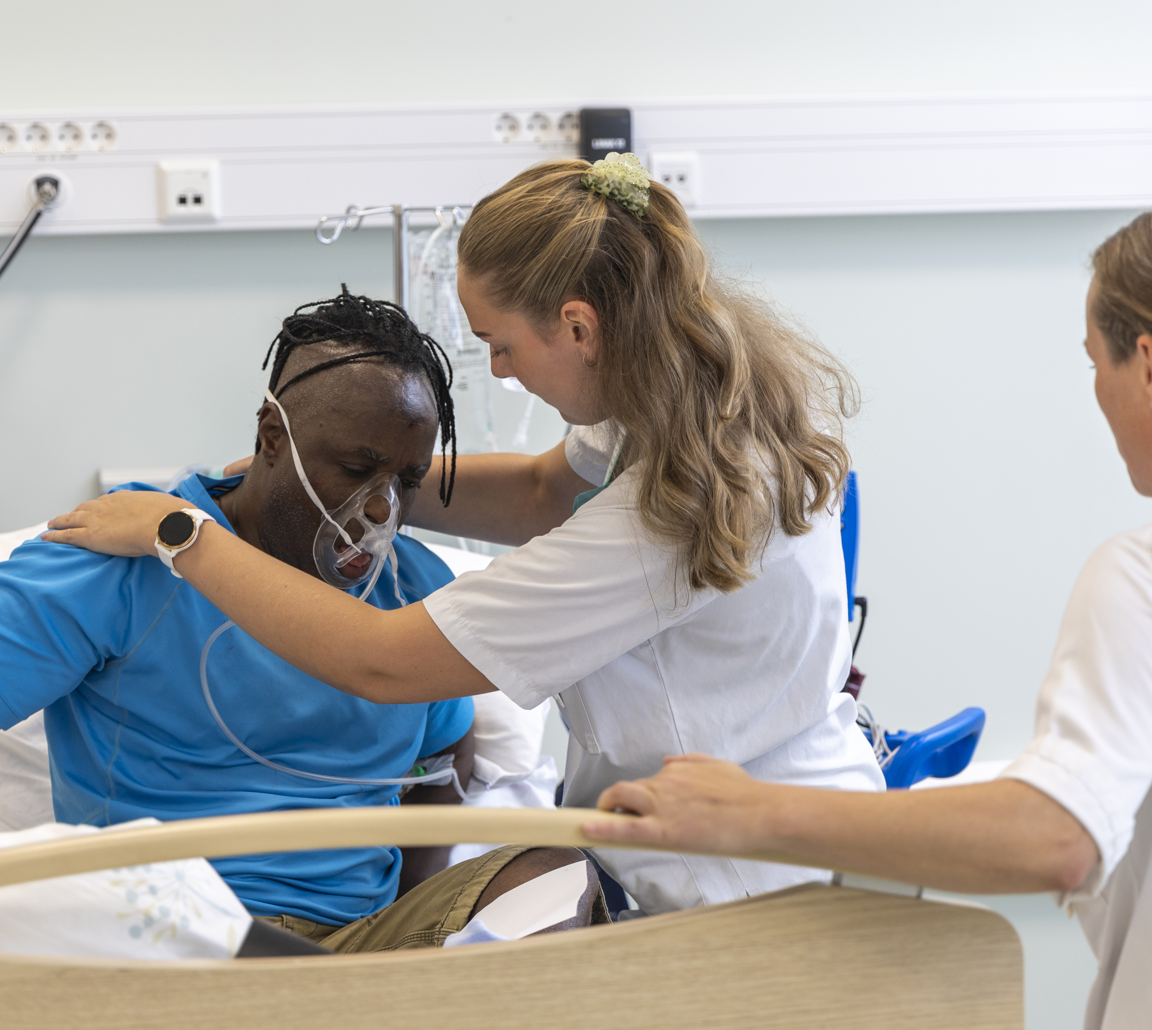
Faculty of Health, Welfare and Organization
Department of Nursing, Health and Laboratory Science
Department of Welfare, Management and Organisation
SimFredrikstad: One of Norway’s largest simulation centers

Slide 11
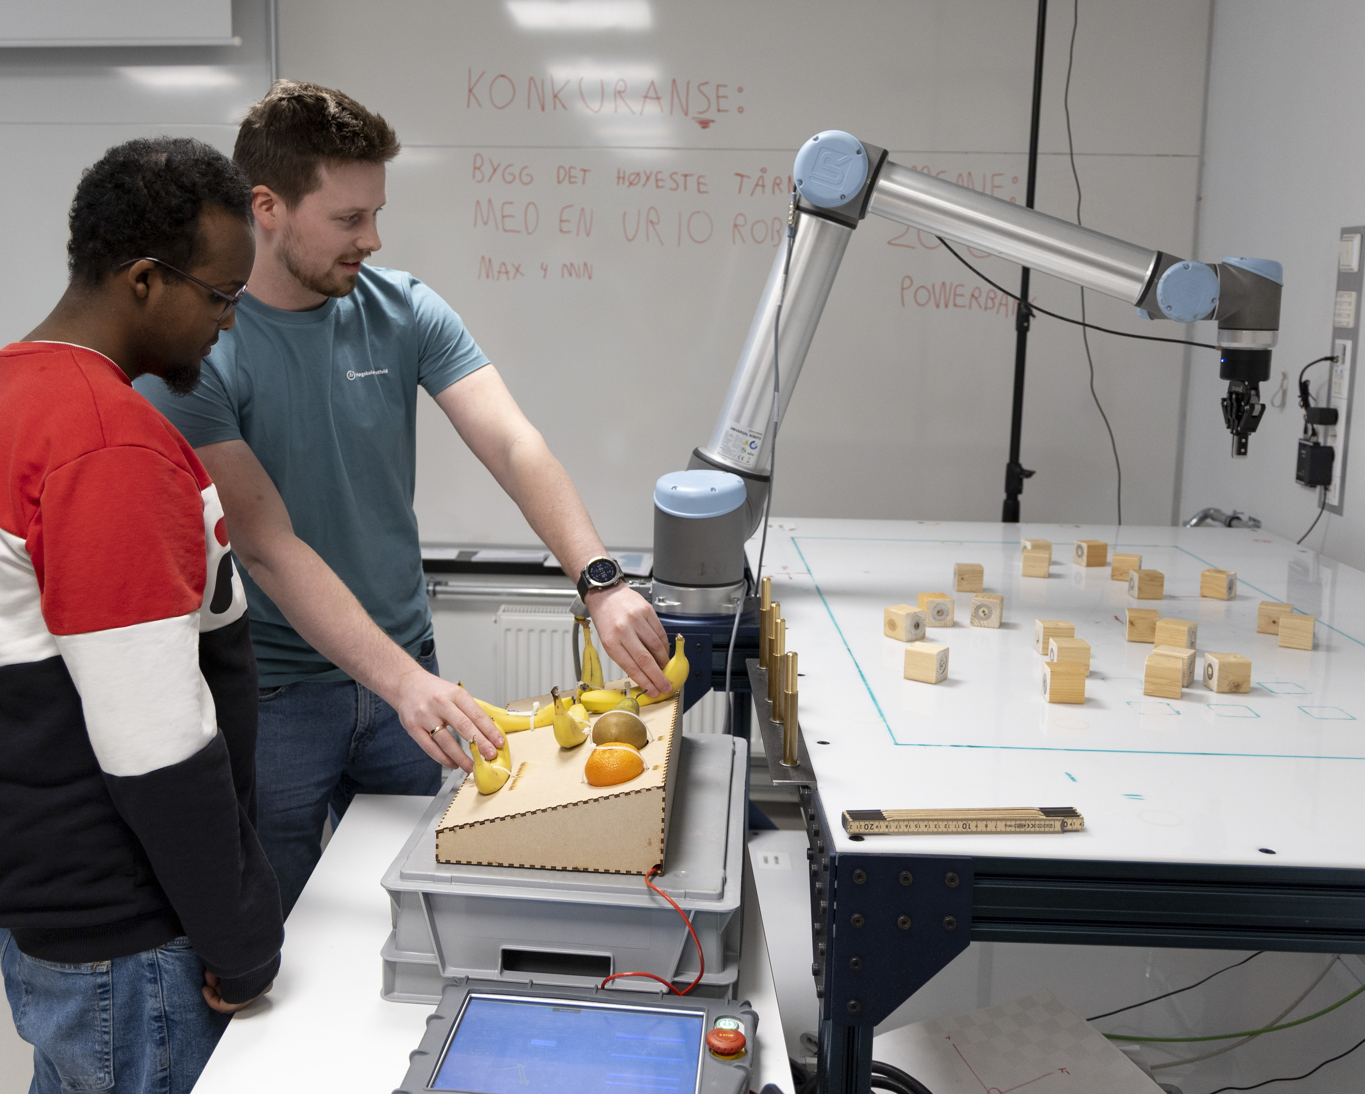
Faculty of Computer Science, Engineering and Economics
Department of Computer Science and Communication
  Makerspace
    A space for technological experimentation and learning.
Department of Engineering
Department of Economics, Innovation and Society

Slide 12
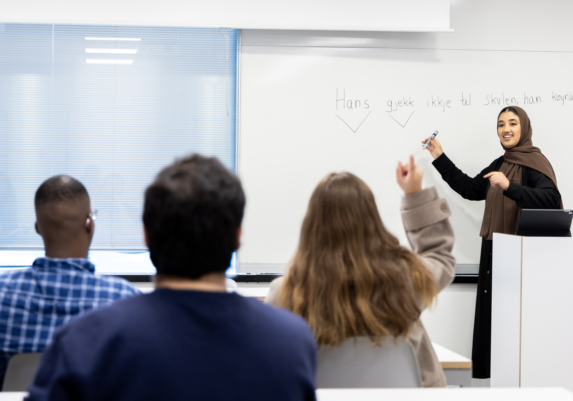
Aculty of Teacher Education and Languages
Department of Languages, Literature and Culture
Department of Education, ICT and LEarning
Department of Natural Sciences, Practical-Aesthetic, Social and Religious Studies.
Norwegian National Centre for English and other Foreign Languages in Education

Slide 13
Study Programs

Slide 14
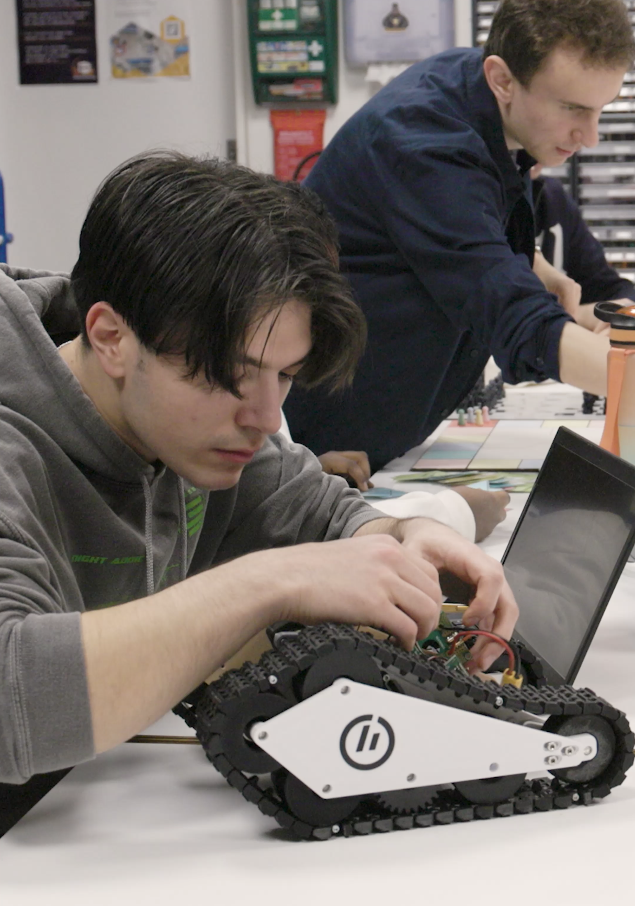
Information technology
Master’s Degree:
  Master in Applied Computer Science

Slide 15
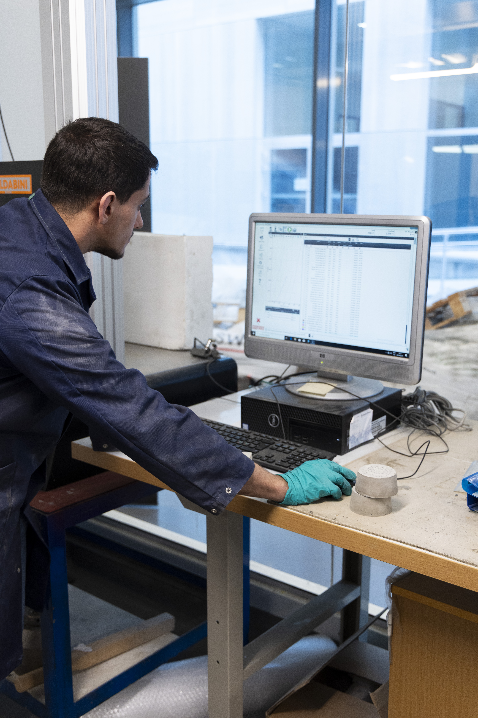

Engineering
Master’s Degree
  Master in Green Energy Technology

Slide 16
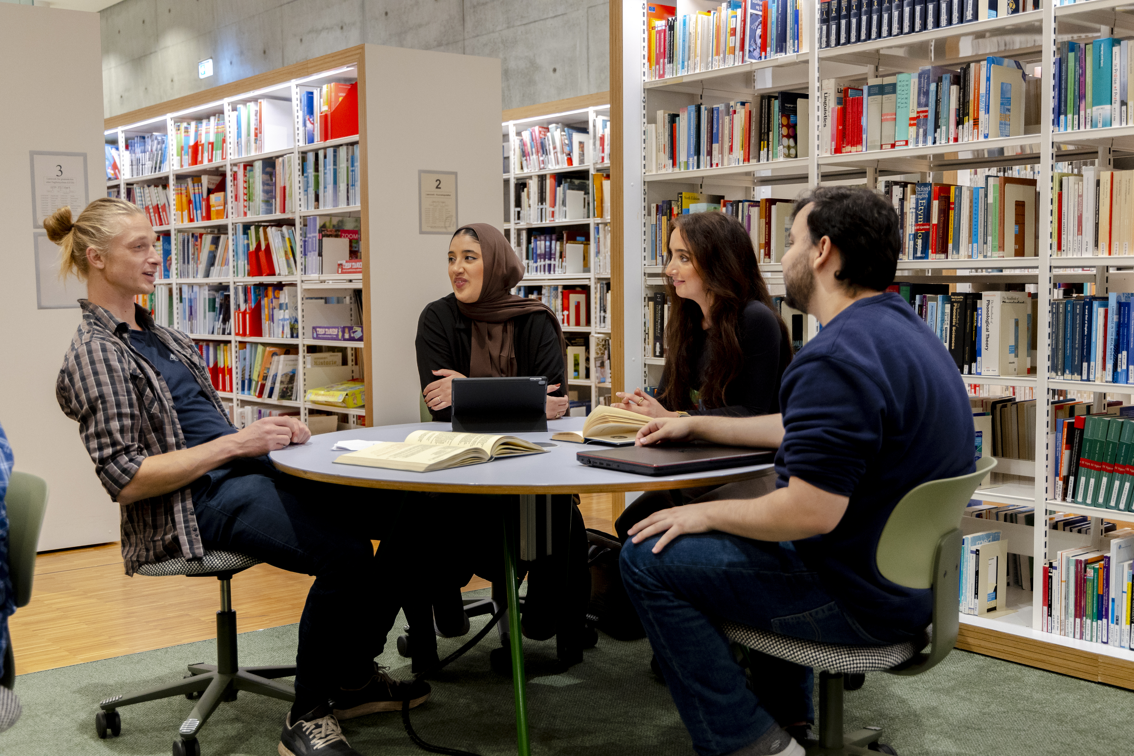
  Economics, Administration and Leadership
Bachelor’s Degree
  Accounting
  Economics and Administration
Master’s Degree
  Organization and Leadership

Slide 17
PhD programme
Digitalisation and Society

Slide 18
Research and Development

Slide 19
Research Focus Areas
  The Digital Society (DDS)
    Interdisciplinary collaboration with four sub-areas: DigiTech, DigiWork, DigiHealth, DigiLearn.
  Language in Education
    A collaboration between two departments and one center

Slide 21
Tittel og innholdsside
Klikk for å redigere tekststiler i malen
  Andre nivå
    Tredje nivå
      Fjerde nivå
        Femte nivå

Slide 22
Kapittelside med plass til sentrert tittel

Slide 23
Kapittelside med plass til sentrert tittel

